Slide 1
Peace with Problems (1945-1960): Part 2
Week 2-6
US History 2
Ms. Lyons

Slide 2
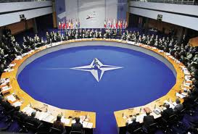

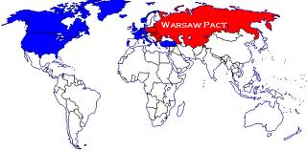
Alliances
NATO
Warsaw Pact
Western European countries
Defend against USSR
USSR & 7 satellite countries
NOTE: This is the 1st time since the Monroe Doctrine that
the US gets involved with Europe’s business

Slide 3
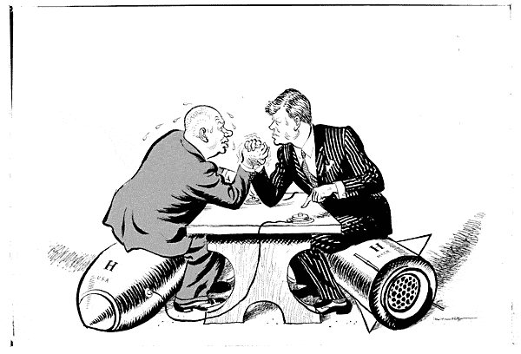
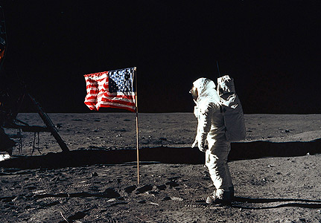
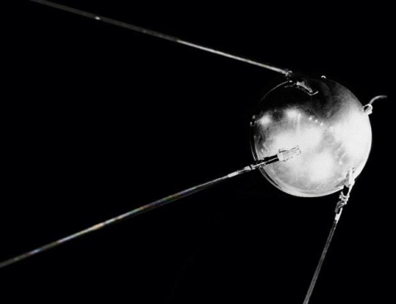
We Want to be Better at Everything!
ARMS RACE
  US made atomic bomb
  USSR copies
SPACE RACE
  Sputnik (USSR starts exploring space)
  NASA (US copies)

Slide 4

European Union
Western Europe: economic cooperation
  NO tariffs (import taxes) between countries
    “free” trade (don’t pay extra)

Slide 5
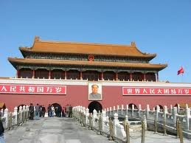
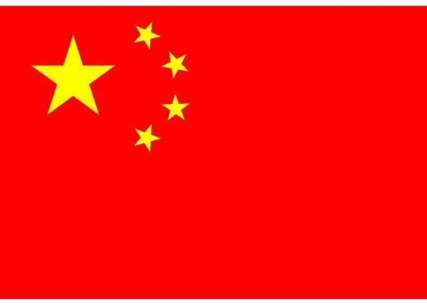
China’s Civil War
US likes Japan now NOT China
  Japan: democracy
  China: communism
China: civil war (1930’s)
  1949: Mao Zedong & communists take over the gov’t & rename China: PRC
  Chiang Kai-shek & nationalists ran away to Taiwan

Slide 6
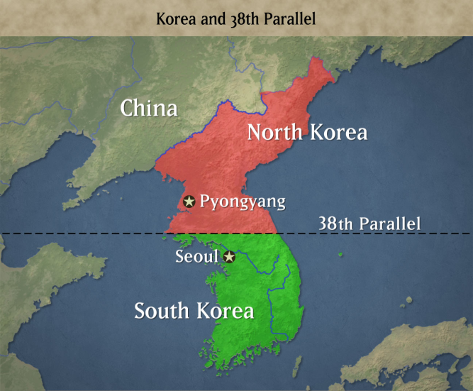
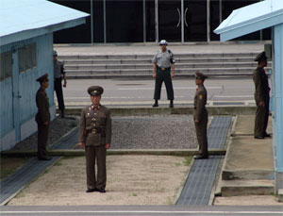
Korean Civil War
North Korea: communism
South Korea: democracy
US fights with South
  Truman fires General MacArthur
    President is the commander in chief (leader of the military)
  Eisenhower elected: ends war
No one wins & border stays at the 38th parallel
Important: US proves they will use
military force to contain communism

Slide 7
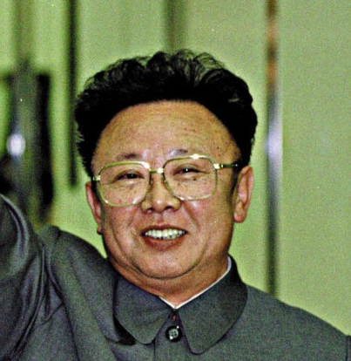
North & South Korea Today

Slide 8

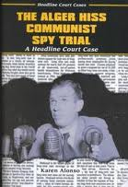
Looking for Communists in the USA
HUAC (House Un-American Activities Committee)
  J. Edgar Hoover (FBI director)
Smith Act
  Makes it illegal to support taking over the government or talking to people that think like that
Loyalty Review Board
  Truman fired gov’t employees
  Alger Hiss accused of spying
    FDR adviser

Slide 9
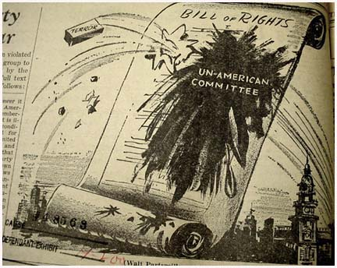

Slide 10
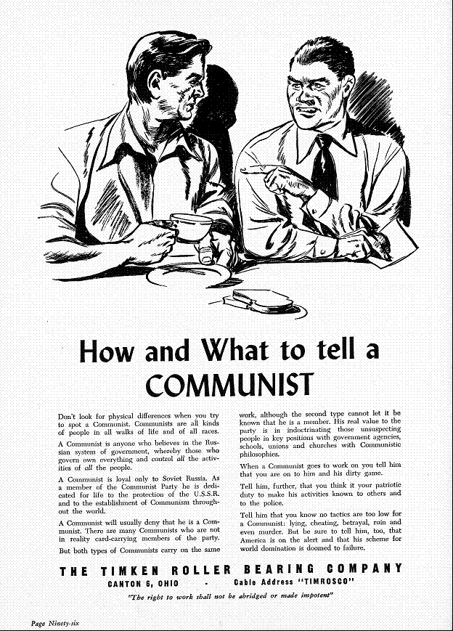

Slide 11
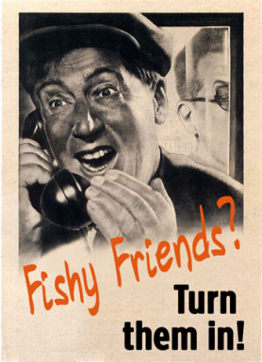
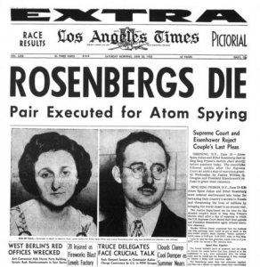
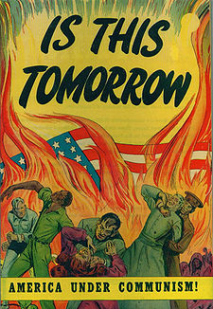
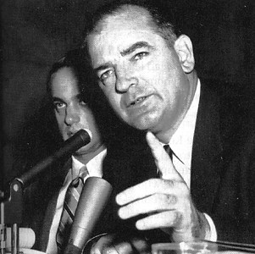
McCarthyism
Accusing people of being disloyal or
communist without evidence!
Rosenberg case (1950)
  executed for giving atomic bomb secrets to USSR
McCarran-Walter Act of 1952
  restricted immigration from communist countries
1954: McCarthy kicked out of Senate (after he tried to accuse the military of communism)
  Red Scare ended

