Slide 1
World War II: Part 2 Week 2-5
US History 2
Ms. Lyons

Slide 2
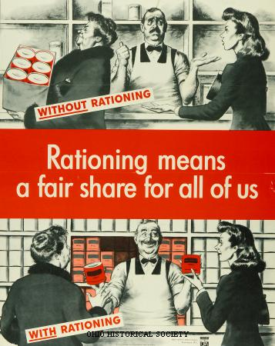
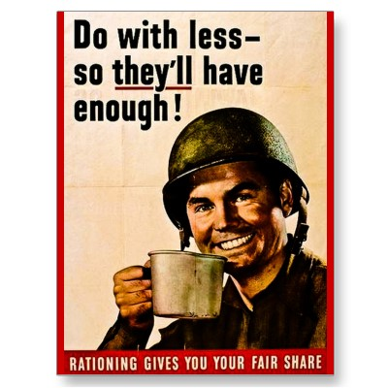
Nationalism
Consumer Rationing
WHY?
Make sure the military had enough materials
Gas, meat…
“Victory gardens”
Economy during World War II
Government control
Told factories what to produce
More war goods produced → economy better
Lots of debt though

Slide 3
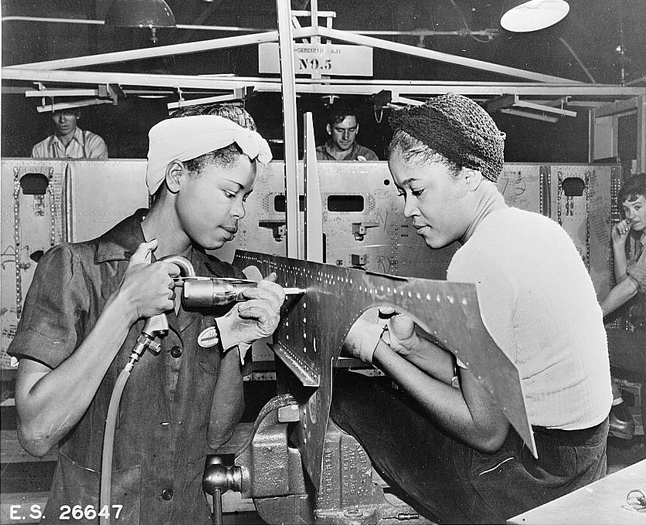
Women
Some joined military
Some worked in factories making war goods
“Rosie the Riveter”
For some, this lasted past WWII

Slide 4
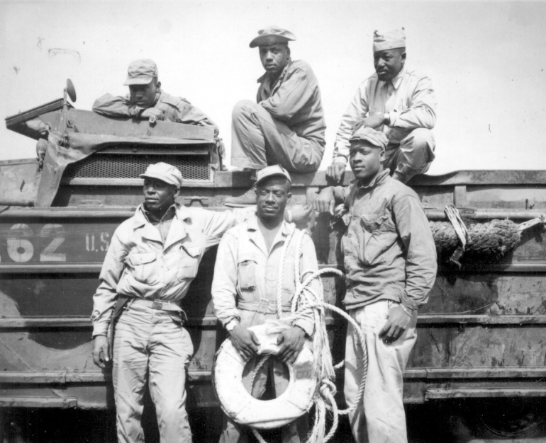
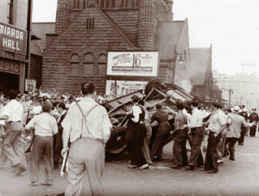
African Americans
Some fought in the military
Segregated units
Still moving North
Still discrimination
Race riots (Detroit & NYC, 1943)
Some worked in factories
More money = more voting power

Slide 5
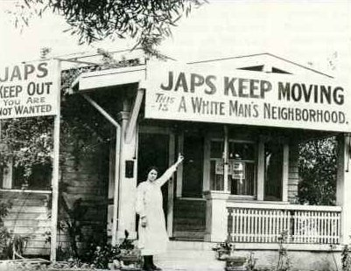
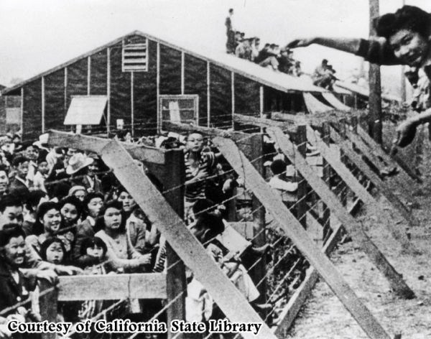
Japanese Americans
Lived on the west coast
WRA (Wartime Relocation Authority)
100,000 Japanese-Americans were moved to camps
Korematsu v. US: okay to put American citizens in camps because it’s a wartime emergency
Japanese-Americans fought in US military
Medals for bravery

Slide 6
After the War…
War ends & factories stop making war goods
Make more civilian goods
GI Bill
More war veterans go to college!
Taft-Hartley Act
Lowers power of labor unions

Slide 7
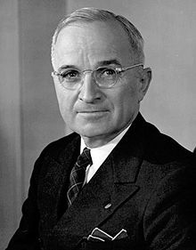
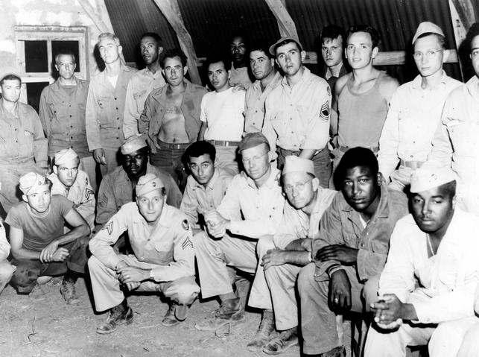
Truman
Creates
Department of Defense (head of military)
CIA
Made discrimination in the military illegal

Slide 8
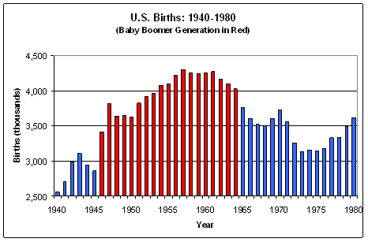
Baby Boom
Lots of babies born!
Increases population
More demand for goods & public services
school

Slide 9
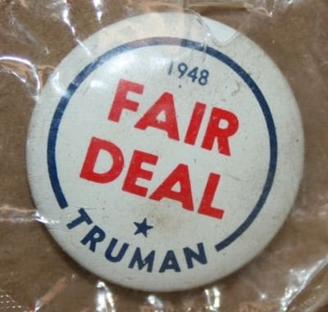
Truman Wins 1948 Election
“Fair Deal”
Plan to help the economy
Modeled after FDR’s New Deal

