Slide 1
War & Prosperity: Part 2 US HISTORY
Week 2-3
Ms. Lyons

Slide 2
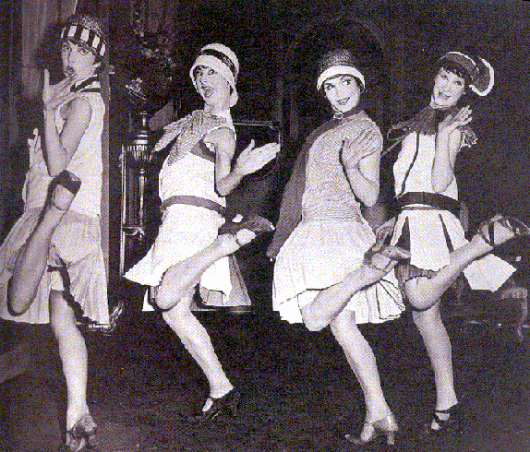
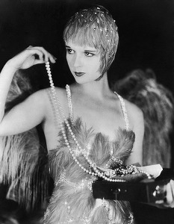
For fun…
Movies, sports, games (mah-jongg)
Flappers : short haircuts, short skirts, thought for herself, smoke, drank, sexual freedom
more in media than in reality

Slide 3
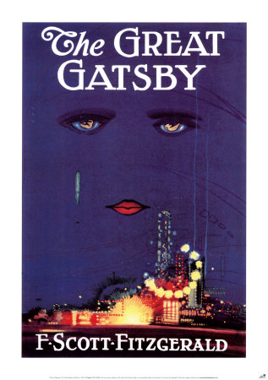
Literature
Showed changing American values
Critical of:
Ruthless business strategies
Conformity, materialism
Some left the US to live in Europe
Ernest Hemingway

Slide 4
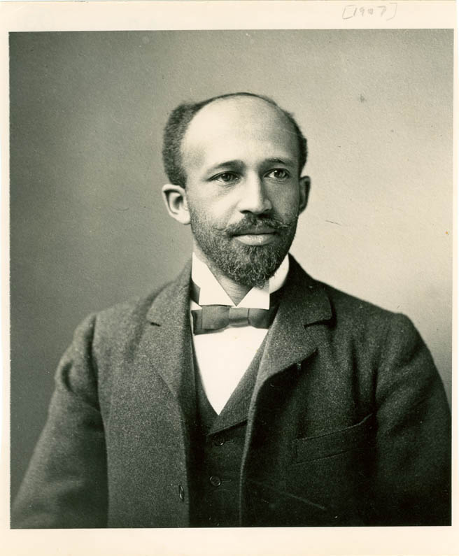
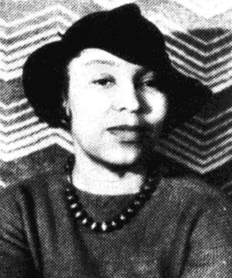
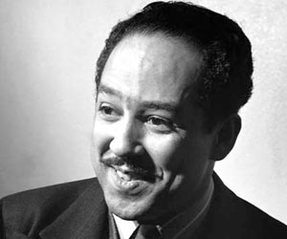
Harlem Renaissance
PRIDE in African-American culture
Led by African-American writers in NYC
well-educated, middle class
Called for action against racism
W.E.B. Du Bois
Langston Hughes
Zora Neale Hurston
Alain Locke

Slide 5
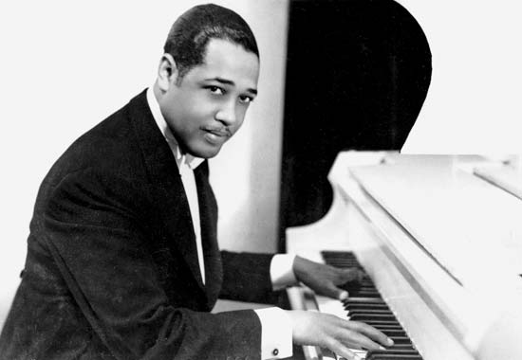
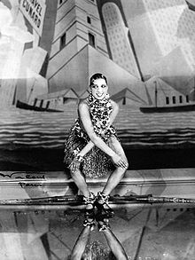
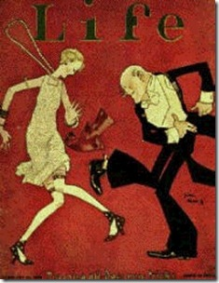
Jazz Age
Harlem Renaissance was not just writers.
Artists, musicians, dancers
Jazz & blues from South
blended African, European, & American music
Charleston (new risky dance moves )
Artists:
Duke Ellington
Bessie Smith

Slide 6
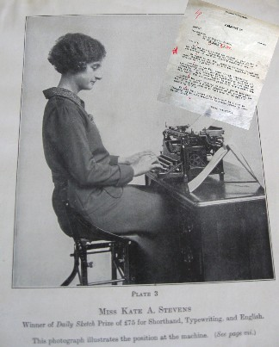
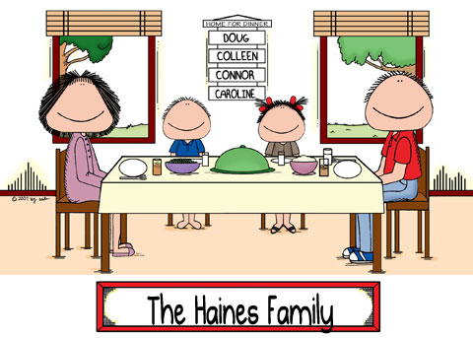
Women
Women workers were NOT married.
“Woman” jobs :
Low-paying
Low-status
Secretaries, teachers, retail
Technology helped with chores
Divorce/birth control =
smaller families

Slide 7
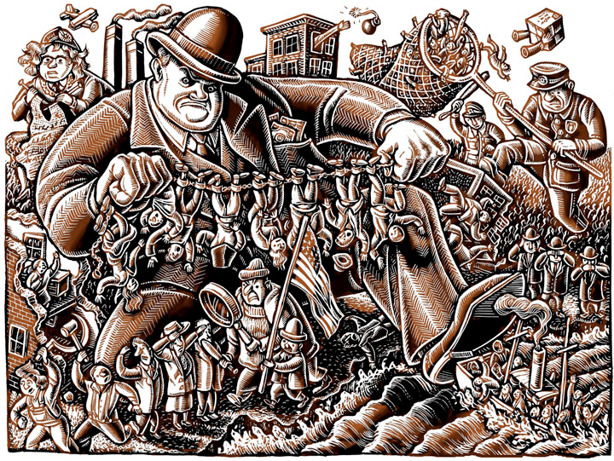
Red Scare
1918-1919
Fear of Communists
Started with Bolshevik Revolution in Russia (1917)
Led by Attorney General Palmer
“Palmer raids”
Arrested 4,000 suspected “communists” without warrants
Deported 560 people

Slide 8
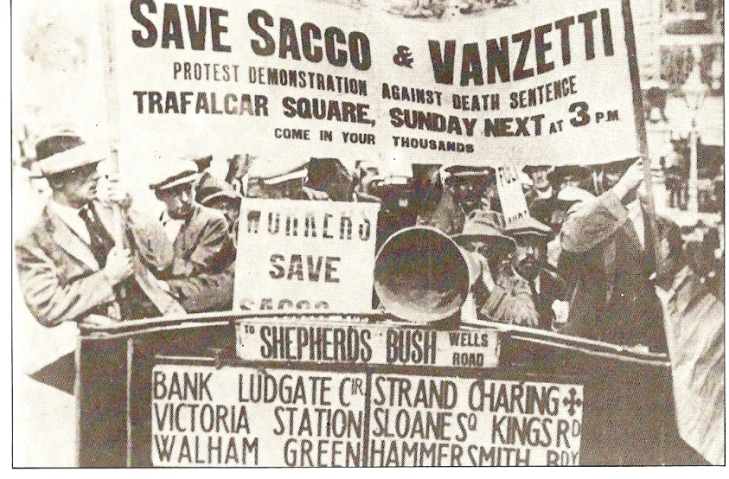
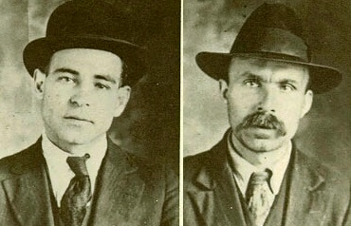
Sacco & Vanzetti
Italian immigrants, anti-government
Convicted of murder
Protesters: no evidence!
Both were executed in 1927
50 yrs later, the government said sorry

Slide 9
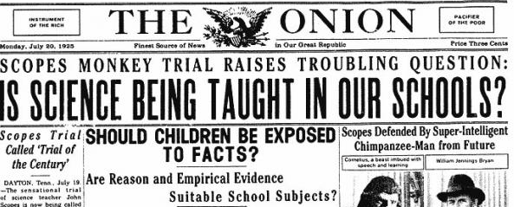
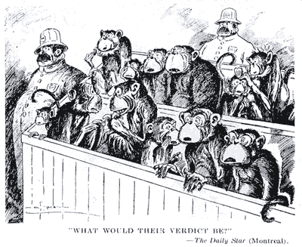
Scopes Trial
1925
SCIENCE vs. RELIGION
John Scopes (a teacher) – taught evolution (against law)
William Jennings Bryan
= prosecutor
Scopes lost (paid $100)
but case weakened fundamentalist arguments

Slide 10
Review: Laws
Immigration Act of 1924:
Quotas
Restricted SE Europe & Asian immigrants
Prohibition: 18th Amendment
Effect: raised crime, bootlegging (illegal making & sale of alcohol)
21st Amendment ended Prohibition

