Slide 1
Postindustrial Society: A Global Age 1 day summary
US History 2
Ms. Lyons

Slide 2
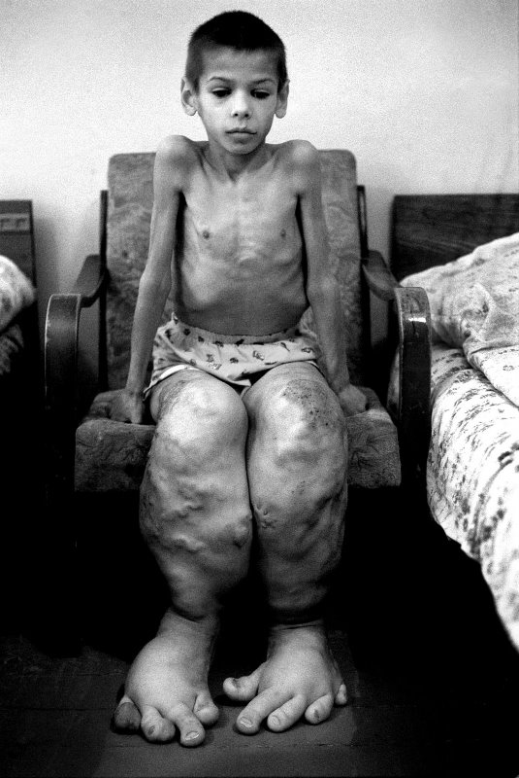
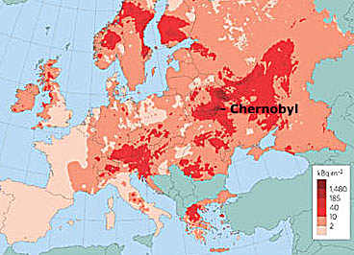
Alternative Energy Sources
Accident at Chernobyl, Ukraine (1986)
Increased debate about nuclear energy

Slide 3
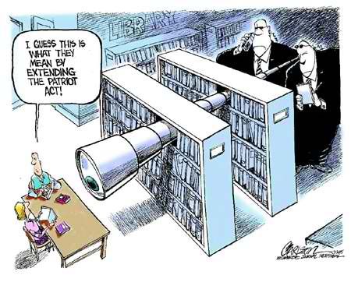
Patriot Act of 2001
Gave gov’t more power
Bush created Homeland Security
Internet security?

Slide 4
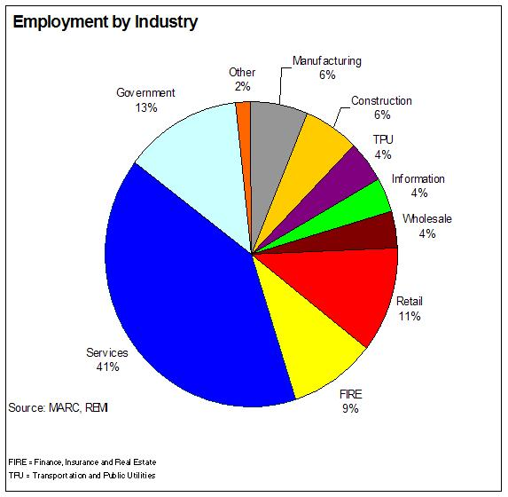
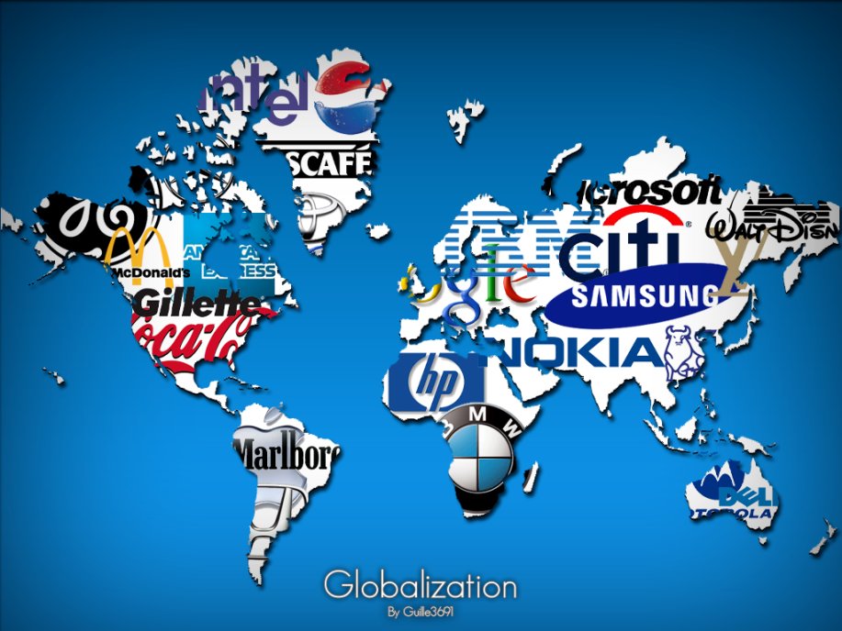
Business
Multi-national corporations (MNCs)
Service industry = big!
Farming jobs = less

Slide 5
Life in the US
Smaller family size
Better health care (technology, medicine)
More diversity in US population
Problems
AIDS
Homelessness
Gun control
Urban violence (gangs)
School shootings

Slide 6
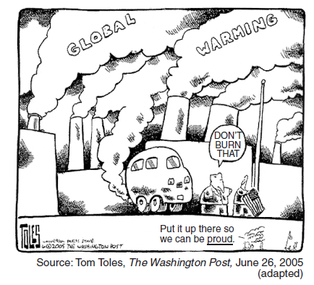
World Problems
Interdependence!
It’s everyone’s problem
International terrorism
Developing countries’
populations keep growing
Environment (pollution, deforestation…)

Slide 7
Power Dynamics
East vs. West
Ideology (way of thinking), economics, politics
North vs. South
Industrialization, technology, wealth
Developed vs. Developing
Industrialization, technology, wealth

