Slide 1
The Decade of Change: Part 2 Week 2-7
US History 2
Ms. Lyons

Slide 2
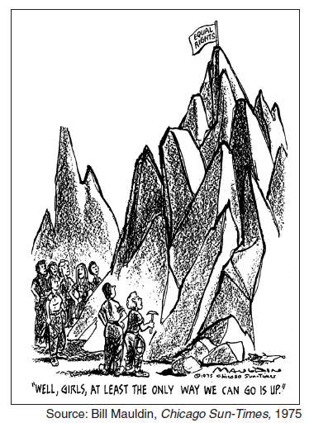
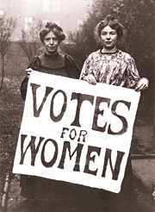
Women’s Rights
Remember:
Seneca Falls
Susan B. Anthony
19th Amendment
Factory jobs in WWII

Slide 3
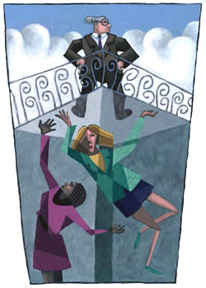
Women’s Rights Movement: 1960’s
More women get “men’s” degrees
law, science, medicine
VOCAB
Feminism: belief in equality between men & women
Sexism: discrimination based on sex/gender
Glass ceiling: keeps women from getting top-level jobs

Slide 4
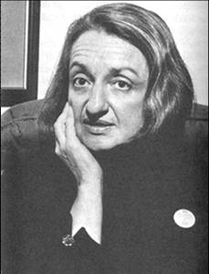
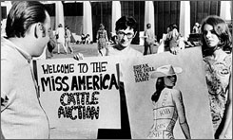
Activism: Women’s Movement
1963: Betty Friedan writes
the Feminine Mystique
1966: NOW (National Organization of Women)
1968: Miss America protest

Slide 5
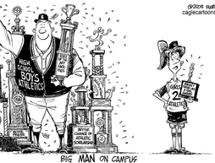
Legislation
Title VII
ended job discrimination based on gender & race
Title IX
Athletic funding is same for females and males
1972: Equal Rights Amendment approved by Congress
Never ratified (passed into law)
Roe v. Wade
Abortion is legal (women have a right to privacy over their bodies)
Affirmative action
UCAL v. Bakke = white male complains about reverse discrimination & wins case

Slide 6
Is there a limit?
1972: Nixon vetoed child care for working moms
Said it’s the family’s job, not the government’s job
1980’s – 1990’s: Protesting abuse
Women want legal protection against
Physical
Mental
Sexual abuse
harassment at work

Slide 7
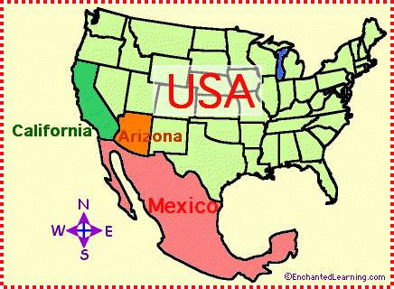
Latinos
Jobs: migrant farm workers
Cesar Chavez started a labor union movement
Nonviolent resistance

Slide 8
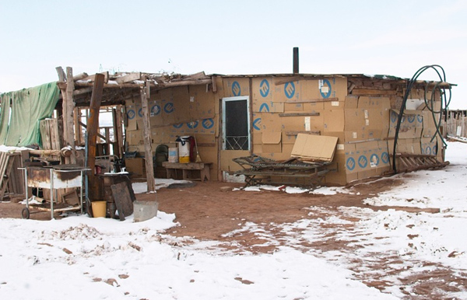
Native Americans
Problems
Poverty, unemployment, 50% high school dropouts
Highest rate of: alcoholism, suicide
“Red Power”
Militant groups took over Alcatraz, Bureau of Indian Affairs (in DC), & town of Wounded Knee (South Dakota)
Effect
US gov’t gave them $80 million as an apology
Natives got more control over reservations

Slide 9
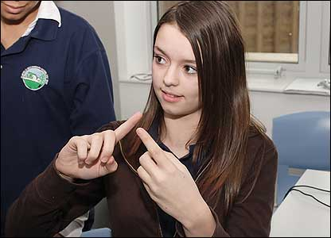
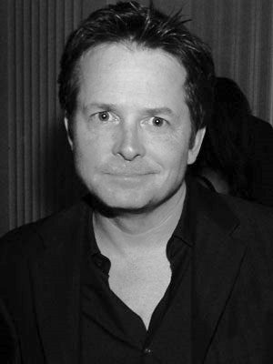
People with Disabilities
Remember:
Dorthea Dix helped the mentally ill (1800’s)
Colleges for blind/deaf (“mainstreaming”)
FAPE (special education, related services)
Inclusion: students can attend public schools
Special Olympics (started by JFK)
Rehabilitation Act of 1973 & Americans with Disabilities Act of 1990
More access to buildings/events
Veterans (Vietnam) & celebrities with disabilities
Michael J. Fox, Christopher Reeves

Slide 10
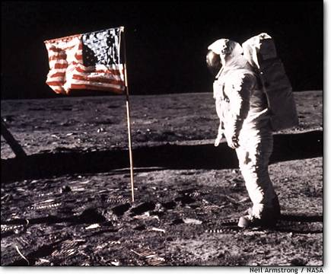
Presidential Policies & Legislation
JFK’s “New Frontier”
Space program [Neil Armstrong lands on moon: $25 billion]
Remember: USSR’s Sputnik was the 1st space event
Peace Corps [goal: to stop communism]
“…ask not what your country can do for you—ask what you can do for your country.…”
Johnson’s “Great Society”
VISTA (Americorps)
Office of economic opportunity: Head Start, Upward Bound, Job Corps
$ to poor, integrated schools
Medicare/Medicaid
Dept. of Housing & Urban Development
Led by the 1st black cabinet member, Robert C. Weaver

Slide 11
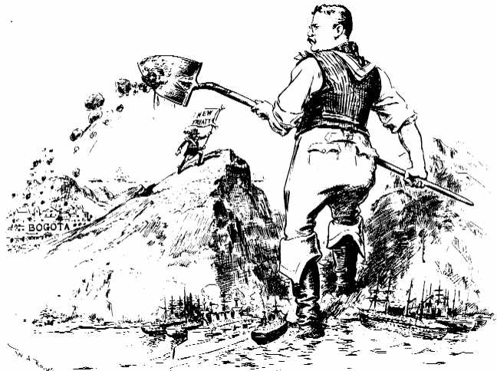
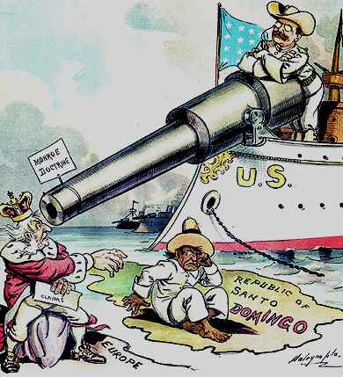
Latin America-US Relations
Remember:
Monroe Doctrine
Spanish-American War
Panama Canal
Roosevelt Corollary
“Dollar Diplomacy” (Taft)
“Good Neighbor Policy” (FDR)

Slide 12
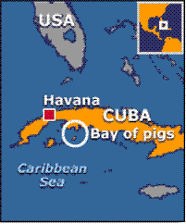
JFK & Latin America
Alliance for Progress
$20 billion to Latin American economies
Goal: to decrease communism
Effect: helped repressive dictators just because they were anti-communism
Bay of Pigs (April 17, 1961)
Cuban exiles sent in to overthrow Castro
FAILED!
Cuban Missile Crisis
JFK demanded USSR take their missiles out of Cuba
USSR did (JFK saved his reputation)
Test ban treaty (can only test bombs underground)

Slide 13
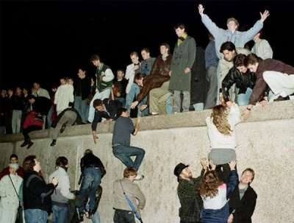
JFK & Berlin
Famous speech
The wall is a sign of tyranny (repressive power)
1989: Berlin wall was torn down
Represents the end of the Cold War

Slide 14
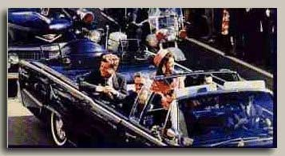
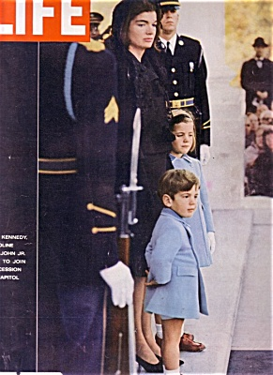
JFK is assassinated
November 1963
JFK & his wife, Jackie made friends with many countries
JFK had good energy; Jackie spoke many languages
Many foreign leaders came to his funeral in the US

