Slide 1
Containment Abroad & Agreement at Home Week 2-7
US History 2
Ms. Lyons

Slide 2
ABROAD…

Slide 3
Cold War Updates
President Eisenhower: containment
Dulles (Secretary of State) wanted to use nuclear weapons & no more ground troops
“Brinkmanship”
Go to the brink of war if threatened

Slide 4
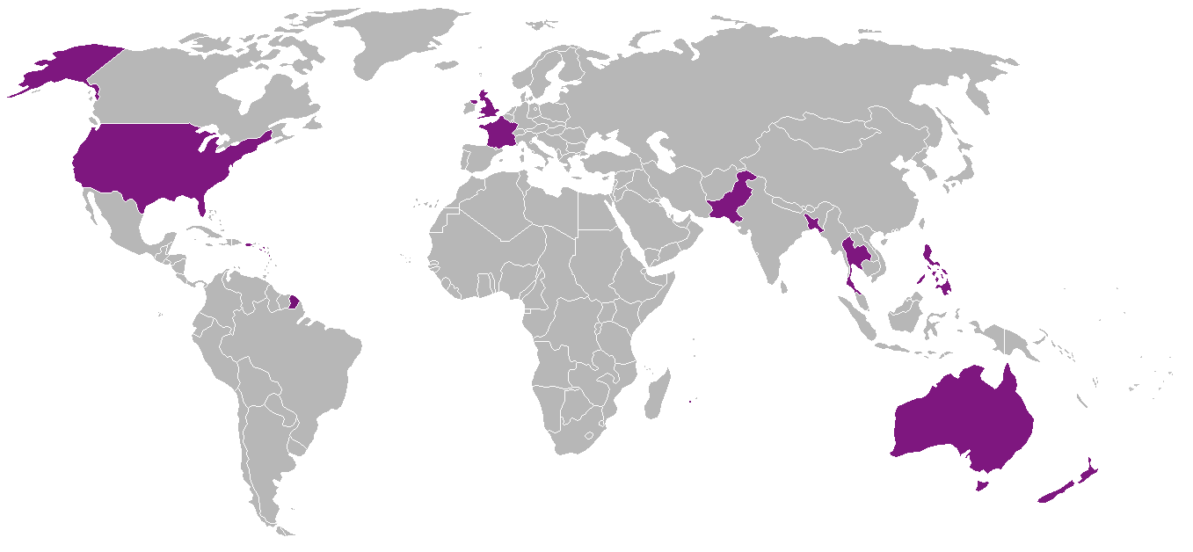
Domino theory
Asian countries will all fall to communism
SEATO (SE Asian version of NATO)
US started it to defend against communism

Slide 5
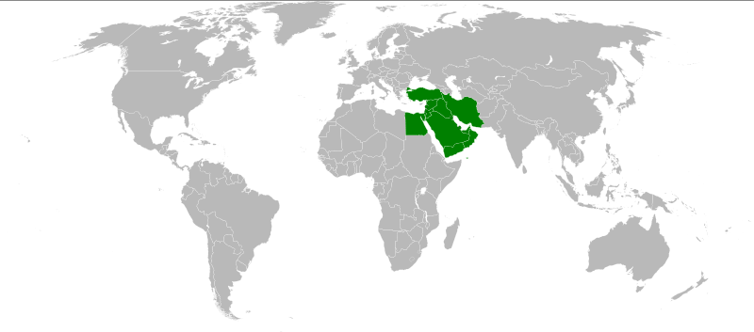
Middle East
Iran
1954: US tried to overthrow the gov’t & restore the repressive shah to power
WHY? … OIL!
Egypt
Nasser took over the Suez Canal (almost a big fight)
Eisenhower Doctrine (1957)
US will help Middle Eastern countries fight against communism
Example: used in Lebanon & Jordan (1958)

Slide 6
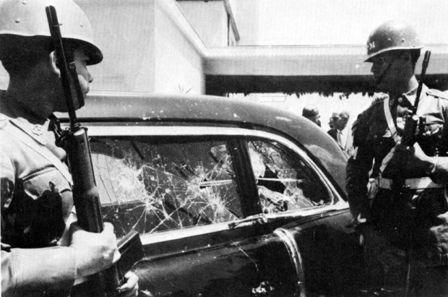
Latin America
Guatemala
1954: US overthrew gov’t because they were too nice to communists
Nixon’s Tour
1958: angry mobs in Peru & Venezuela threw rocks & eggs at his limo (didn’t like the US)
Cuba
1959: Castro takes over
People have less civil rights
Communist (businesses trade with USSR)

Slide 7
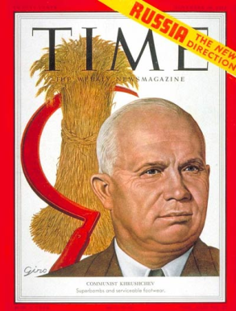
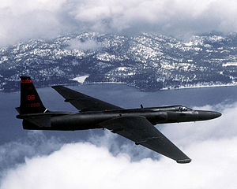
Superpower Relations
1953: Stalin dies & Nikita Khrushchev takes power
Helped the citizens of the USSR
Decreased Cold War tensions
1956: Revolts in Poland & Hungary (against the USSR)
Increased tensions again
1959: Camp David meeting = peace
Then, a U-2 (spy from the US) was caught spying on the USSR
Tensions increase again

Slide 8
AT HOME…

Slide 9
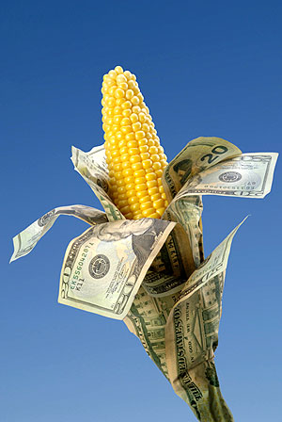
Eisenhower’s Economic Policies
Supported big business
Not much government regulation
Decreased money spent on defense & foreign aid
Expanded social security (made it bigger)
Gave subsidies to farmers
Really low prices hurt farming industry

Slide 10
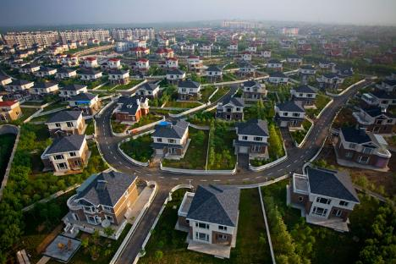
Prosperity in the 1950’s
Reasons
Made money during the war, but couldn’t spend it (rationing)
Factories made more consumer goods (no war)
Examples
More homes!
Baby Boom… suburbs created
Cars!
Commute from suburbs, gov’t made highways
Migration to the Sun Belt (Florida, California)
TVs!

