Slide 1
STRIKES!
US History
Ms. Lyons

Slide 2
STRIKES!
(late 1800’s – early 1900’s)
Great Railway Strike
Haymarket Riot
Chicago
bomb killed 7 police officers
Homestead Strike
Carnegie Steel plant (PA)
16 killed
Knights of Labor blamed
most protesters were fired
1st big one
federal troops sent to end it
Pullman Strike
Lawrence Textile Strike
Railroads
Industrial Workers of the World (IWW) [radical union]
Illinois
federal troops ended it
Supreme Court case[In Re Debs] said this was ok
textile mills in Lawrence, Massachusetts
Workers won!

Slide 3
Great Railway Strike

Slide 4
Haymarket Riot

Slide 5
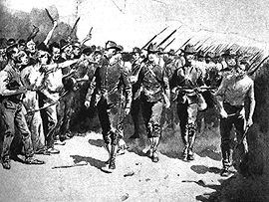
Homestead Strike

Slide 6
Pullman Strike

Slide 7
Lawrence Textile Strike

