Slide 1
Sojourner Truth & Communication
Lindsay Lyons
Notes:
http://www.youtube.com/watch?v=eUdxsQ0Qsrc - video clip of speech reenactment

Slide 2
Aim: How does Sojourner Truth’s “Ain’t I a Woman?” help me improve my ability to communicate? Do Now: Are people treated differently because of their race or gender? Agree or disagree and explain your answer. *When you are done, please fold the index card in half hamburger style & write your name & grade on one side.

Slide 3
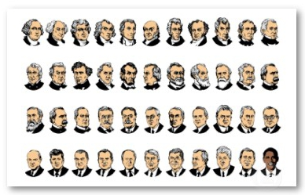
What does this picture show?

Slide 4
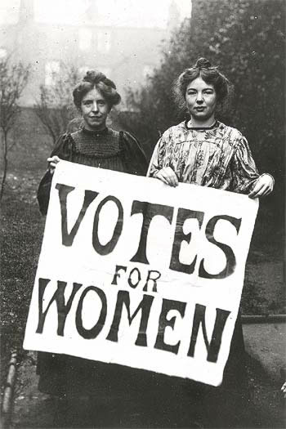
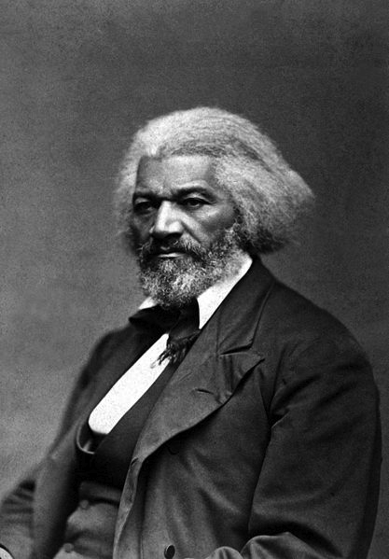
Social Movements
Women’s Rights
Abolition
Led by white women
Led (mostly) by black men
Where did black women fit in?
Notes:
Women’s movement – middle class, heterosexual

Slide 5
Tasks: 1. Look for communication skills * language (words) *speech (how she says it) 2. Highlight language in the text 3. Jot notes on speech in the margin
Notes:
Give example: dramatic pause (write “pause” or pause button symbol) where she paused.

Slide 6
What communication skills did you see?
Language (words)
Speech (how said)

Slide 7
Persuasive Writing Activity
Are people treated differently because of their race or gender?
Use your ideas from the Do Now
Include skills we discussed.
Look on your worksheet for the # of skills you must include!
Use the outline on the back of the worksheet to help you.

