Slide 1
Make-Your-Own-Similes
Friday, 9/21/12
Ms. Lyons

Slide 2
Simile
Comparing 2 things using “like” or “as”
EXAMPLES:
“She is as busy as a bee”
“Life is like a box of chocolates, you never know what you’re going to get.”

Slide 3
Options for Gallery Walk/Write Around
Write what you like about the simile
Describe how it makes you feel
Create the back story
Draw a picture of the simile/back story

Slide 4
Model Similes

Slide 5
She grew on him like she was a colony of E.Coli, and he was room-temperature Canadian beef.

Slide 6
The little boat gently drifted across the pond exactly the way a bowling ball wouldn't.

Slide 7
McBride fell 12 stories, hitting the pavement like a Hefty bag filled with vegetable soup.

Slide 8
Her hair glistened in the rain like a nose hair after a sneeze.

Slide 9
The hailstones leaped from the pavement, just like maggots when you fry them in hot grease.

Slide 10
Even in his last years, Granddad had a mind like a steel trap, only one that had been left out so long, it had rusted shut.

Slide 11
The young fighter had a hungry look, the kind you get from not eating for a while.

Slide 12
The ballerina rose gracefully en Pointe and extended one slender leg behind her, like a dog at a fire hydrant.

Slide 13
“She entered with ungainly struggle like some huge awkward chicken, torn, squawking, out of its coop.” — The Adventure of the Three Gables, by Sir Arthur Conan Doyle

Slide 14
“The very mystery of him excited her curiosity like a door that had neither lock nor key.” — Gone with the Wind, by Margaret Mitchell

Slide 15
Make-Your-Own-Similes!
1 minute per picture to create your own simile
After we are done, you will pass it to your left
When you get someone else’s… READ all the similes
You will choose one simile to comment on
Use the same rules as before

Slide 16
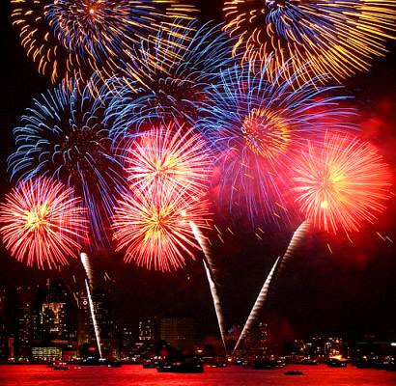

Slide 17
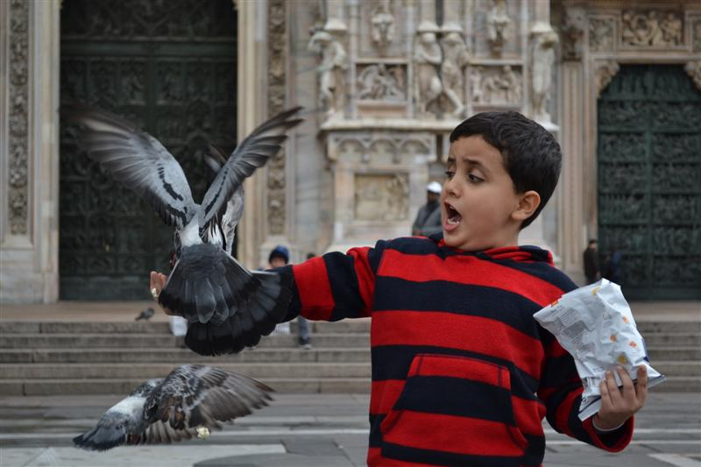

Slide 18
Deanandra
Scared as ever, like the first time on a rollercoaster .

Slide 19
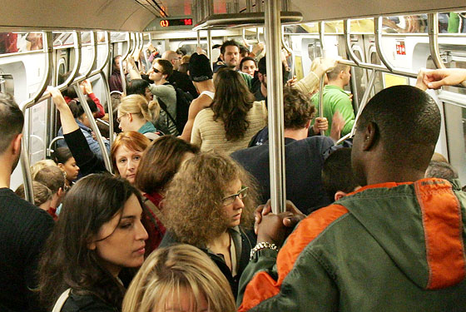

Slide 20
Deanandra / Brandon
Crowded like a man with size 9 feet fitting in a size 4.
The bus was packed – like a pack of wolves.

Slide 21
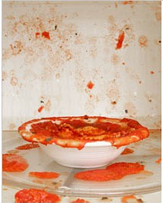

Slide 22
Deanandra / Brandon
The mess like the hurt of the Twin Towers.
The pasta imploded like a water balloon in the microwave, and made me throw both of them away.

Slide 23
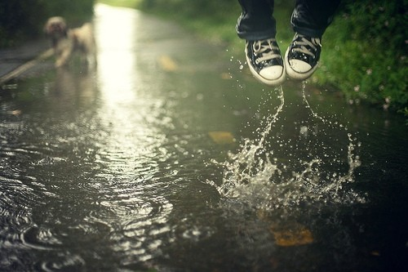

Slide 24
Brandon
Jumping in the puddle made me feel like a child again; it was the best feeling ever.

Slide 25
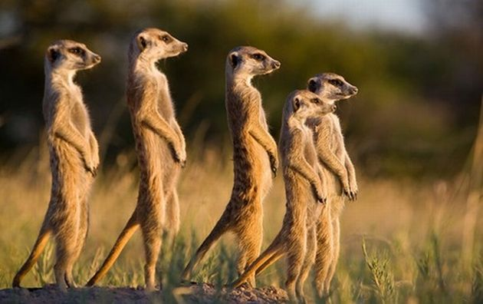

Slide 26
Deanandra
Family is like a jungle – you can’t get away from it and you can never leave.

Slide 27
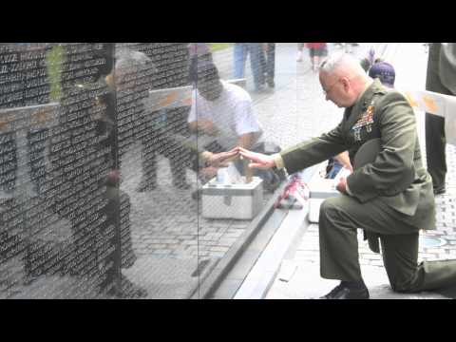

Slide 28
Kneeling brought back feelings of adrenaline like when he was over there seeing fallen soldiers all around him.

Slide 29
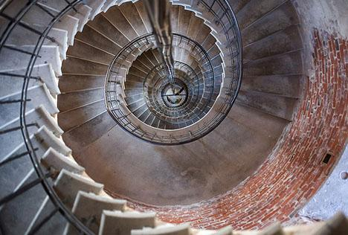

Slide 30
Brandon
Stairway looking like a twisted slide, maybe go for a ride.

Slide 31
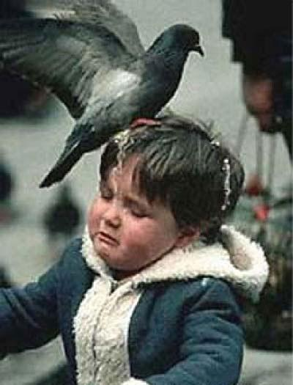

Slide 32
Deanandra
The kid can’t be happy ‘cause the bird is mad like the Hulk on a bad day.

Slide 33
Create your own without a picture! If you can’t think of something to write about, try thinking of a situation in which you use one of your 5 SENSES. (see, smell, hear, taste, touch)

Slide 34
Deanandra
Love is the pain you hate to feel but love to have, like a nice juicy pizza, really hot.

Slide 35
Brandon
If it was time to say I was ready, I would have taken flight in the night sky. Boy, I wish I could fly… as if I were a hawk.

Slide 36
Remember the rules for commenting!
Write what you like about the simile
Describe how it makes you feel
Create the back story
Draw a picture of the simile/back story

