Slide 1
Reproductive Rights
Gender Studies
Ms. Lyons

Slide 2
World Health Organization’s definition of “reproductive rights”
…The basic right of all couples and individuals:
to decide freely and responsibly
the number, spacing and timing of their children
to have the information and means to do so
the highest standard of sexual and reproductive health
make decisions concerning reproduction free of discrimination, coercion and violence.

Slide 3
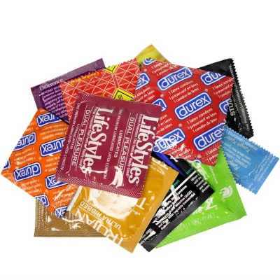
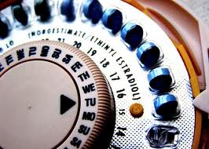
Reproductive rights include:
Legal or safe abortion
Birth control
Quality reproductive healthcare
Education
Ability to make choices
Freedom from:
Forced sterilization
Female genital mutilation

Slide 4
Dangers from Pregnancies
Too Soon:
Girls under 17 are more likely to die or be injured in childbirth
bodies not fully grown
Their babies have a greater chance of dying in the first year
Too Late:
Causes: other health problems or have had many children.
Too Close:
A woman’s body needs time to heal between pregnancies.
Too Many:
A woman with 4+ kids has a greater risk of death after childbirth from bleeding and other causes.

Slide 5
The Girls Who Went Away
True stories
After World War II – before Roe v. Wade
Single, middle-class white girls forced to give up their babies for adoption
Sent away to have the baby
Were not allowed to talk about experience

Slide 6
Importance of Language
PRO Choice is not… PRO Abortion
Just believes women should be able to decide for themselves
Different meanings
“Pro life” vs. “Anti choice”

Slide 7
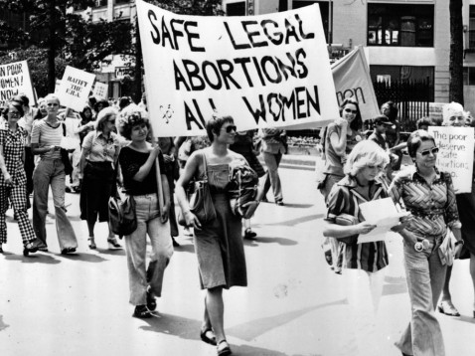
Roe v. Wade
1973, US Supreme Court Case
Ruled women have a right to privacy under the 14th amendment

Slide 8
Hyde Amendment
1976, legal provision
Bans use of federal money for abortions
Exceptions: incest & rape
Primarily affects Medicaid
Notes:
Medicaid = lower class; those women need it most (esp. if deciding to abort for socioeconomic reasons)
1994: President Clinton expanded categories of abortion federal funding would cover under Medicaid
Legal provision: something added to a bill (usually for political reasons)

Slide 9
Global Abortion Laws

Slide 10
Global Abortion Laws: % of countries allowing abortion in the following cases
To save the women’s life: 97%
Preserving physical/mental health: 63-67%
In the case of rape or incest: 49%
For economic or social reasons: 34%
Upon request: 29%

Slide 11
Global Abortion Facts
Nearly half of all abortions worldwide are unsafe, and nearly all unsafe abortions (98%) occur in developing countries. In the developing world, 56% of all abortions are unsafe, compared with just 6% in the developed world.
World Health Organization

Slide 13
Anti-Abortion Laws are NOT associated with lower abortion rates.
The number out of 1,000 women of child-bearing age that have had an abortion
Africa: 29
Latin America: 32
Western Europe: 12

Slide 14
Nicaragua
Daniel Ortega = President
To appeal to the Catholic Church, banned abortion in all cases (even therapeutic abortions)
Rape
Malformation of fetus
Risk to mother’s life
Maternal mortality rates increased by 100% in one year
At-home methods
Notes:
Ortega was served as President of Nicaragua from 1984-1990 as a Sandinista supporting pro-choice. However, switched his stance for the next election to gain the support of the Church.
6 years in prison for abortion

Slide 15
Planned Parenthood
1 in 3 women in the US will have an abortion by age 45
Cost of abortion: $300-$950
% of Planned Parenthood’s budget spent on abortion services: 3%
In some states, you need parental consent to have an abortion.
In New York, you do not.
Notes:
Judges can excuse you from parental consent obligations. Think of how difficult that may be – time consuming, awkward… etc.

Slide 16
Forced Sterilization
US was the 1st country to start mandatory sterilization programs
People with disabilities
Native American & African American women
Criminals
27 states still had sterilization laws in 1956!
North Carolina is paying victims as an apology
Notes:
Native Americans & African Americans: sterilized without their knowledge, while in hospital for other issues – e.g. childbirth

Slide 17
Personhood Amendment
North Dakota – House of Representatives passed a “personhood” amendment, which would grant legal personhood rights to embryos at the moment of fertilization.
If voters vote for it, abortion will be illegal in that state.
Notes:
FACT: North Dakota does not have seatbelt laws (to protect grown humans)

Slide 19
Actual Quotes
"If it's a legitimate rape, the female body has ways to try to shut that whole thing down.”
—Rep. Todd Akin (R-Missouri)
Abortions make up "well over 90 percent of what Planned Parenthood does.”
—Sen. JonKyl (R-Ariz.)
"One of the things I will talk about, that no president has talked about before, is I think the dangers of contraception in this country.... Many of the Christian faith have said, well, that's okay, contraception is okay. It's not okay. It's a license to do things in a sexual realm that is counter to how things are supposed to be.”
—Rick Santorum, former Republican senator from Pennsylvania and former presidential hopeful

Slide 20
Extra Anti-Woman Quotes
"As long as it's inevitable, you might as well lie back and enjoy it.”
—Former Texas Republican gubernatorial contender Clayton Williams on rape
"The Lord says: Be submissive, wives. You are to be submissive to your husbands.”
Michelle Bachmann, US House of Representatives

