Slide 1
History of Feminism
Intro to Gender Studies
Ms. Lyons

Slide 2
3 Waves
3 phases of the women’s movement
Some feminists don’t like the categorization of “waves”
Ignores the progress within each wave

Slide 3
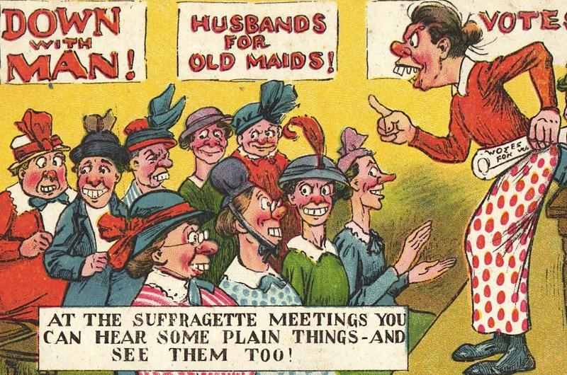
1st Wave
1800’s - early 1900’s
Women’s suffrage (right to vote)
19th Amendment, passed in 1920
https://www.youtube.com/watch?v=StF3_Mj0tBg

Slide 4
Mary Wollstonecraft
Enlightenment
Vindication of the Rights of Women
Fought for education for women
Argument: to become better wives for their men

Slide 5
Feminists in their Work
Authors
Jane Austen
Louisa May Alcott
Nurse
Florence Nightingale

Slide 6
Josephine Butler
Organized a campaign to get repeal (delete) the Contagious Diseases Acts (1864)
Argument: arresting & imprisoning women (prostitutes) for STDs, but not men
Sexual double standard
SHE WON!
Notes:
Contagious Diseases Act allowed police officers to arrest prostitutes in certain ports and army towns, and the women were then subjected to compulsory checks for venereal disease. If a woman was declared to be infected, she would be confined in what was known as a ‘Lock Hospital’ until ‘cured’.

Slide 7
Women’s Rights Conventions
Seneca Falls & the Declaration of Sentiments
Elizabeth Cady Stanton
Lucretia Mott
“Ain’t I a Woman?”
Sojourner Truth
More women
Lucy Stone
Susan B. Anthony

Slide 8
2nd Wave
1960’s-1980’s
Cultural inequalities & role of women in society

Slide 9
Writings
Betty Friedan, The Feminine Mystique (1963)
Women need to get out of the house
Simone de Beauvoir, The Second Sex (1949)
"One is not born, but rather becomes, a woman"
Social forces, not biological
Gloria Steinem, Ms. Magazine (1970)
Men = Mr.
Women = Miss or Mrs.

Slide 10
“Bra Burning”
Never happened
Referring to protest of Miss America Pageant (1968)

Slide 11
Equal Rights Amendment
First introduced in 1923, almost passed in 1970’s
Equality of rights under the law shall not be denied or abridged by the United States or by any State on account of sex.
Still has not passed

Slide 12
Pornography
Susan Brownmiller, Against our Will (1975)
Pornography leads to violence against women

Slide 13
3rd Wave
1990’s
Points out exclusiveness of last 2 waves
Just upper class, white women
Includes women of color, lesbians, transgendered, women around the world

Slide 14
Reject the gender binary
Gender Binary: “You are Male OR you are Female.”
Why do we need categories?
What about transgendered people?
Why can’t we have co-ed bathrooms?

Slide 15
“Reclaiming” Offensive Terms
Bitch magazine
SlutWalks
In response to police officer saying, “women should avoid dressing like sluts in order not to be victimized.”
Notes:
Do we agree with this?

Slide 16
Workplace Issues
Maternity leave
Sexual harassment
Glass ceiling
Child care for working moms

Slide 17
Global Issues
FGM: female genital mutilation
Sex trafficking

Slide 18
Vagina Monologues
Eve Ensler
Challenge traditional ideas of sexuality
Open conversation about topics like orgasm, birth, rape…

Slide 19
Homework for Wednesdays
Extension opportunity
Everyone must do ONE this semester
Extra Credit for more than one
Conduct research on one topic learned in Tuesday’s lecture.
Write a one-page summary of what you learned.
Include your opinion
Write the source (e.g. website) where you found the information.
Example:
Topic: SlutWalks
They started on April 3, 2011 in Toronto, Canada. They have taken place in major cities around the world, including New York City. The last one in NYC was October 1, 2011. The idea is to make the statement that women can dress however they want without being responsible for being raped. This phenomenon is known as “blaming the victim.”
While I agree with the message being sent, I do not agree with reclaiming offensive terms. When females call each other “sluts” and “bitches,” it creates the illusion it is okay for males (or anyone) to call us that. These terms were still created to keep women from feeling confident enough to be successful. That is a message I could never go along with. I see students of color “reclaim” offensive language all the time in school, and maybe that works for them, but I still can’t go along with the idea that it is helping to raise their self-esteem.
Sources: Huffington Post, www.slutwalktoronto.com

Slide 20
A Guy’s Guide to Feminism
Do you think there should be quotas (minimum number) for how many women are in government?
Was the gender inequality ranking surprising?
Men, have you ever thought about the privilege you have? *NOTE: privilege extends to many groups (sexuality, race, class…) What can you do with that privilege?

Slide 21
A Guy’s Guide to Feminism
Language: (did not copy) – “girl” vs “woman” – woman worth much more than girl
Does it matter? What do you use? How do you change your language?
Why do you think women make up the majority of the poor people in the world?

