Slide 1
Gender in Society & the Media
Gender Studies
Ms. Lyons

Slide 2
MONDAY
2/4/13

Slide 4
In your group, write your answers to the following questions INSIDE the box.
GROUP A: According to society, what is “female?”
GROUP B: According to society, what is “male?”

Slide 5
FEMALES: according to society.
WHAT IS FEMALE
WHAT IS NOT FEMALE

Slide 6
MALES: according to society.
WHAT IS MALE
WHAT IS NOT MALE

Slide 7
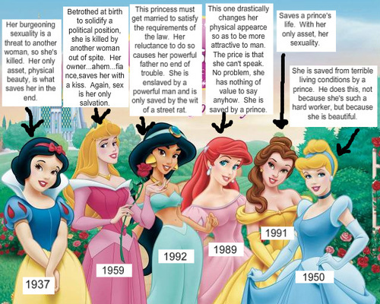

Slide 8
Let’s look at some advertisements…
What messages are being conveyed regarding gender?

Slide 16
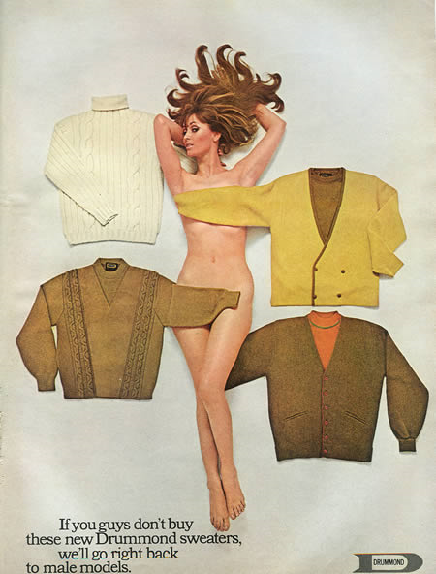

Slide 17
Are there positive messages for women?

Slide 18
DOVE AD
http://www.youtube.com/watch?v=4VGBL-SiqD0

Slide 20
What about the men in ads?

Slide 22
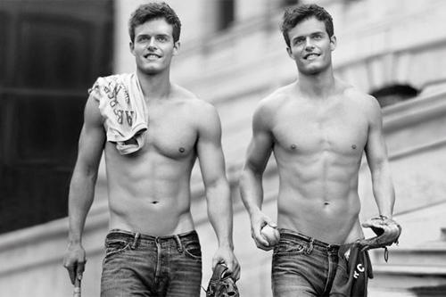

Slide 23
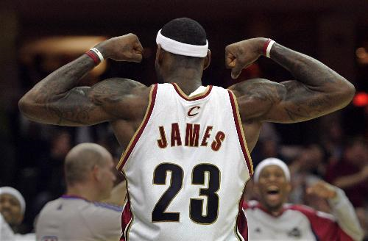

Slide 24
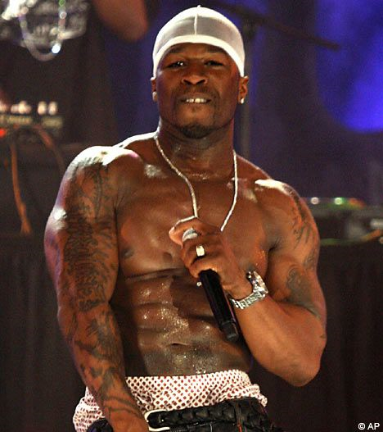

Slide 25
Homework: Respond to this question: What messages do you get from the media you consume? (What messages do they send about gender, race, class…?)

