Slide 1
Film Critique Paper
Gender Studies
Ms. Lyons

Slide 2
What to Do
Choose a movie that addresses a key gendered issue
Body image
Violence against women
Reproductive rights
Your 5-page review should contain:
Briefly describe the movie
Mostly your ORIGINAL analysis.

Slide 3
Include AT LEAST 2 of these questions
(1) Does the film provide context (historical, sociopolitical, economic) for the problem is addresses? Is there a connection between “the personal and the political?”
(2) Does the film portray women or men in a negative and/or stereotypical manner?
(3) Does the film deal with difference among women or men? Are there people of different races, classes, sexual orientation represented in the film?
(4) How is the problem/issue addressed in the film resolved? Does the film provide a comprehensive solution to the problem?

Slide 4
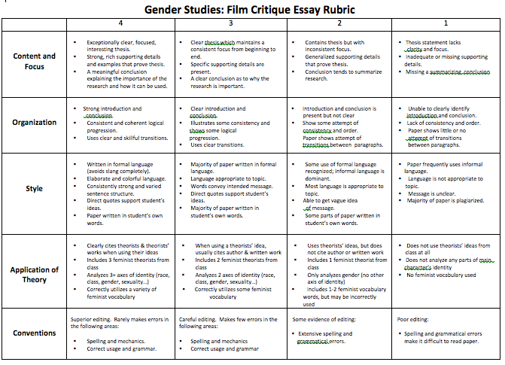

Slide 5
Application of Theory
Clearly cites theorists & theorists’ works when using their ideas
Includes 3 feminist theorists from class
Analyzes 3+ axes of identity
race, class, gender, sexuality…
Correctly utilizes a variety of feminist vocabulary

Slide 6
Note-taking Strategy
RACE | CLASS | GENDER

Slide 7
Note-taking Strategy
VOCAB:
“personal is political”
Intersectionality
Suffrage
Subordinate/dominant
Feminism
Social constructionism
Essentialism
THEORISTS
Betty Friedan (Marriage)
Valerie Solanas
Mary Wollstonecraft
RADICALESBIANS (Sexuality)
Combahee River Collective (Race)
Mary Daly
Sojourner Truth (Race)
Pauli Murray (Race)
Gayle Rubin (Marriage)

Slide 8
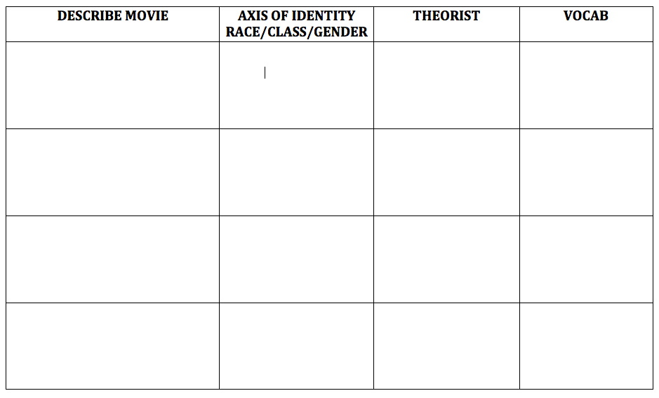

Slide 9
5 pages INCLUDING a Cover Page
Name
Introduction to Gender Studies
Date
Ms. Lyons
Creative Title for Your Paper
Picture

