Slide 1
How to Cite Your Sources
Gender Studies
Ms. Lyons

Slide 2
You Have at least 3 sources…
Now, we need to properly cite them
Definition of cite: to give credit to

Slide 3
AUTOMATIC Citation SITES
www.easybib.com (MLA only)
Notes:
WRITE THIS DOWN

Slide 4
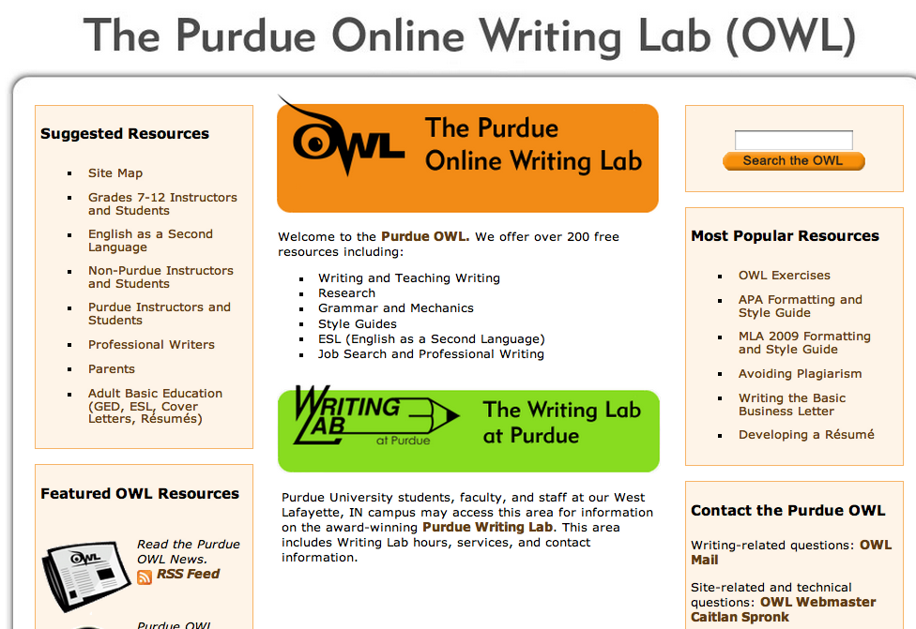
BEST CITATION RULES
www.owl.english.purdue.edu
Notes:
WRITE THIS DOWN

Slide 5
Example (FRONT OF CARD)
“CAREER”
books, plays, “Best Leaders”, V-day (1)
Vagina Monologues (1)
Film – What I Want My Words to do to You (1)

Slide 6
Example (BACK OF CARD)
SOURCES for “CAREER”:
(1) http://www.eveensler.org/about-eve/

Slide 7
EASYBIB.COM Demo
Jing → History

Slide 8
USING EASYBIB.COM
"About Eve." Eveensler.org. Eve Ensler, 2012. Web. 19 Feb. 2013. <http://www.eveensler.org/about-eve/>.

Slide 9
In Text Citations
Include the first item that appears in the Work Cited entry (e.g. author name, article name, website name, film name).
"About Eve." Eveensler.org. Eve Ensler, 2012. Web. 19 Feb. 2013. <http://www.eveensler.org/about-eve/>.
She was also known for creating the film, What I Want My Words to do to You (“About Eve”).

Slide 10
EXAMPLES
Pass around model paper(s).
Show digital models:
Psychology (APA format)
Nicaragua (MLA, research grouped by sources)
Hillary Clinton (APA format)

Slide 11
Replay DEMO
Jing → History

Slide 12
HOMEWORK
Complete your works cited page
AT LEAST 3 sources
Bring everything you need tomorrow to start typing in class
First Draft is due THIS Friday at the start of class
4 pages + Works Cited Page

