Slide 1
ACTIVISM
Gender Studies
Ms. Lyons

Slide 2
Tupac: “Changes”
http://www.youtube.com/watch?v=8zhvf4zwVT0

Slide 3
Letter to the editor
“Trouble With Marijuana Arrests” (editorial, Sept. 27) is very much on point in calling for government agencies to investigate the aggressive marijuana arrest policies of the New York Police Department. But the call for scrutiny should not stop there.
Every day, the city’s police engage in objectionable practices that harm people and communities. Young black and brown men stopped and frisked for no apparent reason; people in psychiatric crisis thrown to the ground, handcuffed and locked up; gay and transgender people harassed as they enter a local community center; sex workers arrested simply for carrying condoms; street vendors fined and arrested for violating arbitrarily enforced minor rules; and homeless people roughed up and apprehended for sleeping on a park bench.
One characteristic joins the people subjected to these harsh practices: they are members of marginalized groups viewed as powerless to oppose police abuse effectively. New York City should help and protect the vulnerable people in its midst, not use its police force to ostracize and punish them.
ROBERT GANGI Director, Police Reform Organizing Project, Urban Justice Center New York, Sept. 27, 2011

Slide 4
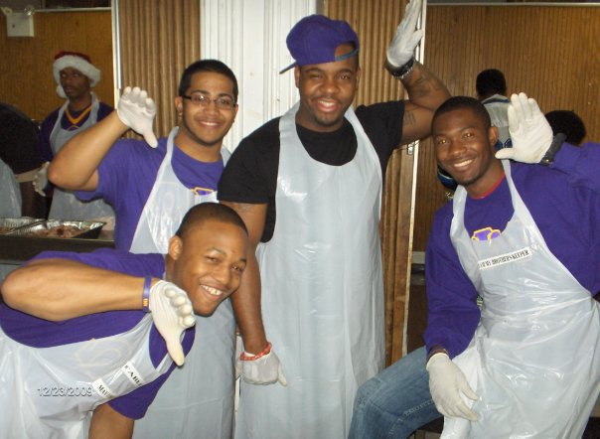
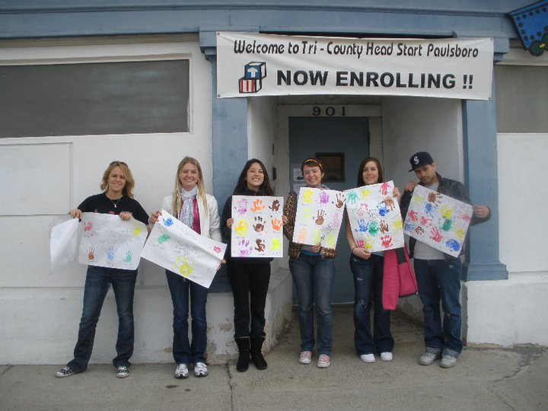
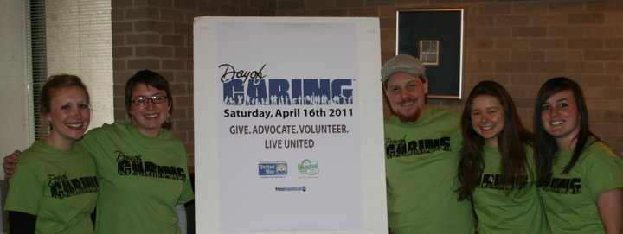
Community service project
Community Service
at soup kitchen in
Harlem, New York.
(Christmas Day)

Slide 5
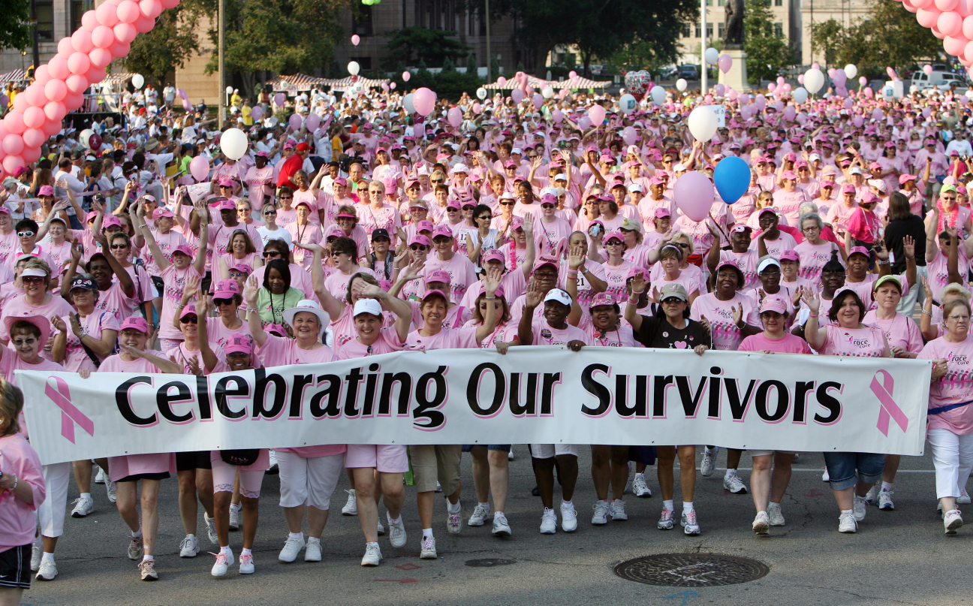
Organize a Fundraiser
SUNY PLATTSBURGH’s
Relay for Life 2011

Slide 6
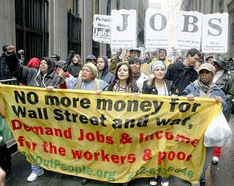
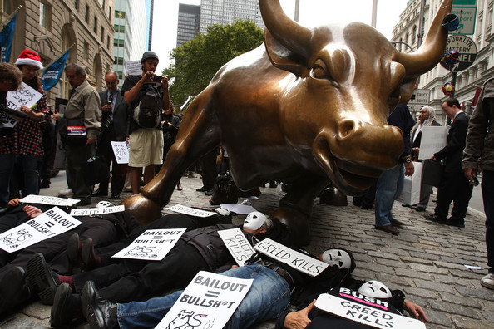
Protest/rally
Occupy Wall Street

Slide 7
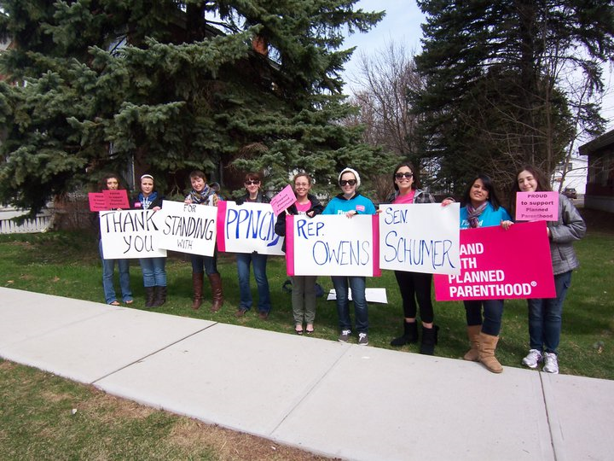
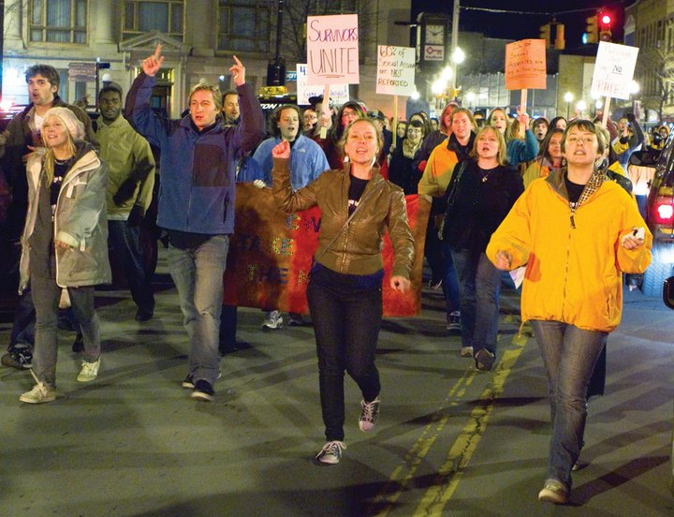
SUNY Plattsburgh Protests

Slide 8
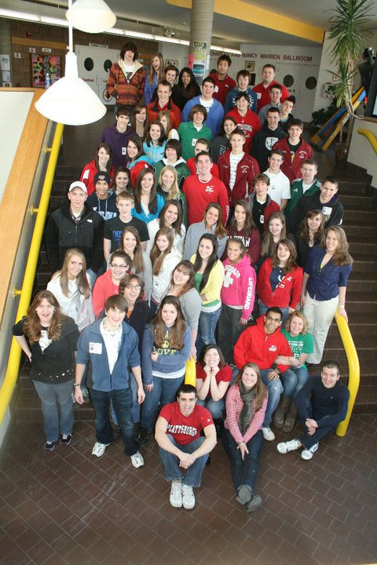
Teach! Younger students
LEADERSHIP CONFERENCE
GIRLS EMPOWERMENT (BODY IMAGE)
BULLYING

Slide 9
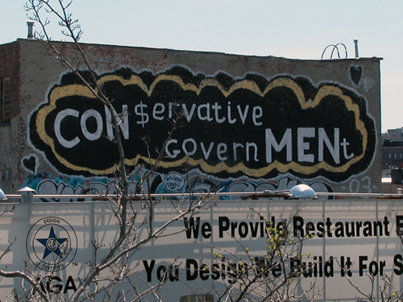
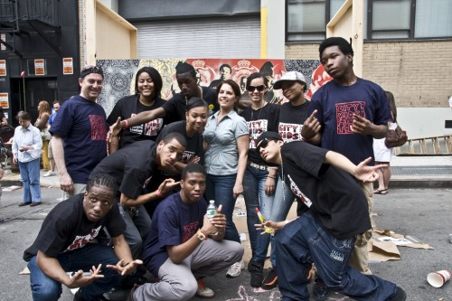
art
Mural, poetry, song, publish a book
La Bruja

Slide 10
Start a business
http://www.youtube.com/watch?v=aKhV9kpGM-k&feature=player_embedded

Slide 11
Lollipop Moment
http://www.youtube.com/watch?client=mv-google&gl=US&hl=en&v=hVCBrkrFrBE&nomobile=1
What does being a leader have to do with activism?

Slide 12
Day 2
Activism

Slide 13
What is the point of activism?
How hard is it to change someone’s mind?
Success:
getting them to Think about what you said & Apply your message to life

Slide 14
From www.dosomething.org
Decide what makes you mad
Learn the issue
Team up
Make a plan
Ask for help
Spread the word
Stay in the know
Celebrate small victories
Don’t give up

Slide 15
From Rules for Radicals:
1. Agitate
2. Aggravate
3. Educate
4. Organize

Slide 16
ACTIVISM VS. ACADEMIA
ACTIVISM
ACADEMIA
EVERYONE CAN PARTICIPATE
ACCESSIBLE LANGUAGE
MAKE CHANGE THROUGH ACTIONS
ONLY COLLEGE EDUCATED
EXCLUSIONARY LANGUAGE
MAKE CHANGE THROUGH WORDS

