Slide 1
Vocab Week 1-3
Government
Ms. Lyons

Slide 2
Flip to the back page

Slide 3
PREFIX: Before
Di- “apart”
Dissect (cut apart)
YOUR PAPER
Di-
apart
dissect,

Slide 4
PREFIX: Before
Ob/Op- “against”
Object (to be against something)
Opposition (the act of going against something)
YOUR PAPER
Ob/Op-
against
Object, opposition,

Slide 5
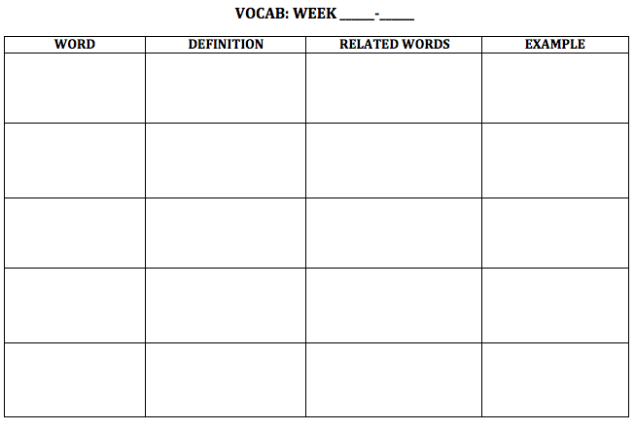
NEW WORDS!
Flip your paper over.
1
3

Slide 6
Infringe

Slide 7
When my mother is doing her homework, no one is allowed to infringe on her quiet time

Slide 8
Infringe
Definition: interrupting or disturbing
Related words: rights, quiet, stopping
Example/Picture: write or draw your own

Slide 9
Oppress

Slide 10
We know of many countries around the world which still oppress their people and deny them their rights.

Slide 11
Oppress
Definition: hurt (a group of people)
Related words: take away, deny, black
Example/Picture: write or draw your own

Slide 12
Diverge

Slide 13
We agree on so many things until it comes to politics, there our opinions really diverge.

Slide 14
Diverge
Definition: to move apart
Related words: separation, apart, move
Example/Picture: write or draw your own

Slide 15
Choose 16 words
Republic
Concurrent
Preamble
Veto
Impeach
Circumnavigate
Federalism
Monarchy
Sovereign
Democracy
Infringe
Diverge
oppress
Im
con/com
Pre
Bi
Circum
Arch
-ism
Di-
Ob/op-

