Slide 1
VOCAB Week 1-1
Government
Ms. Lyons

Slide 3
UNFAIR
How many parts can I break this word into?
If we take out the first part, does the meaning change?

Slide 4
Flip to the back page

Slide 5
PREFIX: Before
2
Circum- “around”
Circumcision
Circumference (distance around a circle)
1
YOUR PAPER
Circum-
Around
Circumference,
3

Slide 6
ROOT : word part from which other words grow
arch / reg “rule”
Hierarchy, regulate
Patriarch (men are rulers)
Regime (gov’t that rules)
YOUR PAPER
arch
ruler
Patriarch, regime

Slide 7
ROOT
demo “people”
Epidemic
Demographics (data about people)
Examples: age, gender, race…

Slide 8
SUFFIX: Added at the end of a word
-ism “belief”
Catholicism, racism
Communism (belief that gov’t should treat all people equally)
YOUR PAPER
Communism,
-ism
Belief

Slide 9
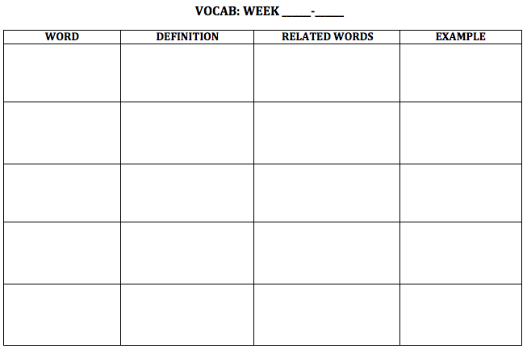
NEW WORDS!
Flip your paper over.
1
1

Slide 10
Circumnavigate

Slide 11
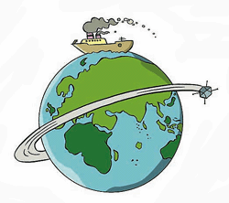
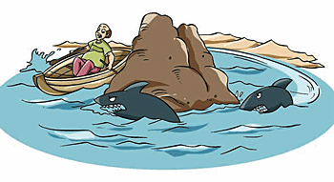
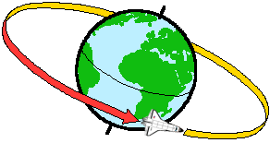
Circumnavigate

Slide 12
Circumnavigate
Definition:
Related words:
Example/Picture: write or draw your own

Slide 13
Federalism

Slide 14
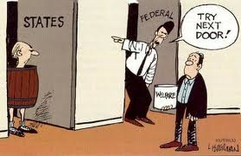
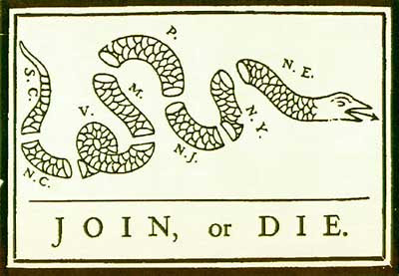
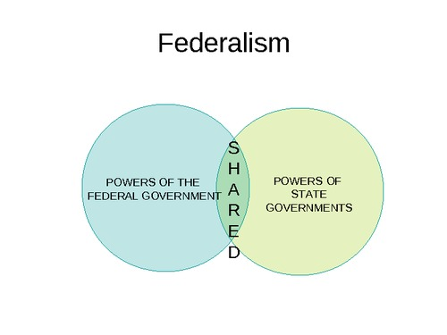
Federalism

Slide 15
Federalism
Definition:
Related words:
Example/Picture: write or draw your own

Slide 16
Monarch

Slide 17
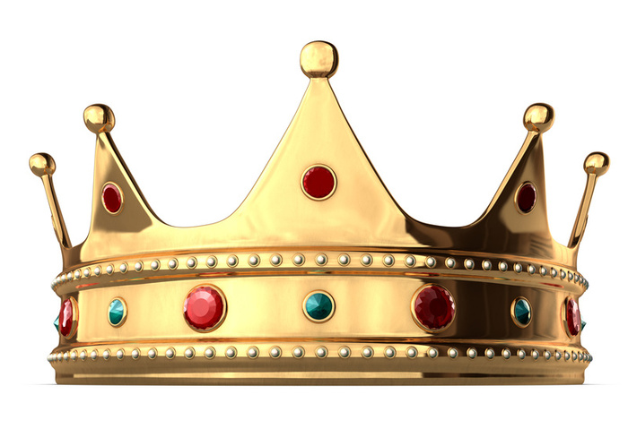
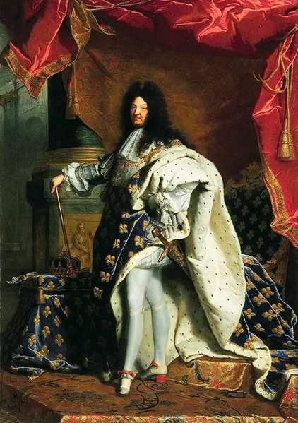
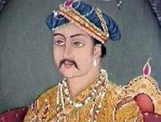
Monarch

Slide 18
Monarch
Definition:
Related words:
Example/Picture: write or draw your own

Slide 19
Sovereign

Slide 20
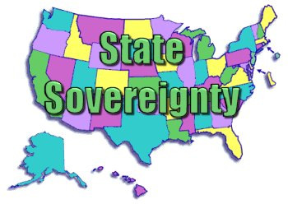
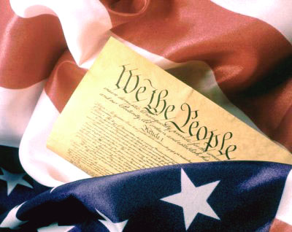
Sovereign

Slide 21
Sovereign
Definition:
Related words:
Example/Picture: write or draw your own

Slide 22
Democracy

Slide 23
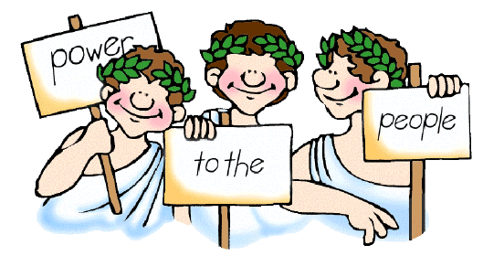
Democracy

Slide 24
Democracy
Definition:
Related words:
Example/Picture: write or draw your own

