Slide 1
2012 Election & the Media
Ms. Lyons

Slide 2
Media Sources Does it matter where we get our information from? Bias: Objective:

Slide 3
State Farm Commercial http://www.youtube.com/watch?v=rmx4twCK3_I

Slide 4
Late Night Television http://www.youtube.com/watch?v=ygq_LuJeWa8 http://www.youtube.com/watch?v=1wVr5Rb9CV0

Slide 5
CNN http://www.youtube.com/watch?v=L9qHFY6bnoU

Slide 6
Fox News http://www.youtube.com/watch?v=Z_TT9zUN1_A

Slide 7
POLITICAL CARTOONS

Slide 8
Who won the debate?

Slide 9
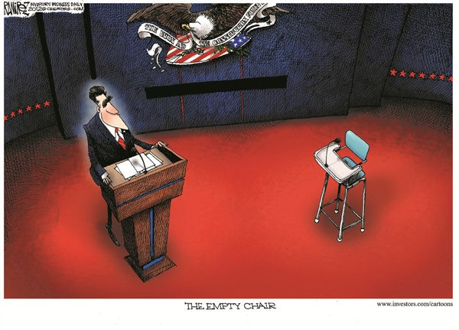

Slide 10
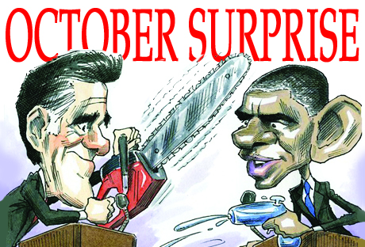

Slide 11
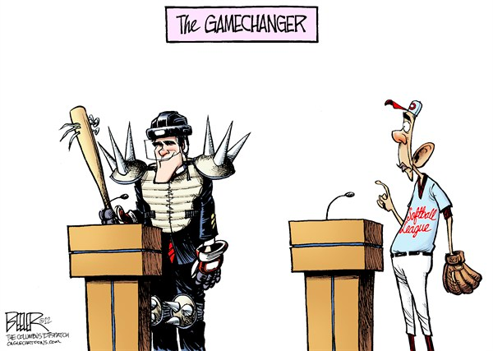

Slide 12
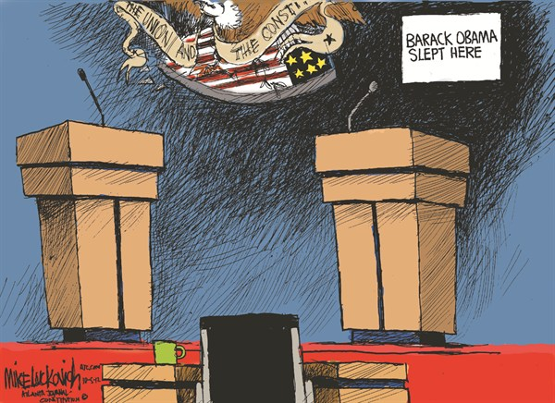

Slide 13
Where does Romney want to cut spending?

Slide 14
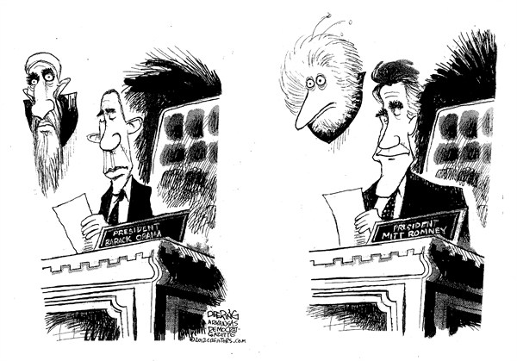

Slide 15
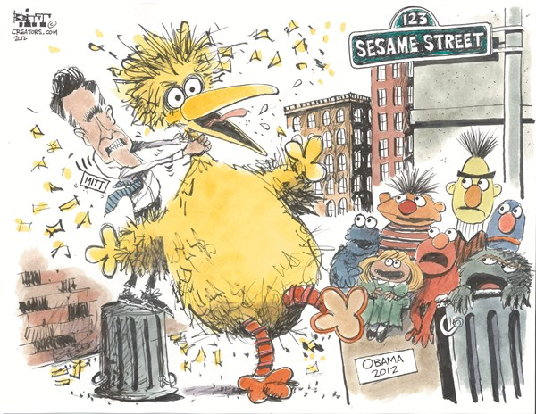

Slide 16
What do people think of Obama’s priorities?

Slide 17
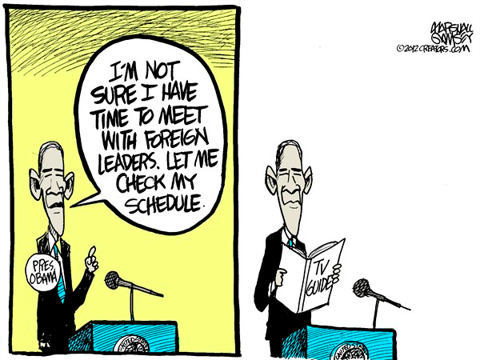

Slide 18
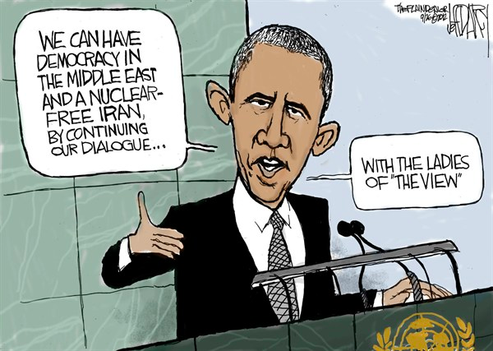

Slide 19
What are the similarities & differences between Obama & Romney?

Slide 20
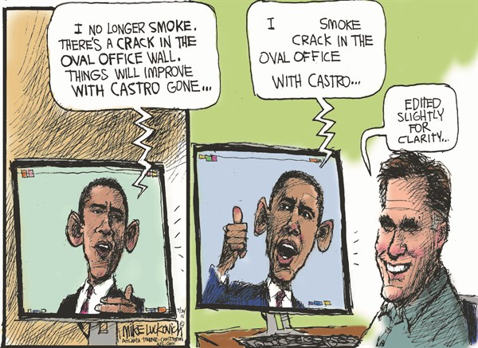

Slide 21
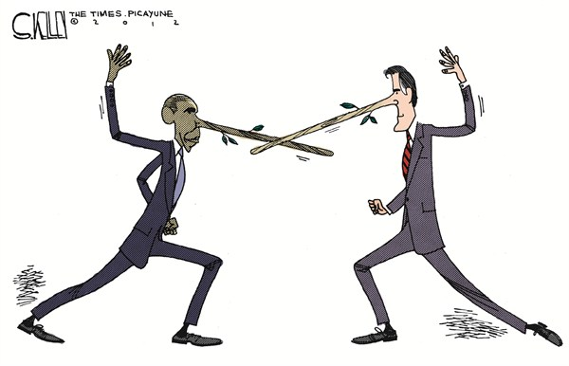

Slide 22
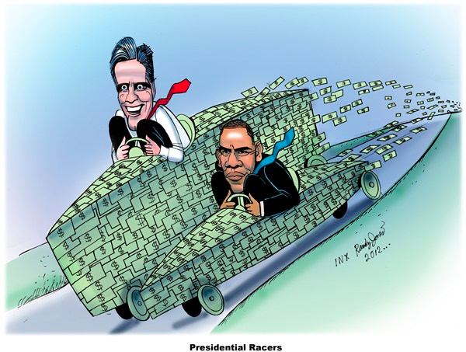

Slide 23
What are the main political issues for this year’s election?

Slide 24
