Slide 1
WORLD MAP SKILLS
Social Studies
Ms. Lyons

Slide 2
GOVERNMENT

Slide 3
Find Venezuela on the map.

Slide 4
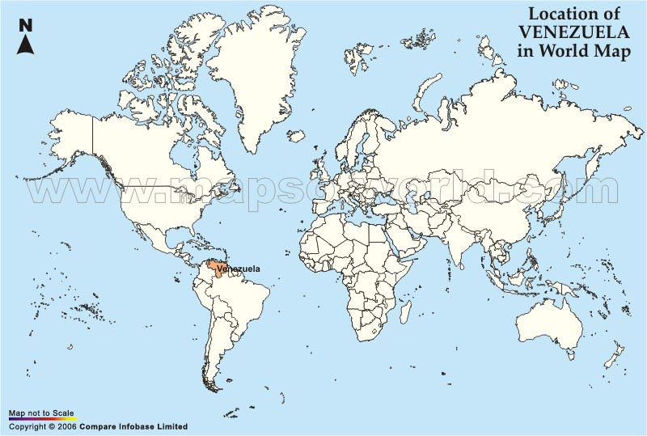

Slide 5
Find Syria on the map.

Slide 6
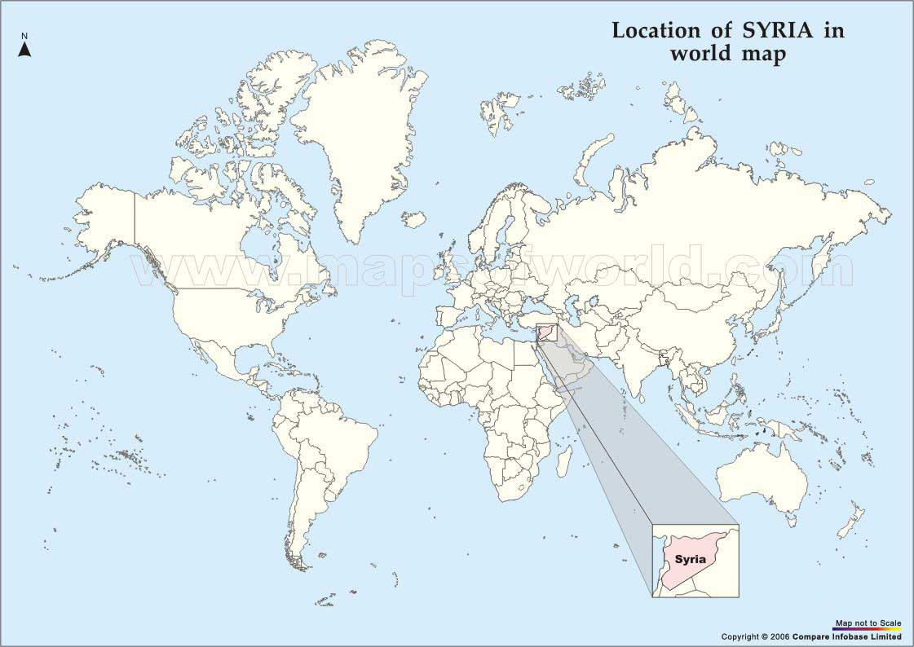

Slide 7
Find Afghanistan on the map.

Slide 8
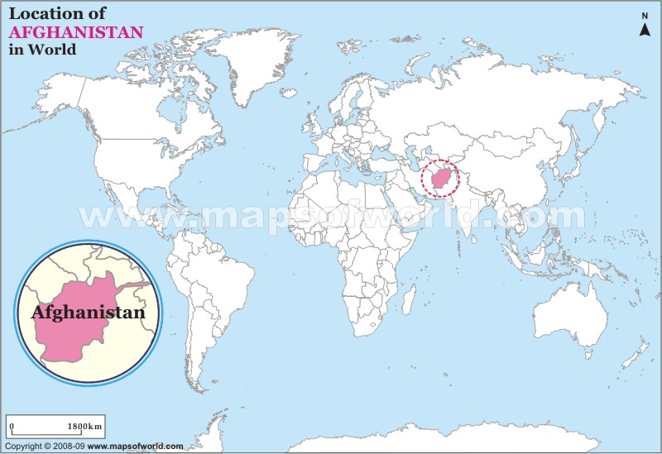

Slide 9
Find Greece on the map.

Slide 10
