Slide 1
Geography of Mesopotamia
Global 1
Ms. Lyons

Slide 2
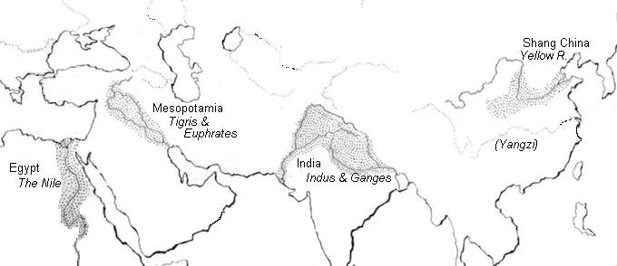
4 early River Valley Civilizations
Sumerian Civilization - Tigris & Euphrates Rivers (Mesopotamia)
Egyptian Civilization - Nile River
Harappan Civilization - Indus River
Ancient China - Huang He (Yellow) River
PP Design of T. Loessin; Akins H.S.

Slide 4
Environment
How did geography affect Mesopotamia’s civilization?

Slide 5
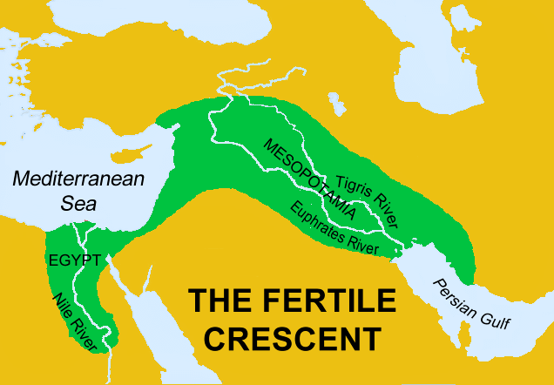
“Fertile Crescent”
Dry desert climate in Middle East
EXCEPT: a flat plain known as Mesopotamia (between the 2 rivers)
Shape + rich soil = Fertile Crescent

Slide 6
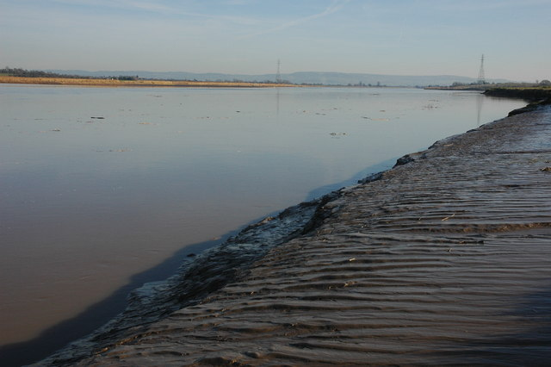
FERTILE SOIL from the Tigris and Euphrates Rivers
River deposits sediment AKA “silt”
Grow lots of crops
Surplus (extra) food
Subsistence means just enough to feed your family.

Slide 7
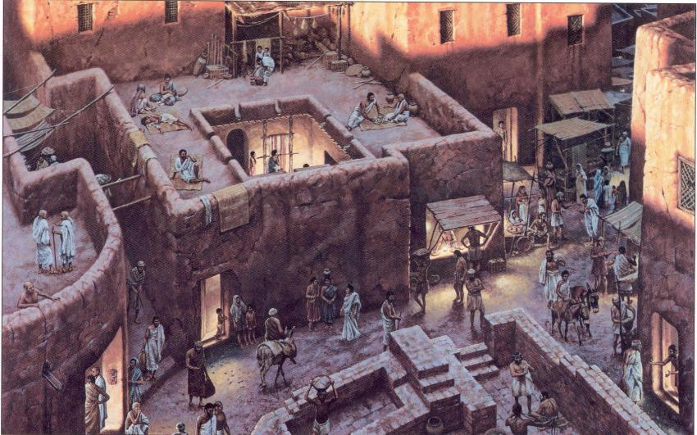
Effects of Geography
PROBLEMS
SOLUTIONS
Unpredictable flooding & too dry in summer
No natural barriers for protection
Limited natural resources
No: stone, wood, metal
Irrigation ditches
Built city walls with mud bricks
Traded for the products they needed

Slide 8
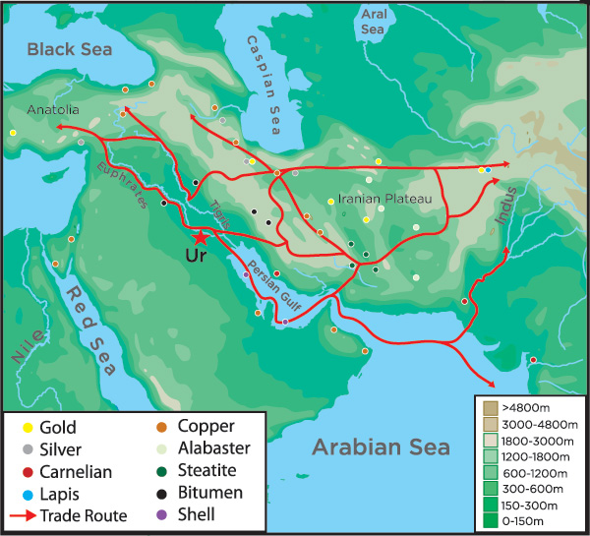
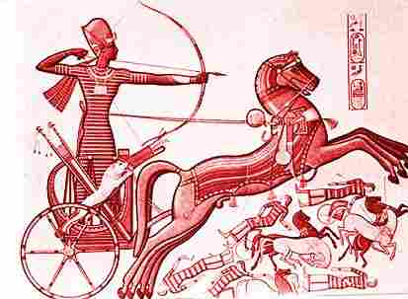
Water = Transportation & Trade
Traveled to: North Africa, India, Asia
Sumerians made first wheeled vehicles to travel to desert regions.

Slide 9
Cultural Diffusion: Ancient written languages are very similar! Why are they so similar?

Slide 10
Power & Authority
What was the social structure of Mesopotamia?
Why did Mesopotamia need a government?

Slide 11
Social Structure
Priests, royalty
Religion = important
polytheistic
Slaves (not free citizens)
not on social pyramid
Women had “many” rights (at the time)
Could: own property, become a low-level priest
Could not: go to school (read & write)
Rich merchants
Regular
workers

Slide 12
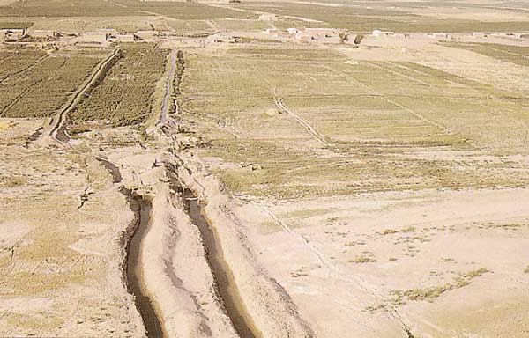
Government was needed to…
Control surplus food
Coordinate the irrigation system
Irrigation: bringing water to dry fields using ditches
Government leaders = priests & royalty

Slide 13
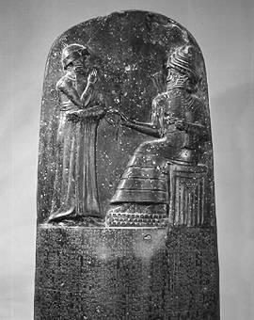
Hammurabi’s Code
Babylon (civilization in Mesopotamia)
1,000 years after Sumer
1st written laws
Unified all laws into one code, carved them onto stone, & hung them up
1st leader to say the government is responsible for keeping society in order
STRICT LAWS!
Others used his laws too (Old Testament)
Shamash, the sun god, is presenting to Hammurabi a staff and ring, which symbolize the power to administer the law.

Slide 15
Science & Technology
What was created in ancient Mesopotamia that we still use today?

Slide 16
Sumer’s Inventions
Cuneiform
One of the 1st writing systems
Wheel, sail, plow
1st people to use bronze
Early maps
Astronomy (studying stars)
Measuring in 60’s
Time: 60 seconds in a minute, 60 minutes in an hour
Math: 360 degrees = circle

Slide 17
ACTIVITY
Let’s see if you are as harsh as Hammurabi…

Slide 18
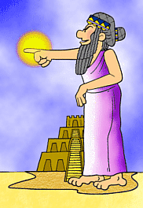
Partnered Students Handout
Hammurabi, the king of righteousness,
On whom Shamash has conferred the Law,
am I.
When Marduk sent me to rule over men,
to give the protection of right to the land,
I did right and in righteousness brought about
the well-being of the oppressed. Below are situations Hammurabi faced.
You and your partner decide what you think to be a fair way to deal with the problem.
Then together we’ll view what Hammurabi actually declared.
We’ll find out if Marduk, the supreme god, will be pleased with your decisions?
What should be done to the carpenter who builds a house that falls and kills the owner?
What should be done about a wife who ignores her duties and belittles her husband?
What should be done when a "sister of god" (or nun) enters the wine shop for a drink?
What should be done if a son is adopted and then the birth-parents want him back?
What happens if a man is unable to pay his debts?
What should happen to a boy who slaps his father?
What happens to the wine seller who fails to arrest bad characters gathered at her shop?
How is the truth determined when one man brings an accusation against another?
http://www.phillipmartin.info/hammurabi/hammurabi_situation_index.htm
Compiled and Illustrated by Phillip Martin copyright 1998

Slide 19
http://www.phillipmartin.info/hammurabi/hammurabi_situation_index.htm

