Slide 1
SUPER FAST REVIEW OF GLOBAL 1-3
Global 4
Ms. Lyons

Slide 2
Neolithic Revolution
Background | Effects
Paleolithic Period: (from 1st humans to 10,000 BCE) * nomads. *hunting and gathering Neolithic Revolution = *growing crops and domesticating animals *Big Change! (Major TURNING POINT) | *develop permanent settlements *social classes *new technologies. Early Civilizations: (fertile river valleys ) - Egypt (Nile) Mesopotamia (Tigris-Euphrates) China (Yellow) India (Indus River)

Slide 3
Causes of European Imperialism
Economic Motives | The Industrial Revolution created an insatiable demand for raw materials and new markets.
Nationalism | European nations wanted to demonstrate their power and prestige to the world.
Balance of Power | European nations were forced to acquire new colonies to achieve a balance with their neighbors and competitors.
White Man's Burden | The Europeans’ sense of superiority made them feel obligated to bring their version of civilization to areas they considered uncivilized.

Slide 4
Geography in Europe
Mediterranean Sea
Good for: cultural diffusion (water = travel & trade)
Greece & Rome =successful because close to water
Greece:
City-states (Athens): mountains on the Greek peninsula = NOT unified
Rome:
sailing and military
Later: nation-states (Portugal & Spain) - first European superpowers

Slide 5
Geography in Asia
CHINA:
Himalayan Mountain Range (largest in the world)
Gobi Desert
Seas to the east
Isolated & protected
INDIA:
Subcontinent
JAPAN:
Islands in the Pacific Ocean
provides food, culture, & jobs
rely on foreign trade to provide other natural resources
protected

Slide 6
Geography in Africa
Sahara Desert (almost all of Africa)
North Africa: above the Sahara on the Mediterranean Sea
Sub-Saharan Africa: any country located to the south of the desert
HOW BIG IS IT? Same as walking from Portland, Maine to San Francisco, California (3000 miles)
Different cultures (North vs. South) – no one wanted to cross desert
Regular Coastline
no natural harbors, which makes landing a ship near impossible.
Protected Africa from European explorers for centuries!
Nile River, (the world's largest river)
source of many of the world's first major civilizations, including Egypt.

Slide 7
Geography in Latin America
Pre-Columbian:
Maya- Mexican peninsula called the Yucatan
Aztec- present day Mexico City, lacked any real geographic protection
Inca. Andes Mountains (protection)
Caribbean islands
Rain forest surrounding Amazon River (2nd largest)
deforestation
Surrounded by 2 oceans (Atlantic & Pacific)
Colonized by Spain & Portugal

Slide 8
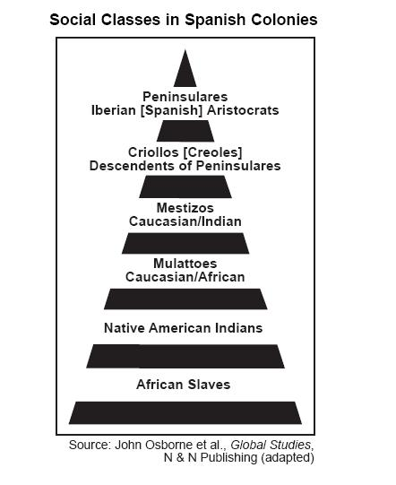

Slide 9
Commercial Revolution
After the Crusades: trade & cultural diffusion increased
Late 1300s: Italian City States became the center of trade
(Venice = most powerful)
Guilds: groups of craft workers and merchants. All of one craft would form together to set standards on prices and quality.
Capitalism: started after feudalism declined. Based on money. Higher demand for a product means higher prices and higher profits.
Banks: loans, “bills of exchange” (don’t have to carry heavy gold)

Slide 10
Encomienda system

