Slide 1
UPDATES ON: Latin America Week 2-7: Part 2
Global 4
Ms. Lyons

Slide 2
Political & Economic Change in Latin America

Slide 3
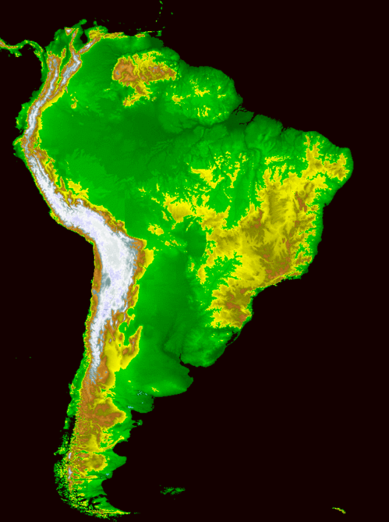
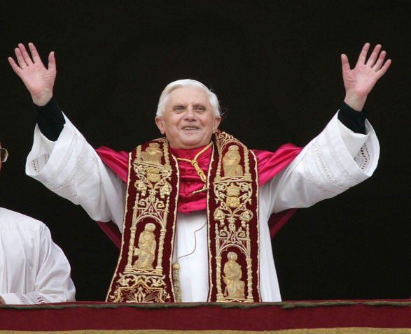
Latin America
Geographic barriers = prevent unity
Diverse people
Religion:
Catholic Church is very powerful
Many conservative leaders still supported social reforms

Slide 4
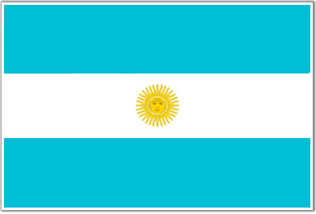
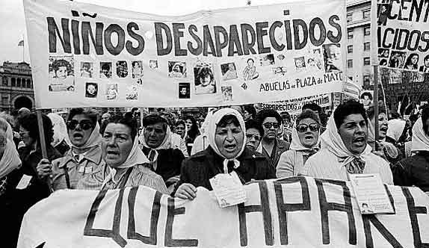
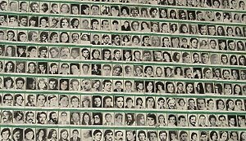
Argentina
1900: richest nation in Latin America
1946-1955: Juan Peron
Import substitution, repressive
1976: military government
“Dirty war” (20,000 people disappeared)
Mothers of the Plaza de Mayo

Slide 5
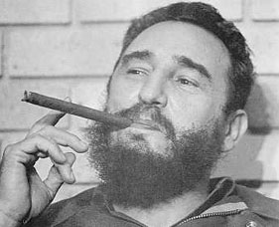
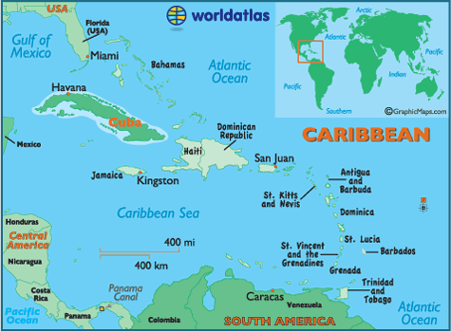
Cuba
1952: repressive and corrupt leader (Batista)
1959: Castro
Overthrew with guerilla army
Communist
Lost trading partners when USSR fell

Slide 6
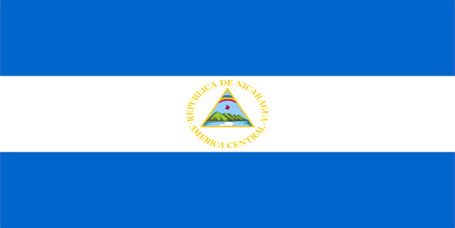
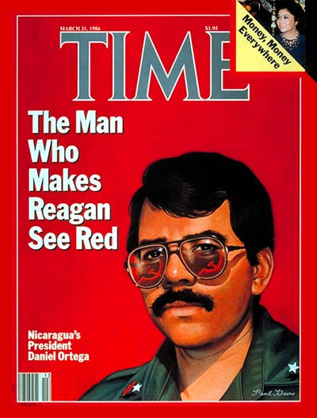
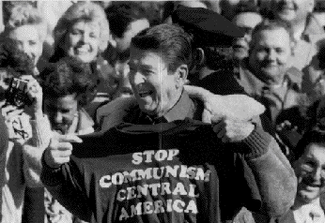
Nicaragua
1936-1979: Somoza
Repressive, close with USA
1979: Sandinistas
Communism
Daniel Ortega
USA opposed them using the Contras
Civil war!
Death & bad economy

Slide 7
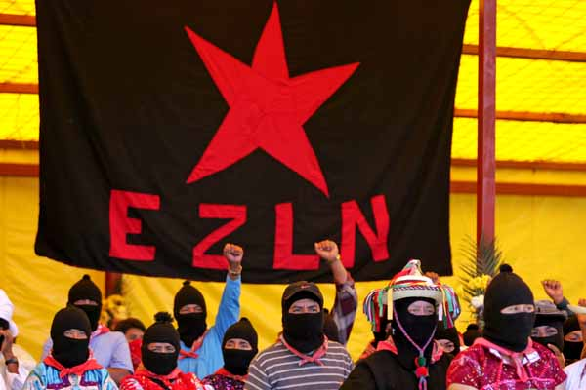
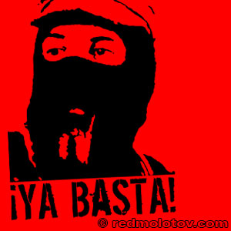
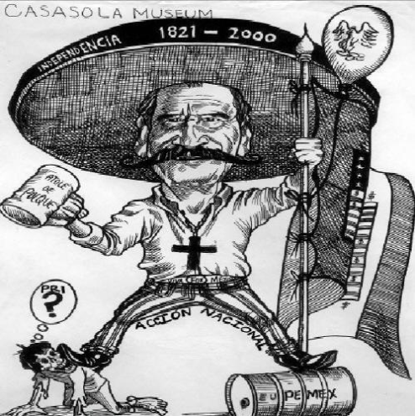
Mexico
PRI (one party) ruled for 71 years!
1994: Zapatista rebels in South (Chiapas) demanded reforms
2000: PRI lost election!
Vincente Fox (PAN party) elected president
1990’s: NAFTA hurt Mexico’s economy
US competition for markets
immigrants moved to US

Slide 8
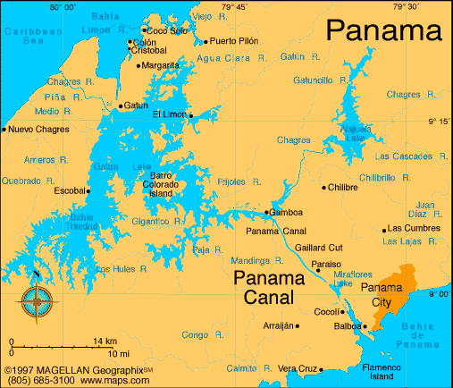
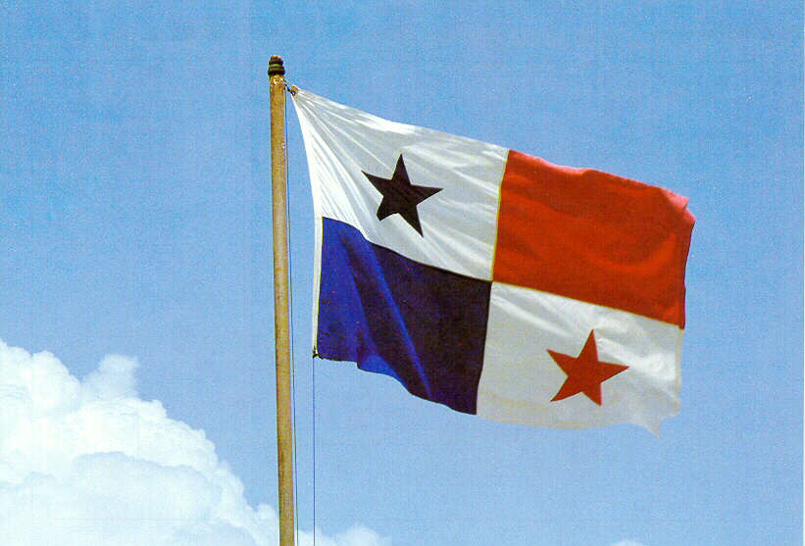
Panama
1989: US arrested president (Manuel Noriega) for helping cartels smuggle drugs into the US
2000: Panama was given full control over the Panama Canal
No more US control

