Slide 1
Fall of the USSR
Global 4
Ms. Lyons

Slide 2
Cold War REVIEW
1917: Russian Revolution
Communism
Leaders: Lenin, Stalin
2 superpowers: US & USSR (Soviet Union)
Arms race, but they never fought each other
Fighting in other countries: Vietnam, Korea

Slide 3
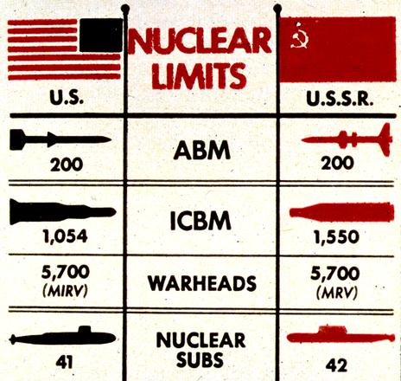
Détente
1970’s
Nixon & Brezhnev
Diplomacy
Arms control
Trade agreements

Slide 4
“Russians in Afghanistan”
USSR breaks détente!
Invade Afghanistan to keep communists in power
USA helps the Afghans
Citizens of the USSR protested the war
Bad economy
USSR was losing

Slide 5
TV SHOW: The Americans
Russian spies in America
http://www.youtube.com/watch?v=NrabBaKAUyU

Slide 6
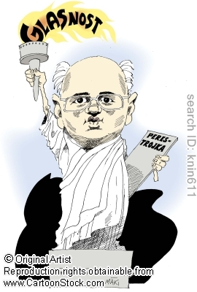
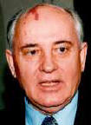
Mikhail Gorbachev
1985-1991: leader of USSR
Pulls USSR out of Afghanistan
Poland becomes independent
2 policies that contributed to the downfall of communism
1. Perestroika
Changed the economy → free market (capitalism)
2. Glasnost
Changed the government → democracy & openness with rest of world (no censorship)
Notes:
Effect of perestroika: inflation, food, & medical shortages

Slide 7
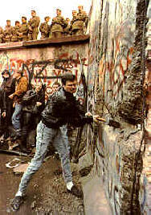
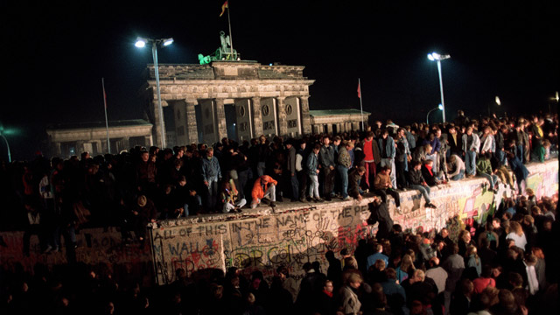
Berlin Wall Comes Down
1989
East Germany allowed visits to West Germany
People tore down parts of the wall

Slide 8
Boris Yeltsin
Criticized Gorbachev for destroying the country
Hard-line communists attempted a coup d’etat
Coup d’etat: act of overthrowing a government, usually violently
1991: Yeltsin stopped the revolt, ended communism, and became president
USSR (Soviet Union) is re-named Russia.
Notes:
At this time, satellite states demanded independence… all comes crumbling down

Slide 9
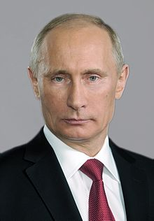
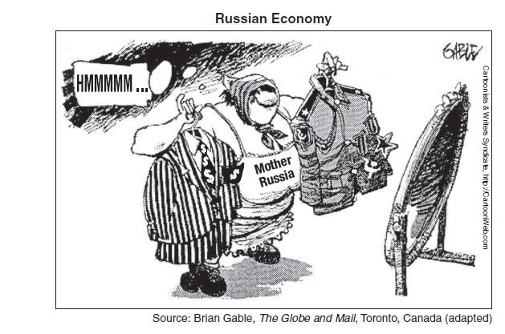
Russia’s President Today
Vladimir Putin
First becomes President in 2000
Makes peace with the US

