Slide 1
Communist China Week 2-6: Part 2
Global 4
Ms. Lyons

Slide 2
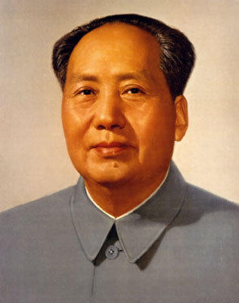
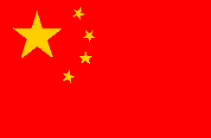
Mao Zedong
Leader of the Communist party
Long March = retreat to North from military
Took over the gov’t in 1949
Created the PRC (People’s Republic of China)

Slide 3
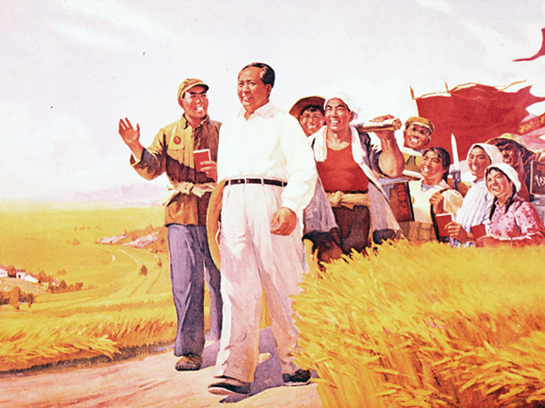
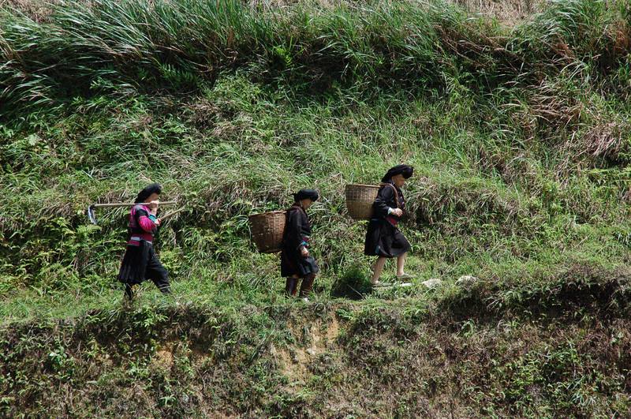
Why was Mao successful?
Promised land to peasants
Gave women more rights (than Confucianism)
Strong army (guerrilla warfare)
People didn’t like Nationalist gov’t
Let foreigners take over

Slide 4
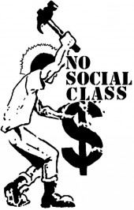
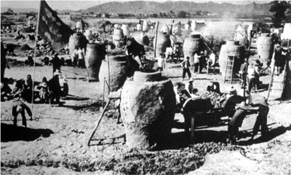
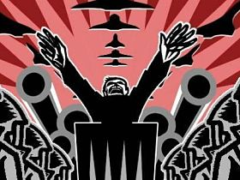
Goals of Mao & the PRC
Modern industrial society (agriculture)
Increase literacy
Landlord/business classes = eliminated
Rural people = given healthcare
Dictatorship (people have no freedoms)

Slide 5
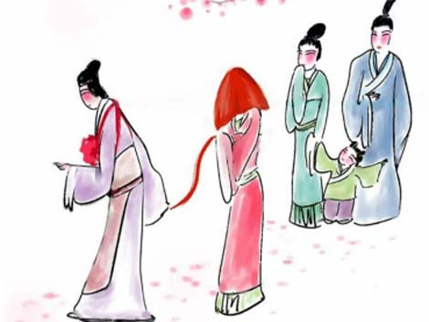
Women
Confucianism says only job is: “wife”
Allowed/expected to work in fields
Not equal pay
Don’t have good (gov’t) jobs

Slide 6
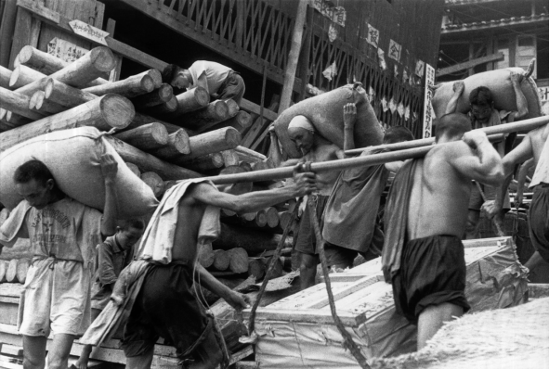
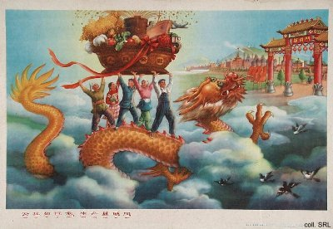
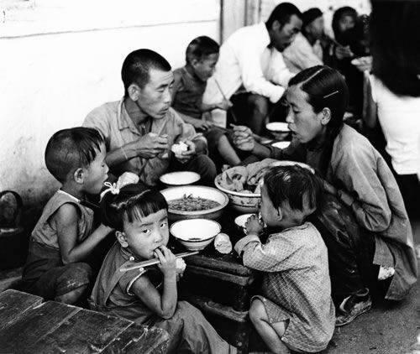
Great Leap Forward
1958
Goal: increase agriculture & industry
Communes
Live & work on same property (share land)
Production quotas
EFFECTS
Low quality goods
Mass starvation

Slide 7
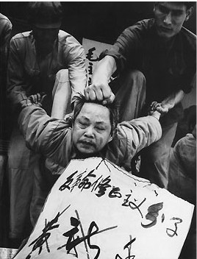
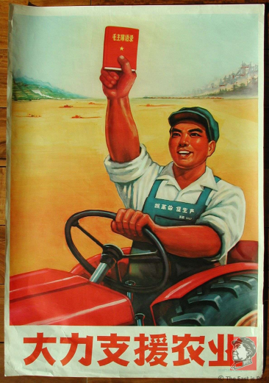
Cultural Revolution
Goal: renew communist loyalty
People feared educated had too much power
So….
Mao shut down schools
Red Guards: student fighters
Attacked professors/officials
Effects
Slowed economy
Fear

Slide 8
Compare 2 Revolutions
Mao’s Communist China
Russian Revolution

Slide 9
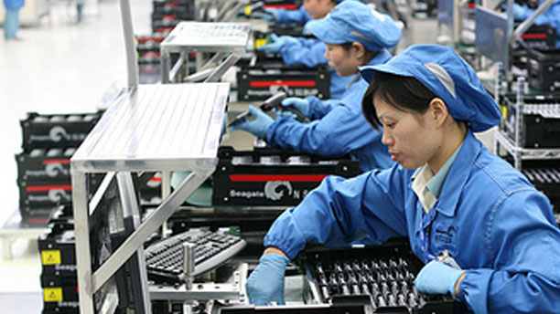
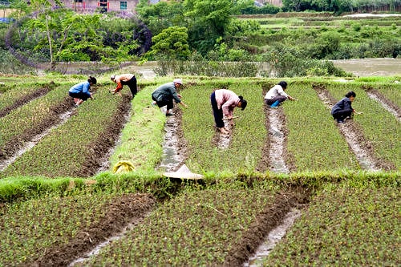
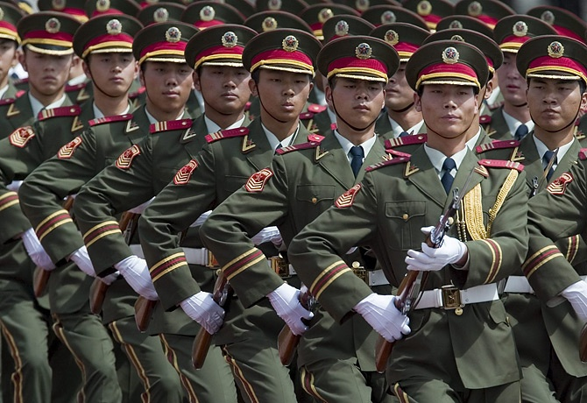
Deng Xiaoping
More economic freedom, no political change
“4 Modernizations”
Farming
Industry
Science/technology
Defense
More private property & more foreign investment
Effects:
Better economy & standard of living
More trade
More crime
Bigger gap between rich & poor

Slide 10
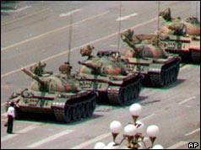
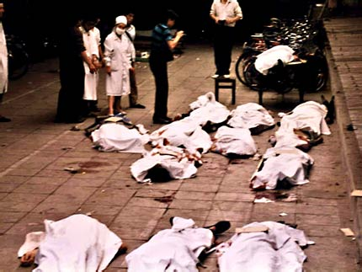
Tiananmen Square
May 1989 in Beijing
1,000’s of demonstrators killed by tanks & troops

