Slide 1
The Cold War: Part 2
Week 2-5
Global 4
Ms. Lyons

Slide 2
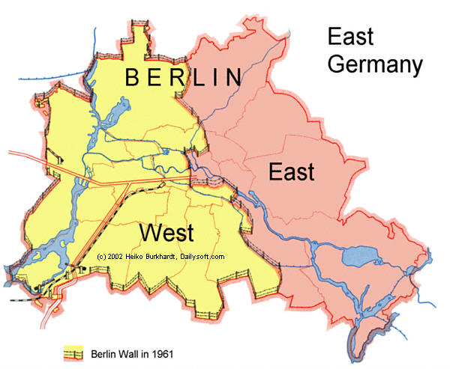
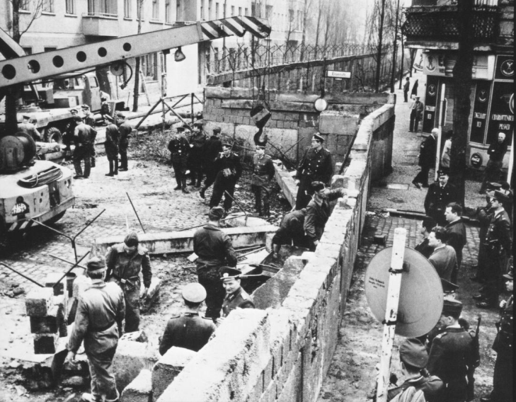
Berlin
Capital of Germany
USSR tried to starve West Germany by blocking all food trucks
  US flew food in on airplanes
East Germany builds the Berlin Wall (1961)
  Divides West & East Berlin
  East German soldiers shot
  people trying to escape to the west

Slide 3
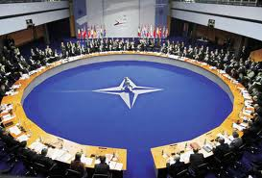
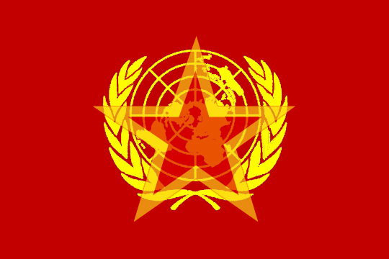
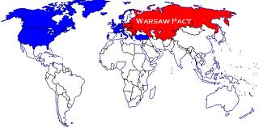
Alliances
NATO
Warsaw Pact
Western European countries
Defend against USSR
USSR & 7 satellite countries

Slide 4
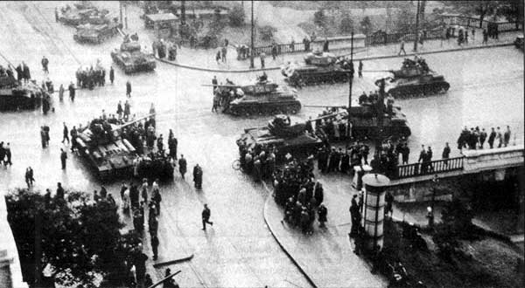
Ruthless USSR
Stalin dies
  Next leaders still ruthless
USSR puts down revolts
  East Germany & Poland
  Hungarian Revolt (1956)
    Thousands killed
  Czechoslovakia reforms government (1968)
    USSR military forces them to return to communism

Slide 5
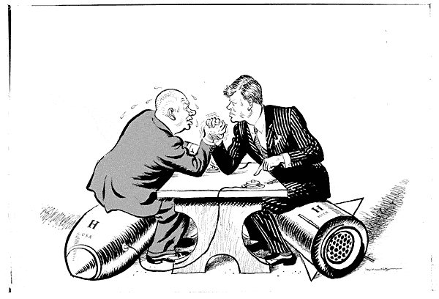
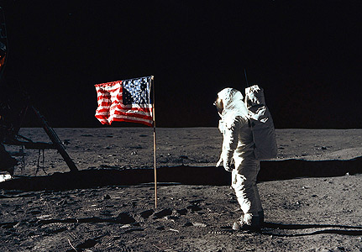
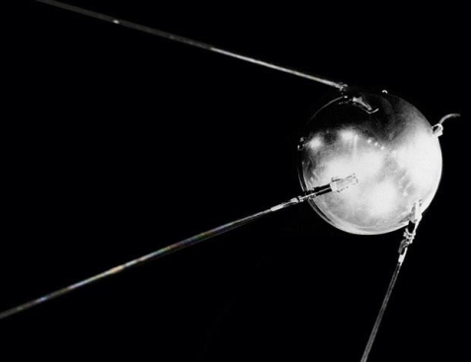
We Want to be Better at Everything!
ARMS RACE
  US made atomic bomb
  USSR copies
SPACE RACE
  Sputnik (USSR starts exploring space)
  NASA (US copies)

Slide 6
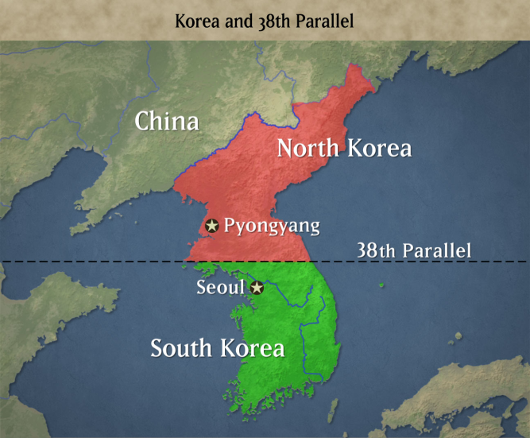
Fighting… but not fighting each other
Surrogate states
  These wars developed from Cold War tension!
North Korea v. South Korea (1950)
  USSR supports North (communist)
  US supports South (capitalist)
  Still divided today
North Vietnam v. South Vietnam (1954-1975)
  USSR supports North (communist)
  US supports South (non-communist)

Slide 7
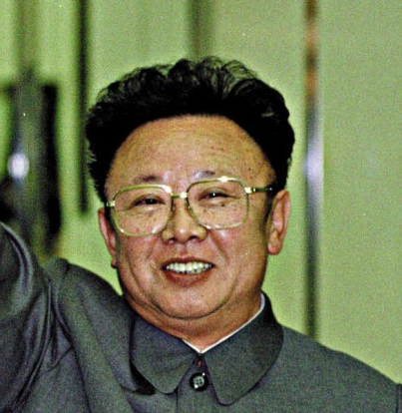
North & South Korea Today

Slide 8
More fighting
Middle East
  Egypt vs. Israel
  Iran
  Iraq, Syria, Libya
Africa
  Congo
  Angola
Latin America
  Cuba
    Castro
  Guatemala
  Nicaragua
    Sandinistas
  El Salvador
US = democracy
  Anti-communist
USSR = communism
  Anti-west

Slide 9
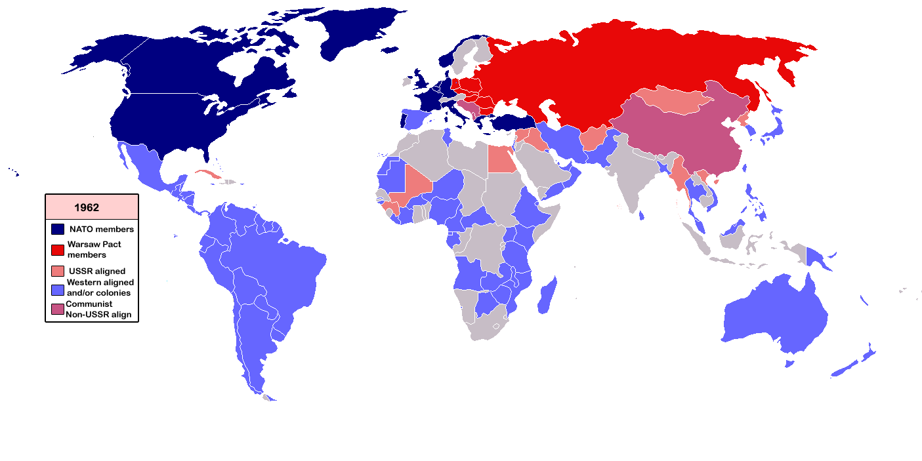
Nonaligned nations
NEUTRAL
  Stayed out of Cold War conflicts
India
Yugoslavia
Many African
nations

Slide 10
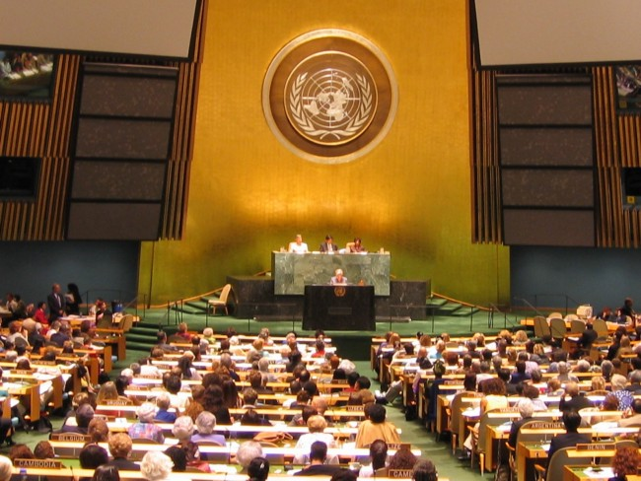
United Nations
Stable, peaceful
Countries voted in blocs (east vs. west)
  Less effective
1991: expanded roles
  Has military peacekeepers (sent to countries)
  Health services
  Human rights
  More effective

