Slide 1
Cold War: Fighting around the World
Global 4
Ms. Lyons
Notes:
Surrogate states (fighting for parent countries) because US & USSR aren’t fighting

Slide 2
East Asia
Korea
Vietnam

Slide 3
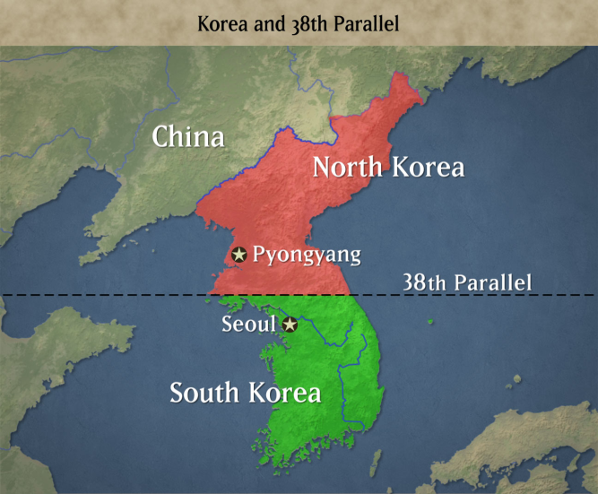
North Korea v. South Korea
Divided after WWII
  Fighting starts in 1950
Communist North
Capitalist South
Still divided today

Slide 4
North Korea Today
https://www.youtube.com/watch?v=mxLBywKrTf4

Slide 5
North Vietnam v.
South Vietnam
1954-1975
  Longest war in US history
Communist North
“American” South
  US didn’t want Vietnam to become communist
Communists won – still communist today

Slide 6
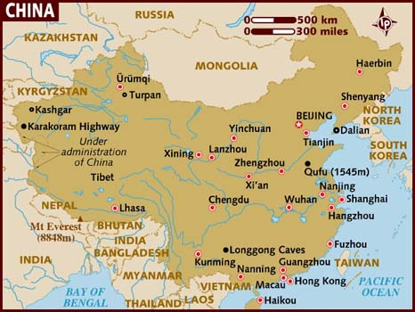
How did Korea & Vietnam’s geography expose them to communism?

Slide 7
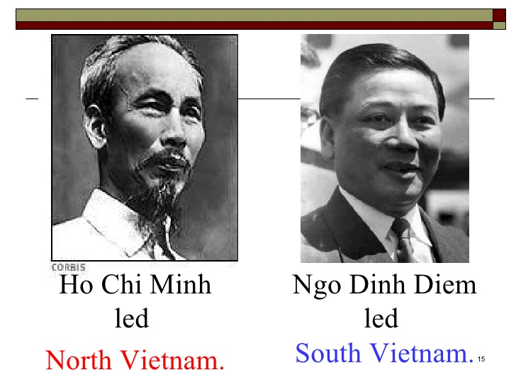
2 sides

Slide 8
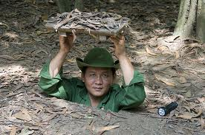
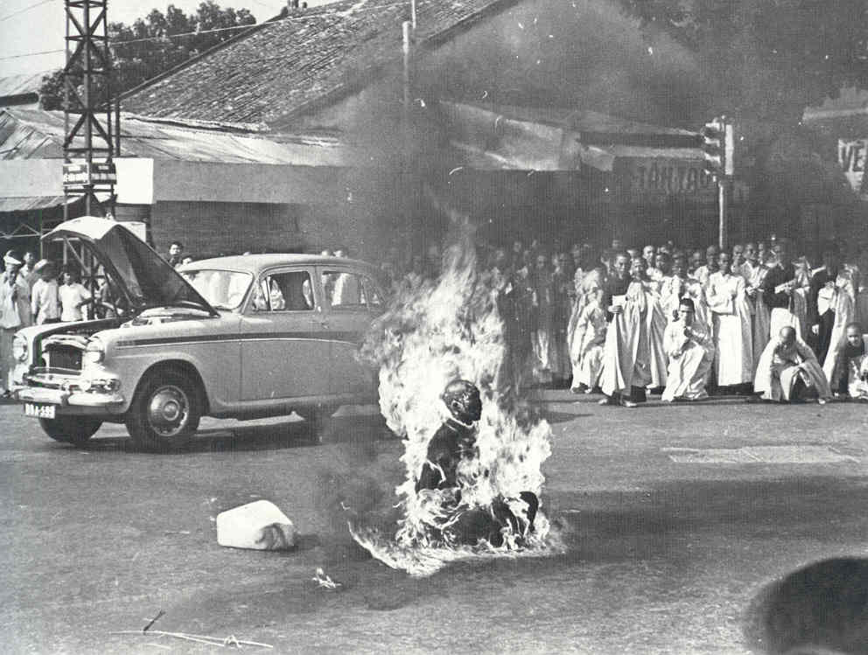
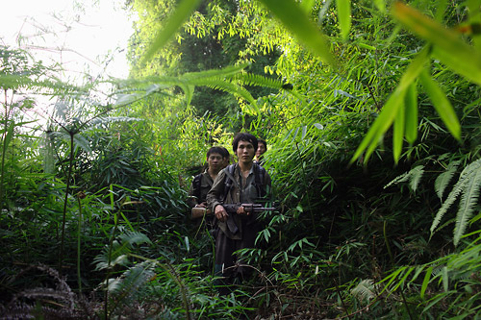
Vietnam War
US
Vietnam
US soldiers: Over 58,000 killed; 300,000 wounded; 800,000 PTSD
  Most were poor & drafted. Average age = 19.
Guerilla warfare
  Sneak attacks, use trees to hide…
Vietnam people: 2,000,000 died; 4,000,000 wounded; 10,000,000 displaced from homes
Notes:
Southern leader (Diem) = Catholic & persecuted Buddhists

Slide 9
Middle East & Africa

Slide 10
More fighting…
Middle East
  Egypt vs. Israel
  Iran
  Iraq, Syria, Libya
Africa
  Congo
  Angola
US = democracy
  Anti-communist
USSR = communism
  Anti-west

Slide 11
Latin America
Cuba
Nicaragua
Guatemala
El Salvador

Slide 12
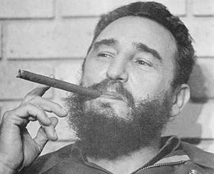
Cuba
1959: Fidel Castro takes over
Makes Cuba communist & allies with USSR
US tries to invade Cuba at the Bay of Pigs
  90 miles from Florida
  FAILED
USSR built nuclear missiles in Cuba until 1962
  Promised to remove them if US would stop invading Cuba
Still communist today

Slide 13
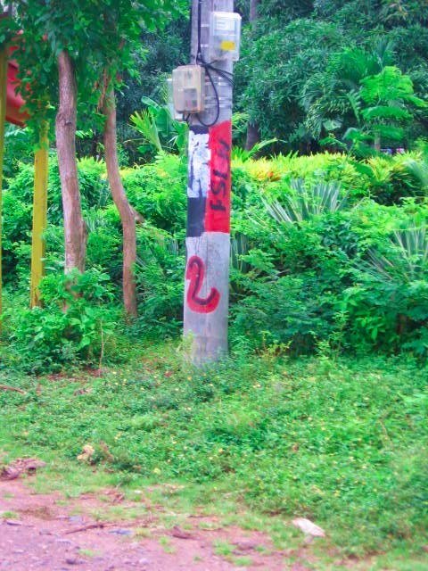
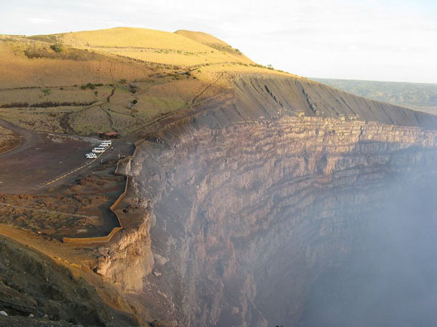
Nicaragua
Somoza Dictatorship: 1936-1979
  Took all money & land for Somoza family
  Killed Nicaraguans who didn't’t like him
Sandinista Rule: 1979-1990
  Socialist reforms
    Literacy program
    Took Somoza’s land & divided for all
US trained a group called the Contras to overthrow the Sandinistas
Feared spread of communism
Notes:
Rumor: used to fly political opponents over volcano & drop them in

Slide 14
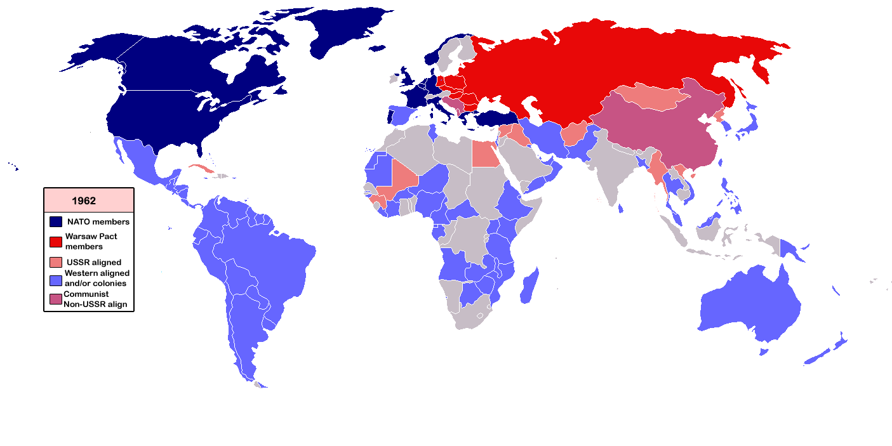
Nonaligned nations
NEUTRAL
  Stayed out of Cold War conflicts
India
Yugoslavia
Many African
nations

Slide 15

Where was the
United Nations?
Countries voted in blocs (east vs. west)
  Bloc: a combination of countries sharing a common purpose
  Less effective

