Slide 1
The Cold War Begins
Global 4
Ms. Lyons

Slide 2
NOW…
It’s 1945

Slide 3
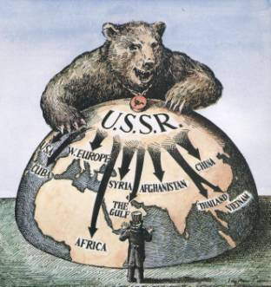
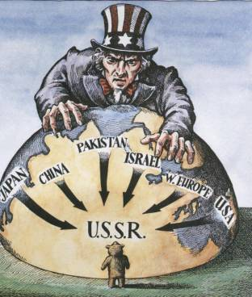
Superpowers
United States
Soviet Union (USSR)

Slide 4
No Fighting, All Talk

Slide 5
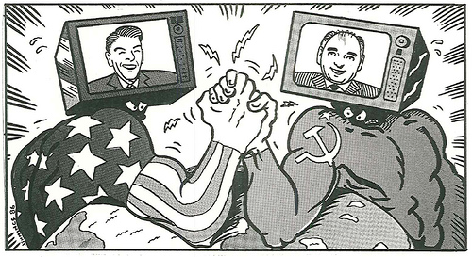
Cold War
United States
USSR
“The West”
Democracy, Capitalism
Feared spread of communism
Containment
“The East”
Communism
Growing power
Satellite states

Slide 6
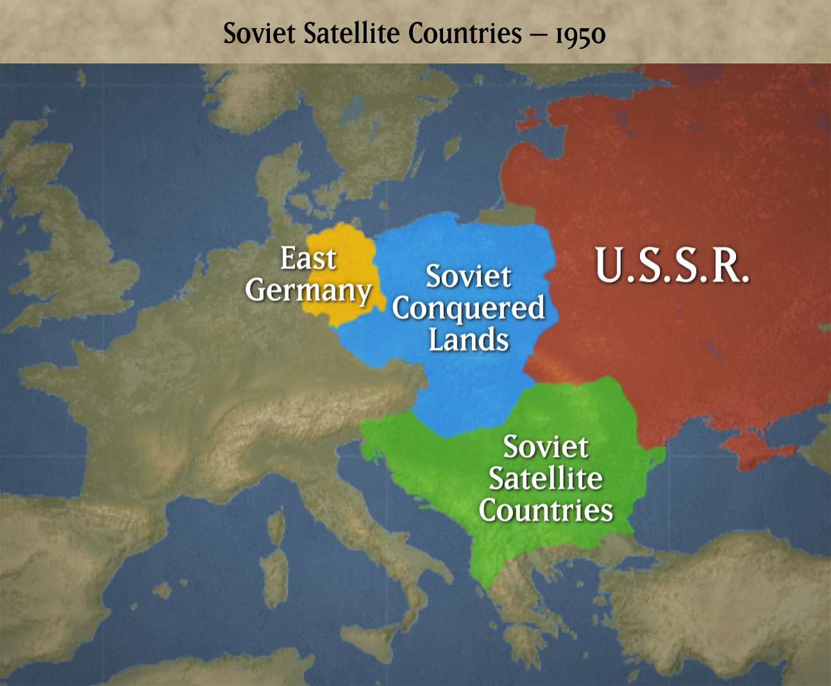
Notes:
Poland, Czechoslovakia, Hungary, Romania, Bulgaria

Slide 7
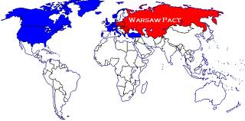
Alliances
NATO
Warsaw Pact
Western European countries
Defend against USSR
USSR & 7 satellite countries

Slide 8
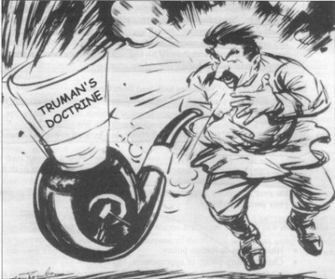
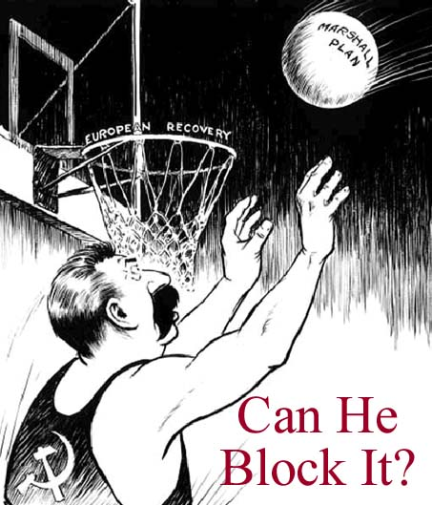
US Policies
Truman Doctrine (1947)
Containment
US will resist the expansion of communism
Marshall Plan (1947)
Give money to democratic
governments, so they won’t
want to become communist
Notes:
Is this slide needed? – Check amount of Regents question on this topic

Slide 9
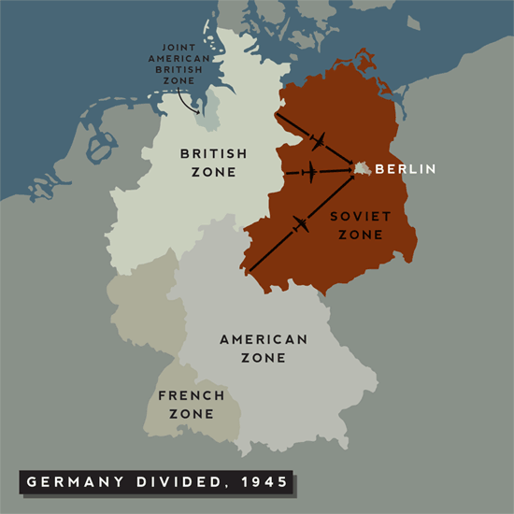
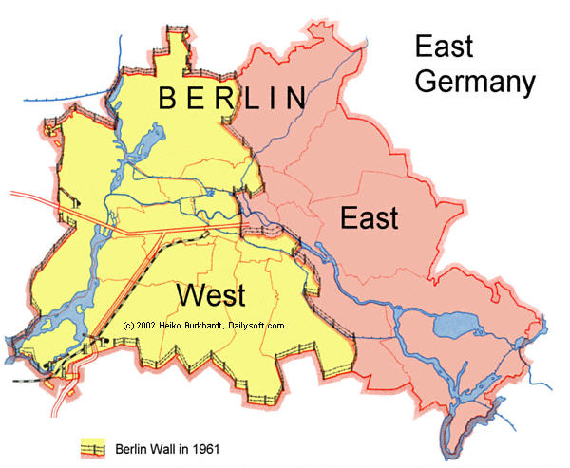
Berlin Blockade
Capital of Germany (East side)
USSR wanted all of Berlin
Tried to starve West Berlin by blocking all food trucks
US flew food in on airplanes
Notes:
Berlin was located 100 miles inside the Soviet occupation zone.[5] The Soviet zone produced much of Germany's food supply, while the territory of the British and American zones had to rely on food imports even before the war

Slide 10
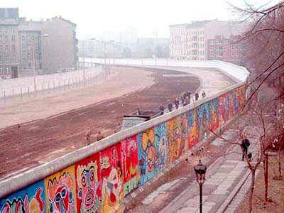
Berlin Wall
East Germany builds the Berlin Wall (1961)
Divides West & East Berlin
“Death Strip”
East German soldiers shot people trying to escape to the west
Notes:
Wall = 87 miles long
Death Strip – space between 2 fences with sand/gravel – easy to spot footprints, clear shot for guards, see which guards neglected their duty if someone escaped

Slide 11
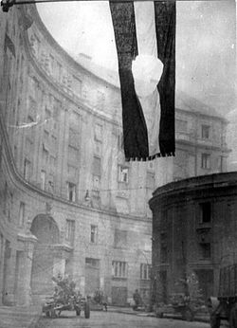
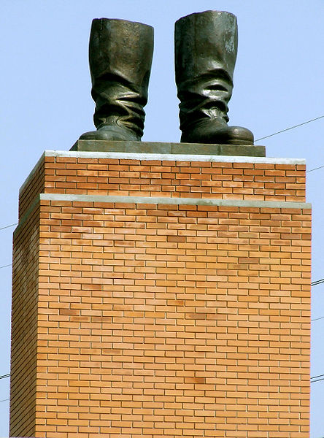
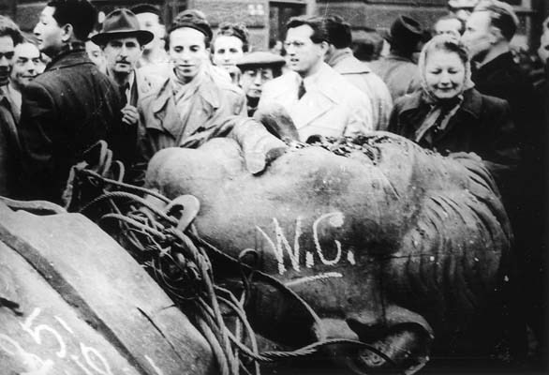
USSR Crushes Satellite Revolts
Hungary (1956)
Thousands killed
USSR forced them to return to communism after they tried to change their government
WHY IS THIS IMPORTANT?
Shows the USSR will use military power to keep communism alive
Notes:
Czechoslovakia too

Slide 12
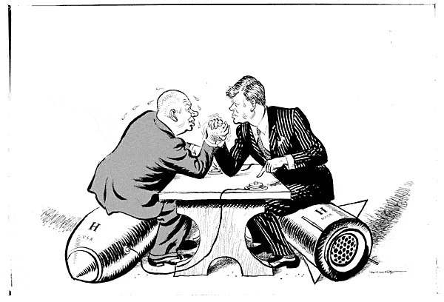
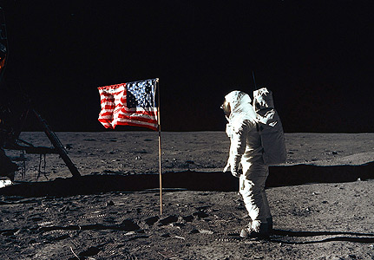
We Want to be Better at Everything!
ARMS RACE
US made atomic bomb
USSR copies
SPACE RACE
Sputnik (USSR starts exploring space)
NASA (US copies)

