Slide 1
China’s Cultural Revolution
Global 4
Ms. Lyons

Slide 2
History of China
Isolated
mountains, oceans, deserts, jungles, Great Wall
1899: Open Door Policy
gave western countries influence
1899: Boxer Rebellion
tried to kick out foreigners, failed
1911: Nationalist party overthrows Qing dynasty
democracy led by Sun Yixian
Notes:
1. How and why did Nationalism develop in China in the early 1900s?
2. Why did Sun Yixian receive vast support for overthrowing the Qing Empire which had existed for almost 300 years?

Slide 3
History of China…
1919: Treaty of Versailles
gives some of China’s land to Japan
1919: May Fourth Movement
Students protest Japan in China
Notes:
How did WWI affect China?

Slide 4
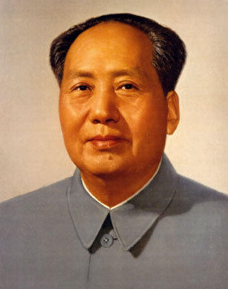
Mao Zedong forms Communist Party
1921
Wanted centralized government to control education, agriculture, & society
Split land up equally

Slide 5
Civil War
1930 = WAR: Communists vs. Nationalists
Mao Zedong vs. Jiang Jieshi
1934: The Long March
Nationalists chase Communists 6,000 miles through China
30,000 survived out of 100,000

Slide 6
Communists Take Over
1949: Mao Zedong creates People’s Republic of China
Nationalists flee to Taiwan
“2 Chinas” today
Notes:
How did Mao Zedong and the Communists win the Civil War?

Slide 7
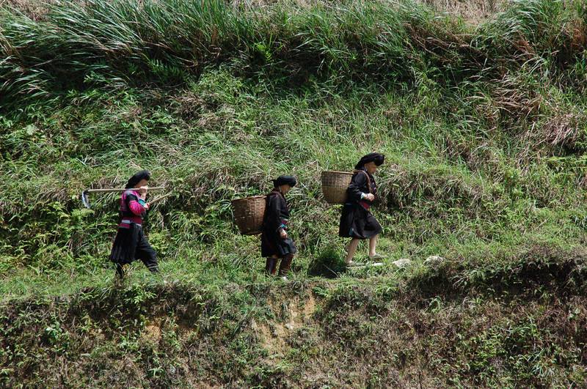
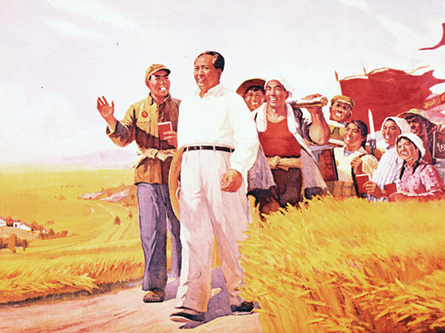
Why was Mao successful?
Promised land to peasants
Gave women more rights (than Confucianism)
Strong army (guerrilla warfare)
People didn’t like Nationalist gov’t
Let foreigners take over

Slide 8
Communist Reforms
All resources go towards political, social, & economic growth of the country
Move from agricultural society → industrialized
Peasants get healthcare
Build schools
Dictatorship
Censorship of media
Notes:
Reforms: to change something
Censorship: edit out things you don’t want people to hear/see
Industrialized: factories & technology, make things with machines (Industrial Revolution in Great Britain, 1750)

Slide 9
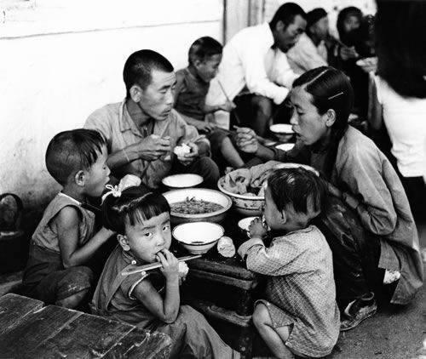
Great Leap Forward
1958
Goal: Increase agriculture and industry
Communes
Everyone shares land (lives & works together)
Production quotas
EFFECTS:
Low quality goods
Mass starvation
Notes:
Quotas: minimum # (you have to make this many things before you can stop working)
What other revolution does the Great Leap Forward remind you of?

Slide 10
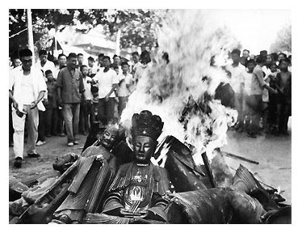
Cultural Revolution
GOAL: increase loyalty to communism
Reject the “Four Olds”
Ideas
Cultures
Manners
Customs

Slide 11
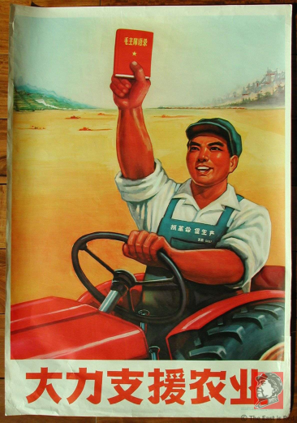
The Little Red Book
Quotations from Chairman Mao (1964)
All Chinese citizens must own it, read it, & carry it all times
PUNISHMENT: beating, years at a hard-labor camp
Studied it in school & at work

Slide 12
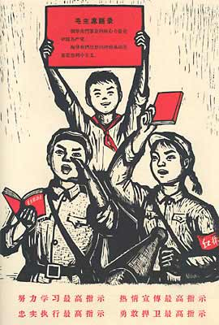
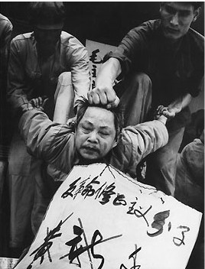
Red Guards
Started as students accusing their teachers of “intellectual elitism”
Mao’s “army” of students
Violent towards people who went against Mao
Public humiliation

Slide 13
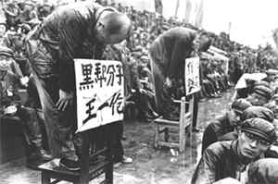
Effects of Cultural Revolution
Slowed the economy
Created fear

Slide 14
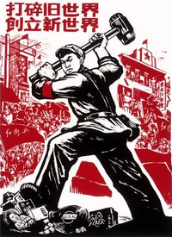
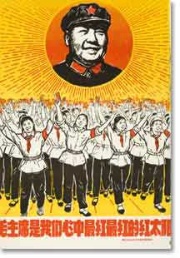
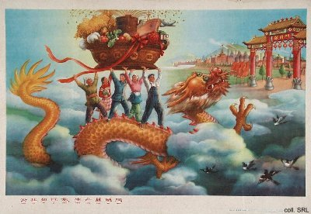
Propaganda
Form of communication that aims to influence the attitudes of a community
Notes:
"Destroy the old world; Forge the new world." A Red Guard crushes the crucifix, Buddha, and classical Chinese texts with his hammer; 1967.

Slide 15
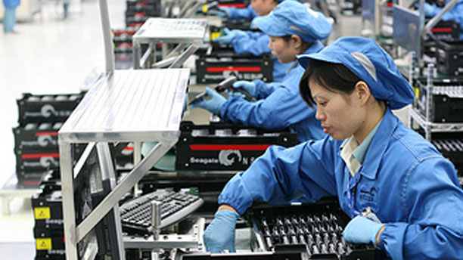
After Mao Dies…
1976: Deng Xioping takes over
Economic Reforms
4 modernizations
Farming
Industry
Science/Technology
Defense
More private property & more foreign investment

Slide 16
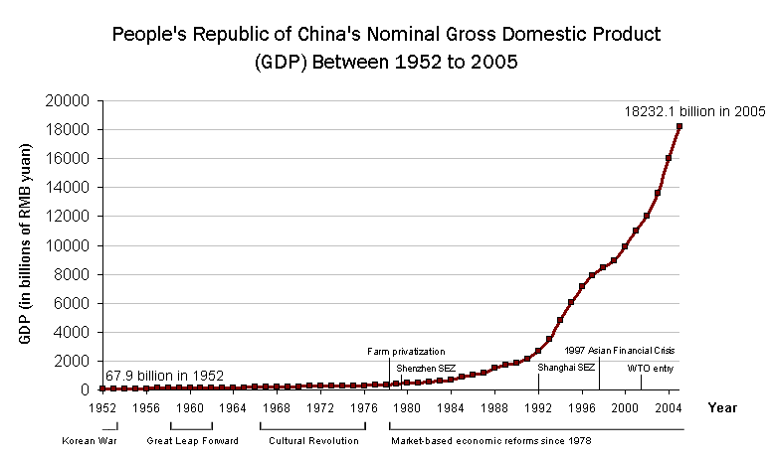
Effects of 4 Modernizations
Better economy & standard of living
More trade
More crime
More inequality
Rich & poor

Slide 17
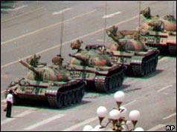
Tiananmen Square
May 1989 in Beijing
Protestors demanded more rights & freedoms
Thousands were killed by tanks & troops

Slide 18
Today in China
Not allowed to talk about the Cultural Revolution
Media Censorship

Slide 19
Next 2 weeks…

