Slide 1
Before the Cold War Begins…
Global 4
Ms. Lyons

Slide 2
RECAP
After World War II…

Slide 3
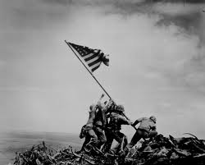
World War II just ended…

Slide 4
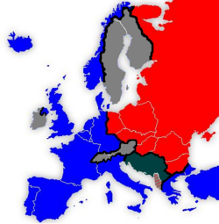
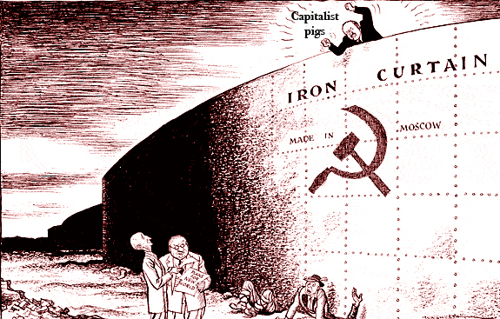
Europe is Divided by an “Iron Curtain”
WEST SIDE
EAST SIDE
US & Great Britain
Democracy
USSR (Soviet Union)
Stalin
Communism

Slide 5
The “Iron Curtain” goes through Germany

Slide 6
Berlin (capital of Germany) was divided

Slide 7
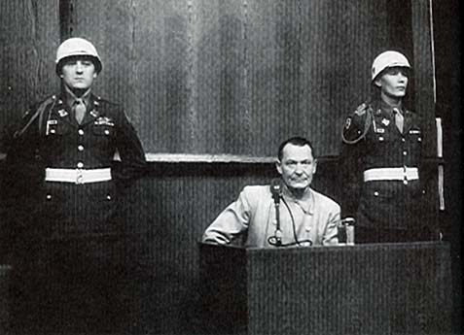
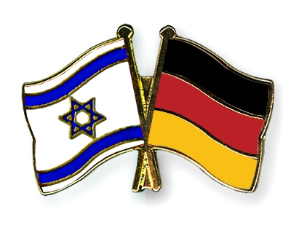
West Germany
The Nazi party is outlawed
Nuremberg trials
punish war criminals
Wrote a new constitution
Became a republic
Notes:
Israel is formed – West Germany befriends them
Gave money to some victims as an apology

Slide 8
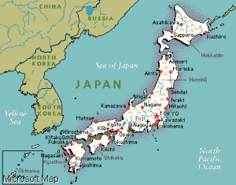
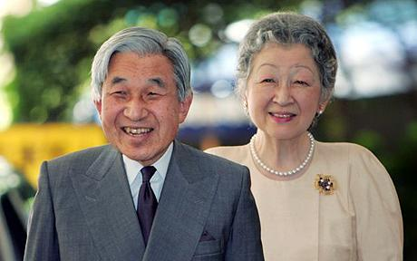
Japan
No more military
US wrote a new constitution for them
Constitutional monarchy
Emperor has less power

Slide 9
Economic Systems
Capitalism
Communism
Individualism
Profit
Laissez-faire (no government rules)
Lots of inequality
AKA: “market” economy
Community (everyone)
Sharing
Government controls everything
All equal
AKA: “command” economy

