Slide 1
Asian Independence Week 2-6: Part 4
Global 4
Ms. Lyons

Slide 2
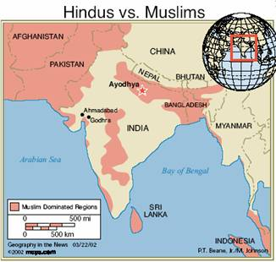
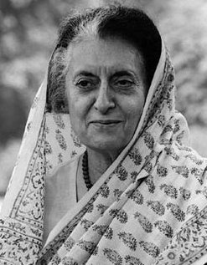
India gains independence!
1947: free from Great Britain
Muslims vs. Hindus
Muslim Pakistan created
Muslims & Hindus killed crossing the border
Gandhi assassinated by a Hindu fanatic
World’s largest democracy
Indira Gandi (woman as prime minister!)
Caste system
1950 constitution: illegal to discriminate by caste
affirmative action
Still discrimination today (more in rural areas)
Women
1950 constitution: women can vote, divorce, inherit property

Slide 3
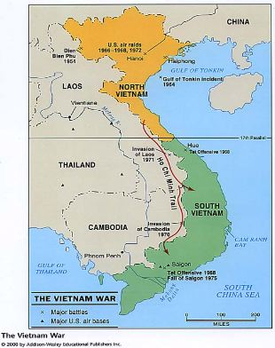
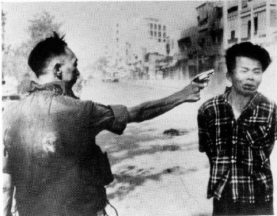
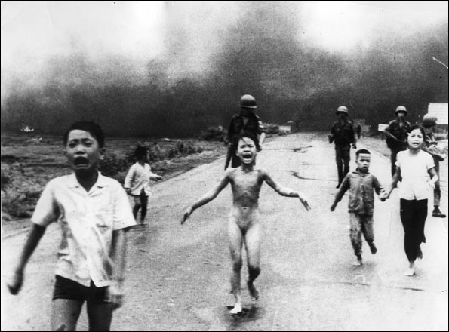
Vietnam War
Ho Chi Minh = leader
Divided
north (communism)
south (non-communism)
North invades South: WAR!
US sends troops to South, but they lose
Added to Cold War tension

Slide 4
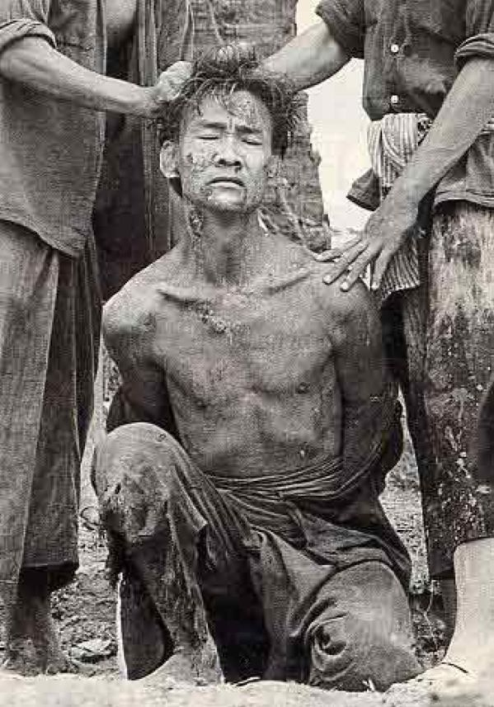
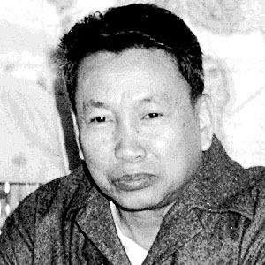
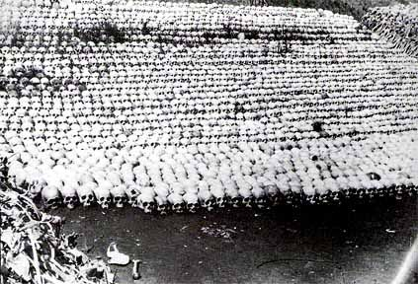
Cambodia
Khemer Rouge (communist guerillas) took control of gov’t
Pol Pot (leader)
Reign of terror to remove western influence
1 million Cambodians killed
Starvation, curable disease, genocide

Slide 5
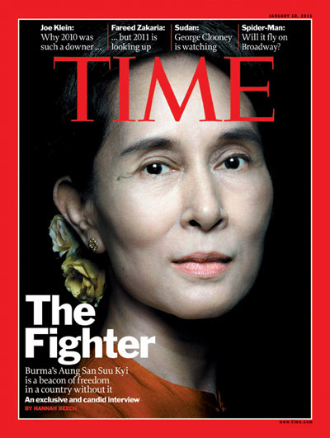
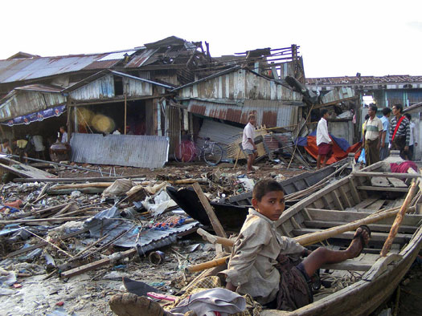
Myanmar (formerly Burma)
Mid-1900’s: independent from Great Britain
Poor country, low standard of living
Ethnic tensions, repressive military
Opposition led by: Aung San Suukyi
put in jail for 7 years

