Slide 1
African Independence Week 2-6: Part 3
Global 4
Ms. Lyons

Slide 2
Pan-Africanism
Started in 1920’s – united Africans everywhere
Atlantic Charter
FDR & Churchill signed
Self-determination
All nations should be able
to rule themselves

Slide 3
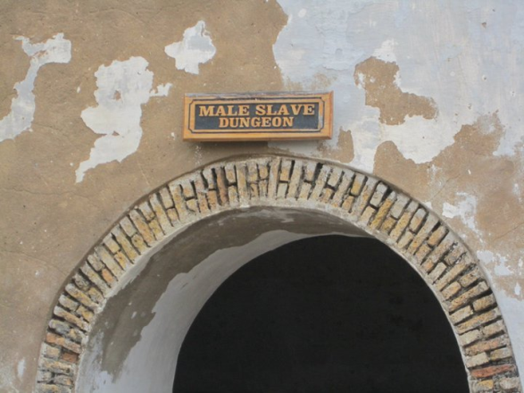
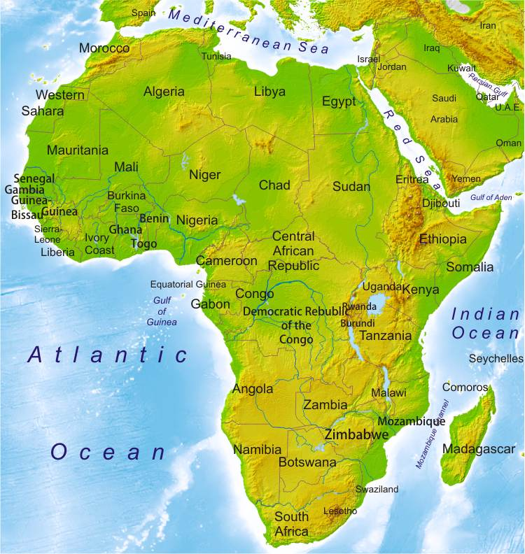
African independence
Ghana (1957)
Kwame Nkrumah = leader
Renamed country from “Gold Coast”
Formed the Organization of African Unity
Kenya (1963)
Jomo Kenyatta = leader
Algeria (1962)
Muslim nationalists vs.
French colonizers

Slide 4
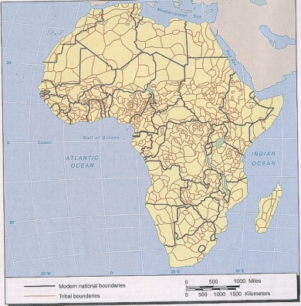
Not easy in all African countries…
Civil wars over religious/ethnic tensions
Didn’t care about tribal boundaries when making the countries’ borders
Examples: Nigeria, Chechnya, Azerbaijan, & Bosnia

Slide 5
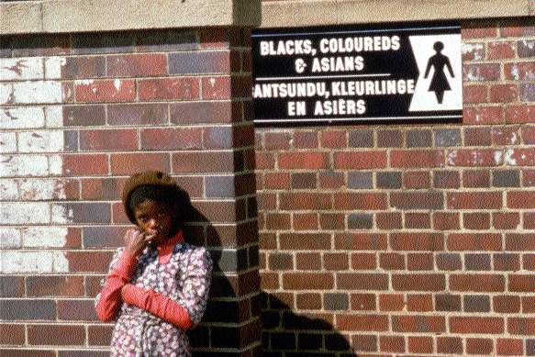
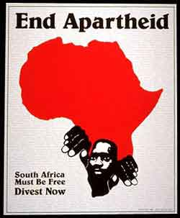
Apartheid in South Africa
1910: independent
1948: apartheid
Segregation:
blacks & coloreds must live in poor townships
separate trains/schools
no interracial marriage

Slide 6
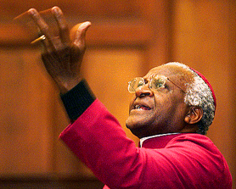
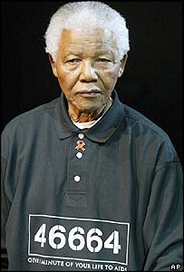
People who fought against Apartheid
Nelson Mandela
Leader of African National Congress (political party)
Civil disobedience
Jailed: 1964-1990
Desmond Tutu
Told foreign investors to stop giving money to segregated SA
F.W. de Klerk
President of SA (1989) repealed segregation & released Mandela
1994: all races can vote
Mandela is voted president!

Slide 7
