Slide 1
World War I
Global 3
Ms. Lyons

Slide 2
Remember how Nationalism…
UNITES & DIVIDES
The Ottoman Empire was super HUGE & had many different groups of people.
The different groups DIVIDED & the empire started falling apart.
Nickname: “Sick Man of Europe”
European countries wanted to imperialize it!

Slide 3
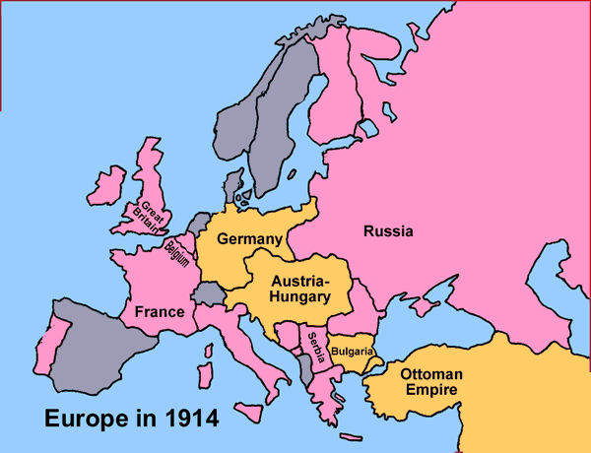
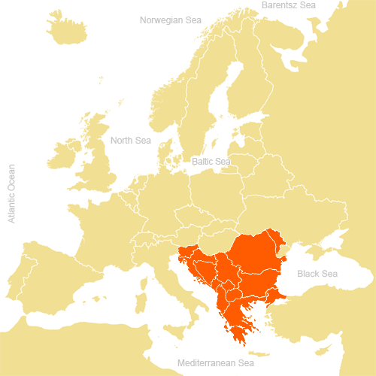
Balkans: “Powder Keg”
Balkans: area in the Ottoman Empire
Serbia broke free, supported by Russia.
Wanted to take Bosnia, BUT Austria-Hungary controlled it.
Serbian nationalists formed a secret group called the Black Hand, who worked to defeat Austria-Hungary.

Slide 4
What Exactly Caused the War?

Slide 5
Long-Term Causes: “MAIN”
Militarism:
All countries made their militaries BIGGER
NOW: more likely to use violence to solve problems
Alliances:
Agree to defend others if a fight breaks out
Imperialism:
European countries were competing for colonies (Asia, Africa…)
Nationalism:
Germany & France: each PROUD of own nation & wanted to be stronger
Russian & Balkan people shared a similar culture → wanted to UNITE

Slide 6
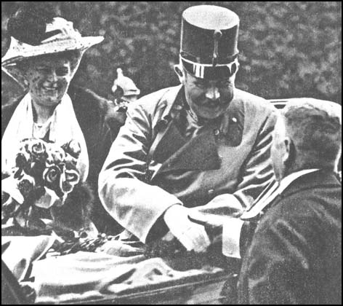
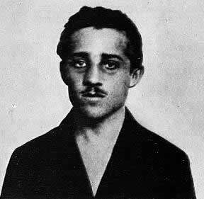
Short-Term Cause: Assassination
REMEMBER:
Austria-Hungary still controls Bosnia (country in the Balkans)
June 28, 1914:
Archduke Franz Ferdinand (next king of Austria) & his wife visit Bosnia.
Member of the Black Hand shot the Archduke & his wife. They both died.
The killer: Gavrilo Princip (20 years old)

Slide 7
Alliances…
Central Powers
Allies
Germany
Austria-Hungary
Ottoman Empire
Britain
France
Russia
Italy & US join later

Slide 8
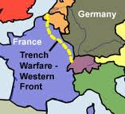
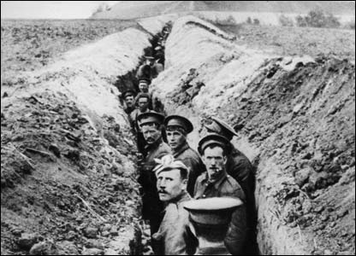
Industrialized War
New Inventions
Dynamite, airplanes, machine guns, tanks, poison gas
A lot of DESTRUCTION
Trench Warfare
Both sides dug long tunnels
For 4 years, no one moved forward, but many soldiers died

Slide 9
How did the war affect civilians?

Slide 10
Total War
Style of war that affects all aspects of life for soldiers and civilians.
Targets of attacks
Give resources (money, food, etc.)
Governments took control of economies

Slide 11
Turning Points of the War
April 1917: US enters the war!
Germany had killed US citizens on cruise ships with their submarine warfare.
1918: Russia drops out of the war.
The people of Russia revolted!
So… The ALLIES WIN!

Slide 12
Costs of War
November 11, 1918
All countries signed an armistice (agreed to stop fighting).
Human Cost:
Over 8.5 million people died
Over 17 million wounded
Economic Cost:
Factories, farms, & homes destroyed
Nations had huge war debts to repay

Slide 13
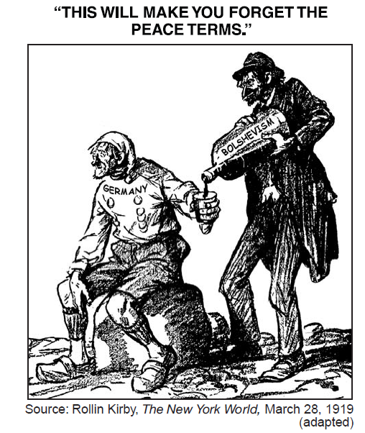
Effects of World War I
Treaty of Versailles
Germany has to take ALL responsibility
give up land & military
pay reparations
League of Nations (1st draft of the United Nations)
US never joined
didn’t want to get into future wars

Slide 14
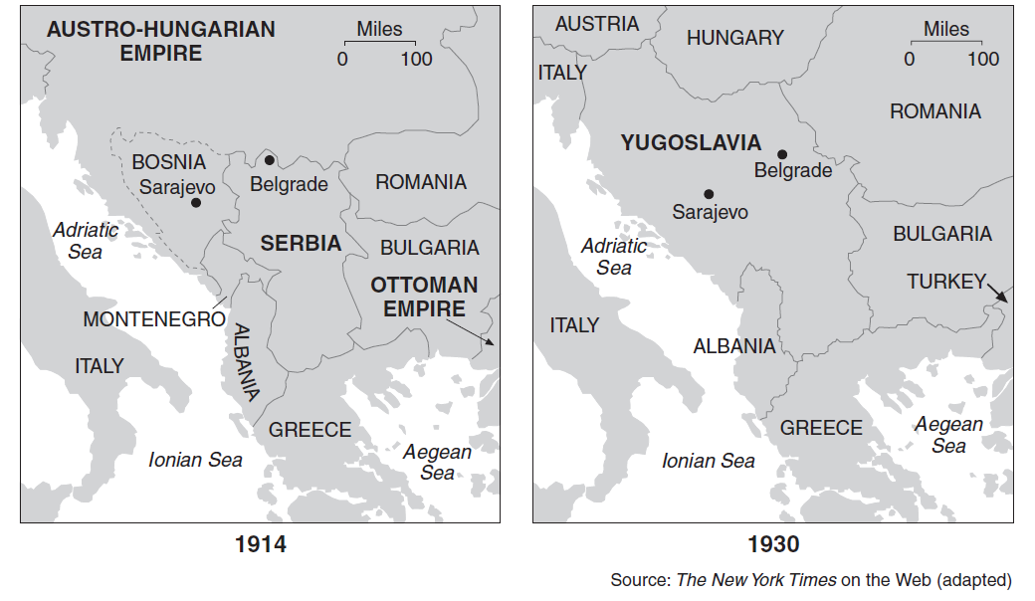
Collapse of Empires

