Slide 1
World War II
GLOBAL 3
MS. LYONS

Slide 2
WORLD WAR II
1939-1945

Slide 3
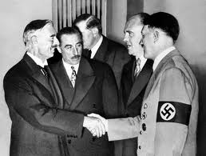
Causes of WWII
Military aggression
Italy, Germany, & Japan taking land
League of Nations was weak
No military to enforce rules
Appeasement by the Allies
Munich Conference (1938)
Hitler could keep what land he had already taken
Had to promise not to take any more

Slide 4
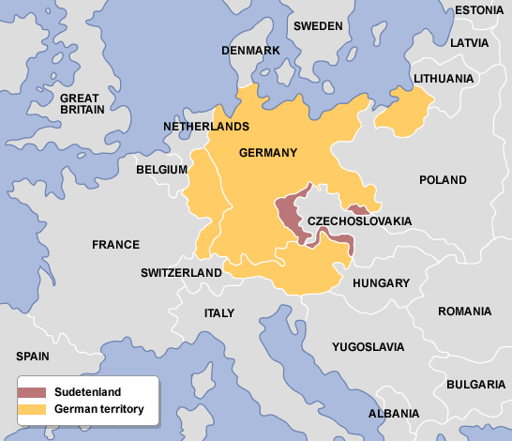
Just started with the mountains…
Sudetenland (edge of Czechoslovakia)

Slide 5
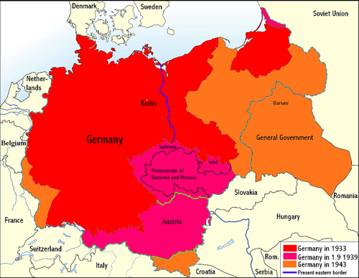
Did Hitler keep his promise?
1939:
Hitler takes the rest of Czechoslovakia
Then quickly invades Poland
Blitzkrieg – “lightning war”
Quick & forceful attack

Slide 6
1939: World War II Starts!
AXIS
ALLIES
Japan
Italy
Germany
Britain
France
Later (1941):
US
USSR

Slide 7
2 Areas of Fighting
Europe
Pacific
Germany
Italy
Japan

Slide 8
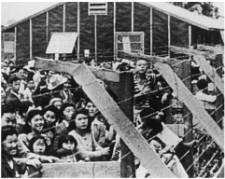
What was World War II like?
More technology = more destruction
Atomic bomb
Total war – both sides targeted cities to bomb
Germany bombed city of London
Governments took more power
Controlled economy
Limited rights of people
In US: Japanese -Americans were forced into internment camps
Women worked in factories & in army!

Slide 9
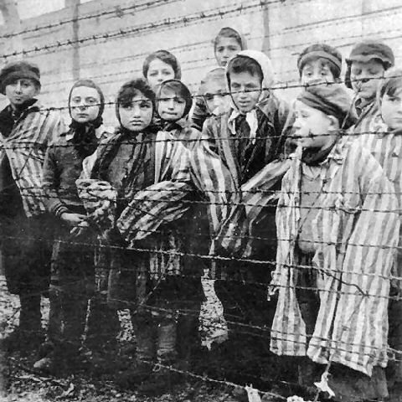
The Holocaust
Hitler thought Germans were the best race
Genocide: attempt to destroy an entire ethnic/religious group
Jews
Russians, Gypsies, mentally/physically disabled, gays
Kristallnacht: organized violence against Jews (start of the Holocaust)
1,000s of Jewish synagogues, businesses, homes, schools = destroyed
Concentration camps
Auschwitz: Jews starved, shot, gassed to death
Over 6million died in the Holocaust

Slide 10
Germany’s Battle Record
1940: Took over Paris, France
Lost it
1940: Battle of Britain
Had to take out British airplanes before invading on land
Hitler bombs city of London because he can’t beat Britain’s airplanes
Lasted over 1 month
Germany lost

Slide 11
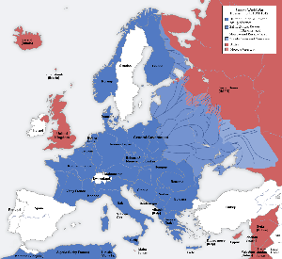
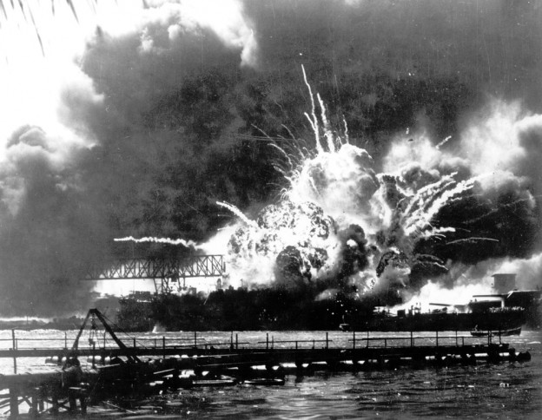
Axis Mistakes
1941: Germany attacks Russia – opens 2 fronts in Europe
Battle of Stalingrad
Russia is too cold! (-29 degrees!)
1941: Japan bombs Pearl Harbor
US joins war

Slide 12
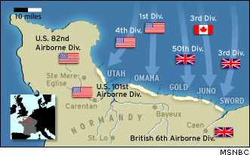
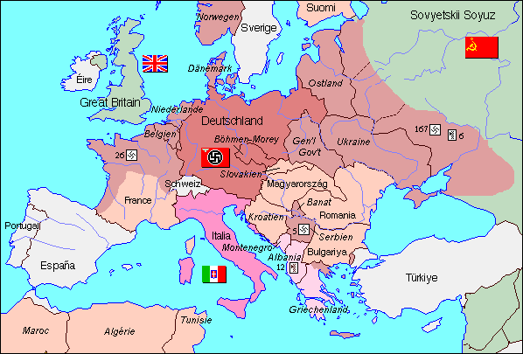
D-Day
Invasion of Normandy
Allies invaded France on June 6, 1944
Freed France from Germans
Allies then pushed into Germany

Slide 13
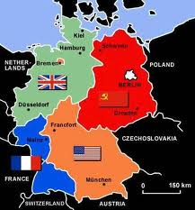
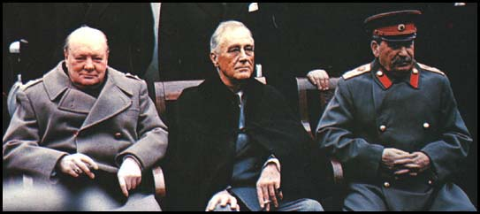
War Ends in Europe
May 7, 1945 – Germans surrendered
Yalta Conference (Feb. 1945)
FDR, Stalin, Churchill met to divide Germany
British, French, & US would each control a zone in the West
USSR would get a zone in the East

Slide 14
War Ends in the Pacific
August 1945 in Pacific – Japan surrendered
Atomic Bombs:
Japan refused to surrender
August 6, 1945: US dropped atomic bomb on Hiroshima
Flattened 4 sq. miles of city & killed 70,000 people
Dropped another bomb on Nagasaki (killing 40,000)
Aug. 10, 1945: emperor Hirohito surrendered

Slide 15
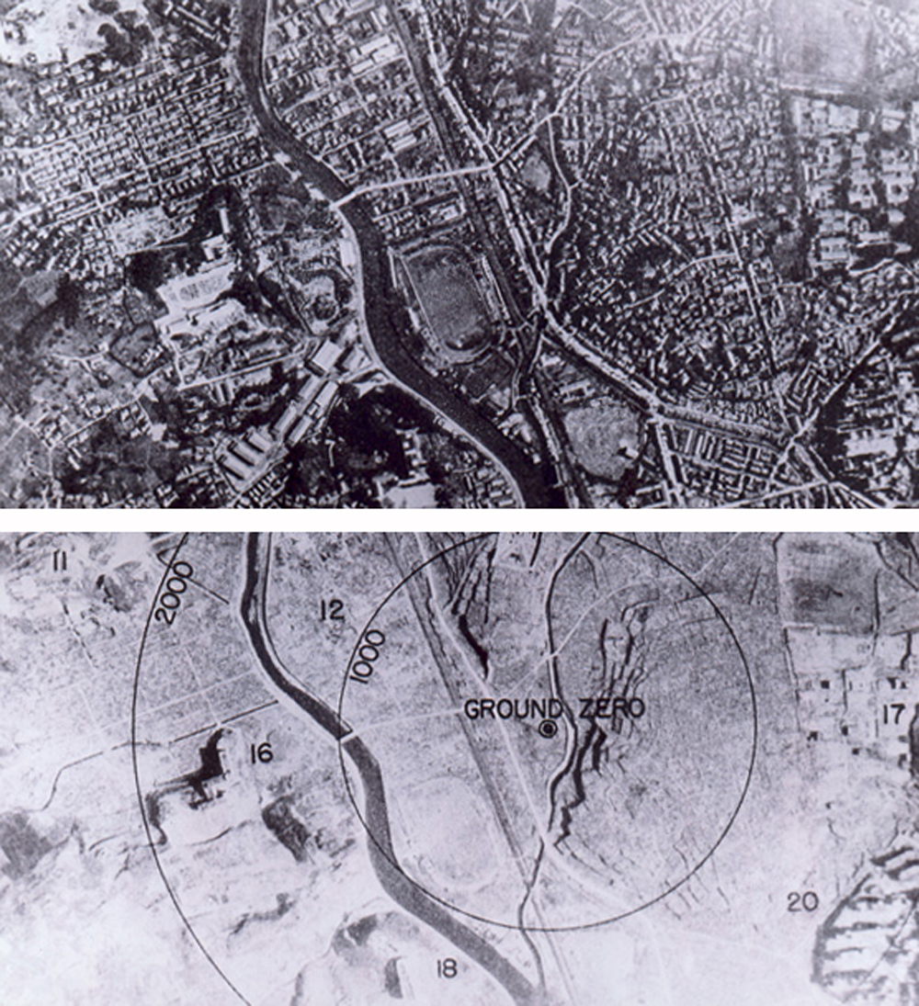
Atomic Bomb Test Footage
Youtube clip:
https://www.youtube.com/watch?v=RqyBzXYZPoM

Slide 16
Now that the War is Over, Who Should We Blame for the Holocaust?
Nazi officers – told people to kill, but never killed anyone themselves
Nazis soldiers – physically killed Jewish people when they were told to do so by the officers
German citizens – knew what was going on, but never tried to stop it

Slide 17
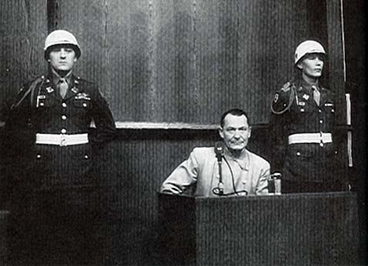
Nuremburg Trials
Allies wanted to punish people for war crimes.
Hitler had committed suicide, but he wasn’t the only one responsible for the Holocaust.
Nuremburg, Germany: (1945-1946)
22 Nazi leaders were tried
Some got death penalty, some got prison
IMPORTANT because: even if you didn’t kill people, if you gave the orders, you are still responsible.

Slide 18
United Nations is Formed
Created in April 1945
PURPOSE: provide a place to discuss world problems & develop solutions
PEACE!

Slide 19
IMPACT OF WWII:
Human Losses:
75 million died
Many were Jewish (died in concentration camps)
Economic Losses:
Cities were in ruins (air bombs)
Economies took a long time to recover

Slide 20
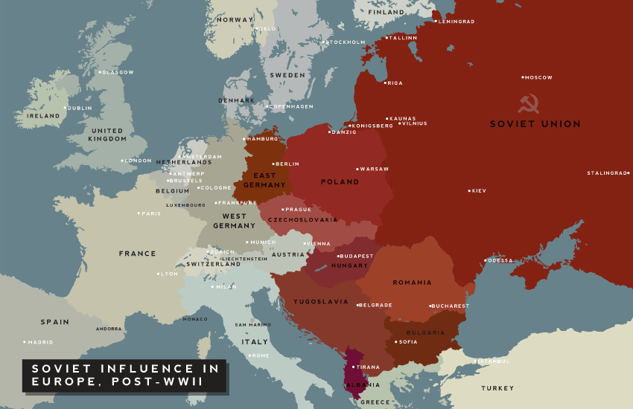
Europe is Divided
EUROPE = DIVIDED
Democracy in the West / Communism in the East

Slide 21
READING IDEAS…
George Orwell’s Animal Farm
totalitarian government
William Golding’s Lord of the Flies
human capacity for evil
Nevil Shute’s On the Beach
life after nuclear war

