Slide 1
Vocab 1-3
Global 3
Ms. Lyons

Slide 2
Flip to the back page

Slide 3
PREFIX: Before
Re- “again”
Repaint
Reread (read again)
YOUR PAPER
Re-
again
reread,

Slide 4
ROOT : word part from which other words grow
migr “moving to a new place”
Immigrant (person who moves into the country)
YOUR PAPER
migr
Moving to a new place
Immigrant,

Slide 5
ROOT : word part from which other words grow
phil “love”
Bibliophile (person who loves books)
YOUR PAPER
bibliophile,
phil
love

Slide 6
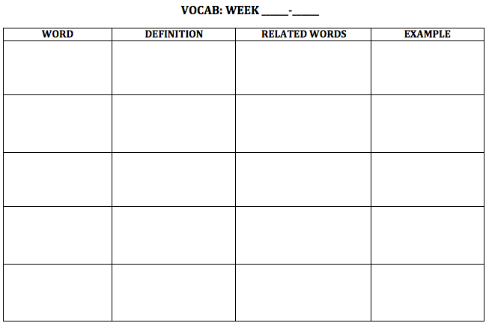
NEW WORDS!
Flip your paper over.
1
3

Slide 7
Emigration

Slide 8
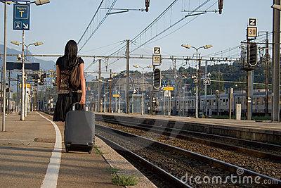
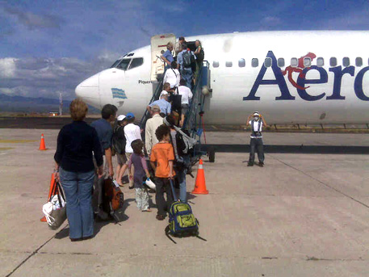
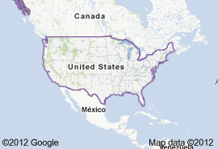
Emigration
Going OUT

Slide 9
Emigration
Definition: the act of moving out
Related words: outsiders, NY, Mexican
Example/Picture: write or draw your own

Slide 10
Divine

Slide 11
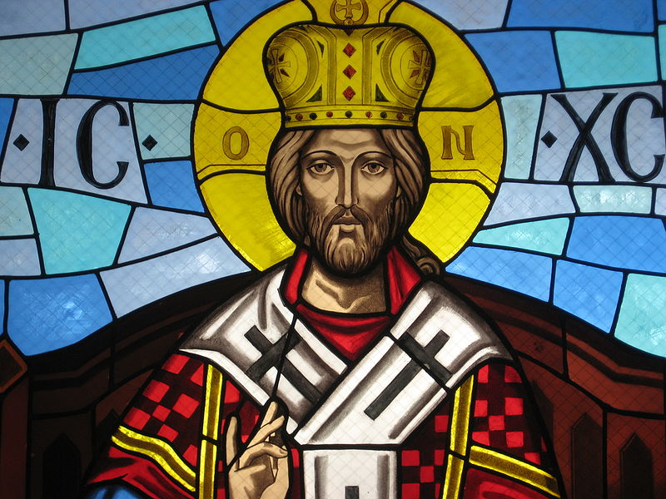
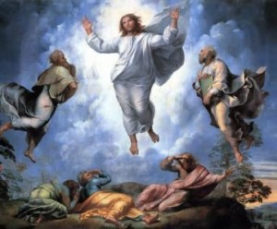
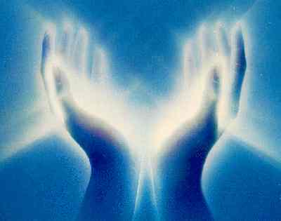
Divine

Slide 12
Divine
Definition: relating to God/religion
Related words: Jesus, atheist, church
Example/Picture: write or draw your own

Slide 13
Economy

Slide 14
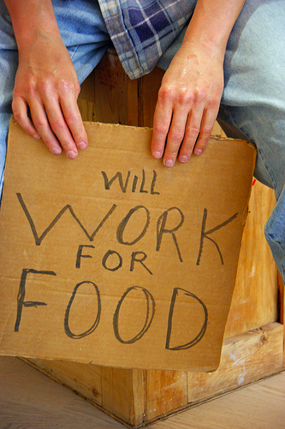
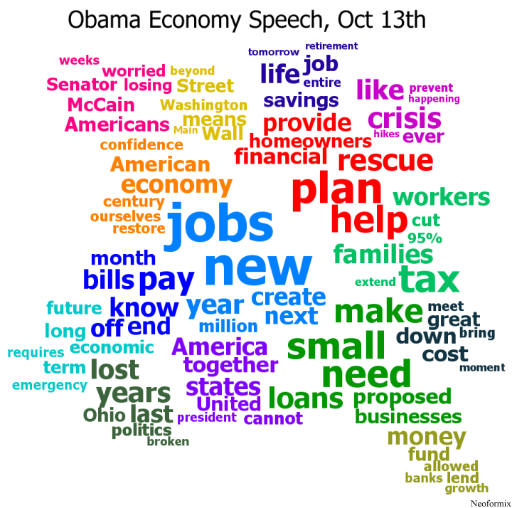
Economy

Slide 15
Economy
Definition: system of how people make money
Related words: jobs, government, $
Example/Picture: write or draw your own

Slide 16
Philosophy

Slide 17
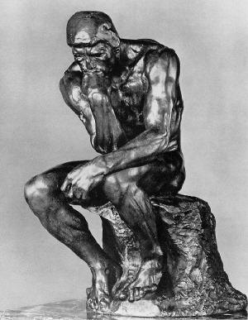
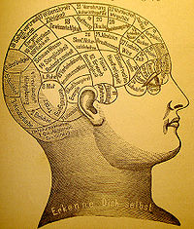
Philosophy

Slide 18
Philosophy
Definition: the love of wisdom (knowledge)
Related words: thinking, art, philosopher
Example/Picture: write or draw your own

Slide 19
Choose 16 words & write them (one per box)
In-
Mono-
Arch
Equi
-ism
Agri
Corp
-tion
-ian
Inequality
Monarch
Unification
Nationalism
Imperialism
Laissez-faire
Urbanization
Agrarian
Harbor
Corporation

