Slide 1
Vocab Week 1-2
Global 3 Ms. Lyons

Slide 2
ROOT : word part from which other words grow
agri “farming”
Agriculture (science or practice of farming)
YOUR PAPER
agri
farming
Agriculture,

Slide 3
ROOT : word part from which other words grow
corp “body”
Corpse, scorpion
Corps (group of people with a purpose)

Slide 4
SUFFIX: Added at the end of a word
-tion “action, state of being”
Multiplication, caution
Plantation (act of planting crops)
YOUR PAPER
Action, state of being
Plantation,
-tion

Slide 5
SUFFIX: Added at the end of a word
-ian “relating to, belonging to”
Italian, comedian
Totalitarian (type of government, related to idea of total control )

Slide 6
Laissez-faire

Slide 7
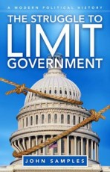
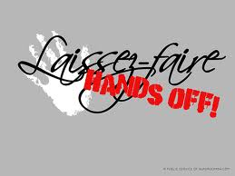
Laissez-faire

Slide 8
Laissez-faire
Definition: government keeps their hands off business
Related words: fair, lazy, control
Example/Picture: write or draw your own

Slide 9
Urbanization

Slide 10
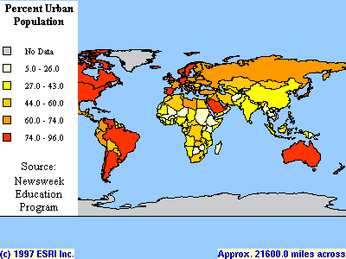
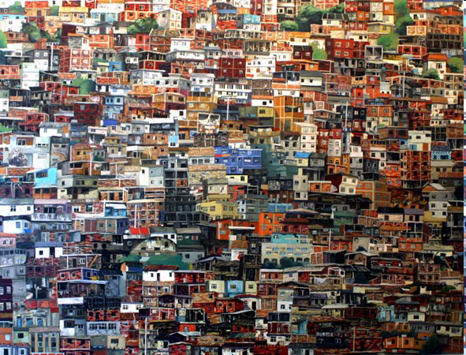
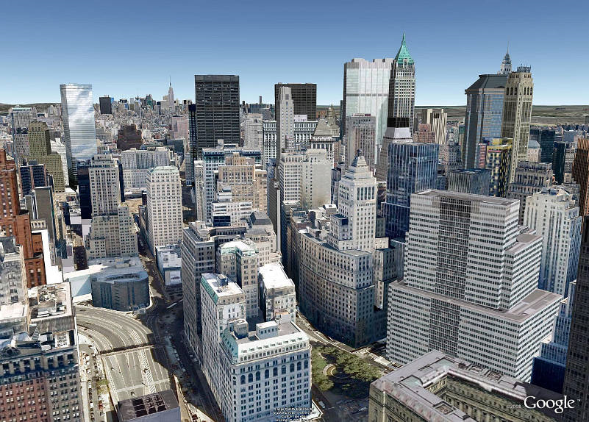
Urbanization

Slide 11
urbanization
Definition: people move to cities & cities grow
Related words: population, move, urban
Example/Picture: write or draw your own

Slide 12
AGRARIAN

Slide 13
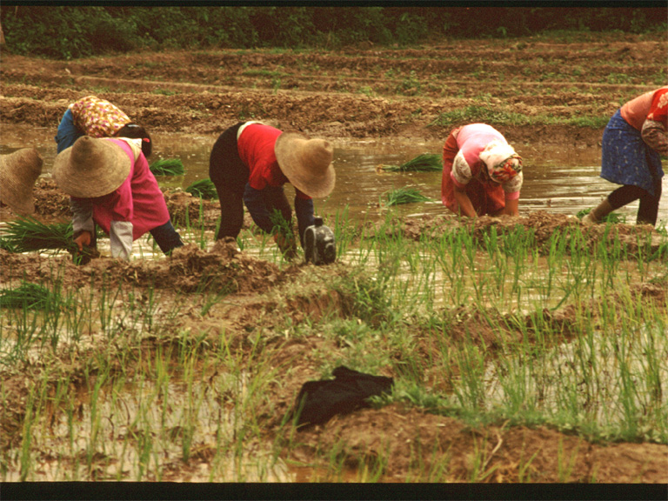
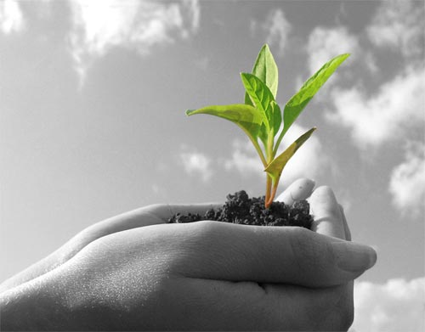
Agrarian

Slide 14
agrarian
Definition: relating to farming
Related words: agriculture, farm, corn
Example/Picture: write or draw your own

Slide 15
HARBOR

Slide 16
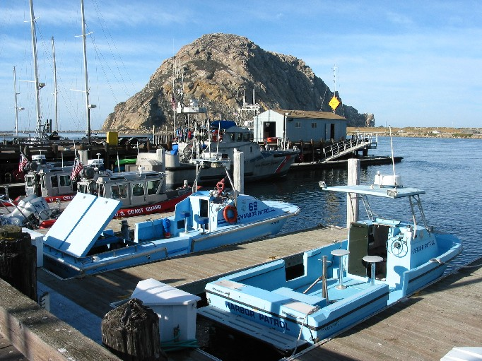
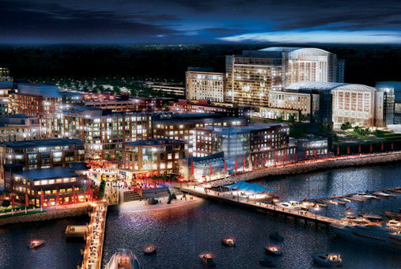
HARBOR

Slide 17
HARBOR
Definition: a place where ships come to trade
Related words: shore, birds, ocean
Example/Picture: write or draw your own

Slide 18
corporation

Slide 19
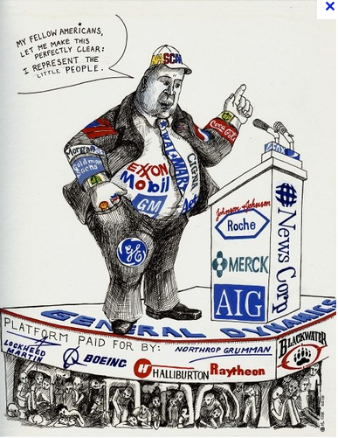
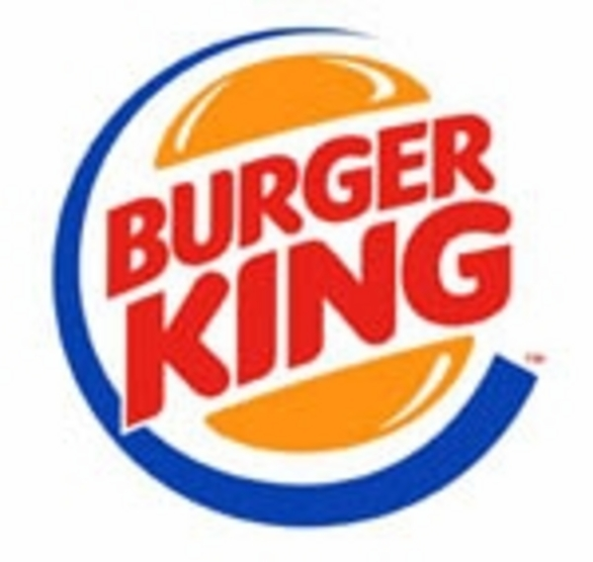
CORPORATION

Slide 20
Corporation
Definition: business that has been turned into a “person” legally
Related words: stores, companies, corpse
Example/Picture: write or draw your own

