Slide 1
VOCAB Week 1-1
Global 3
Ms. Lyons

Slide 2
UNFAIR
How many parts can I break this word into?
If we take out the first part, does the meaning change?

Slide 3
Flip to the back page

Slide 4
PREFIX: Before
2
In- “not”
Incorrect, incomplete
Intolerant (not tolerant)
1
YOUR PAPER
In-
Not
Intolerant,
3

Slide 5
PREFIX
Mono- “one”
Monologue, monocle
Monotheism (belief in one God)

Slide 6
ROOT : word part from which other words grow
arch “ruler”
Anarchy, hierarchy
Patriarch (men are rulers)
YOUR PAPER
arch
ruler
Patriarch,

Slide 7
ROOT
equi “equal”
Equilateral, equation
Equator (splits Earth into 2 equal parts)

Slide 8
SUFFIX: Added at the end of a word
-ism “belief”
Catholicism, racism
Communism (belief that gov’t should treat all people equally)
YOUR PAPER
Communism,
-ism
Belief

Slide 9
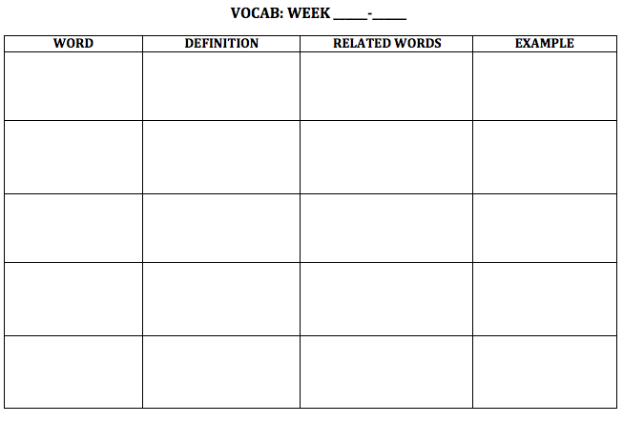
NEW WORDS!
Flip your paper over.
1
1

Slide 10
Inequality

Slide 11
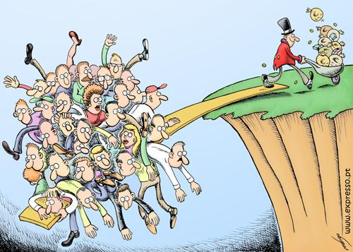
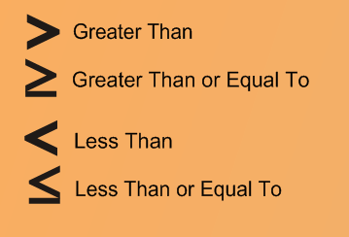
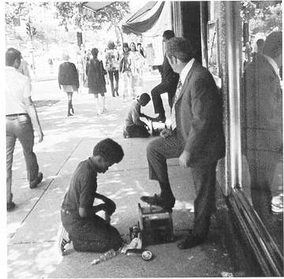
Inequality

Slide 12
Inequality
Definition:
Related words:
Example/Picture: write or draw your own

Slide 13
Monarch

Slide 14
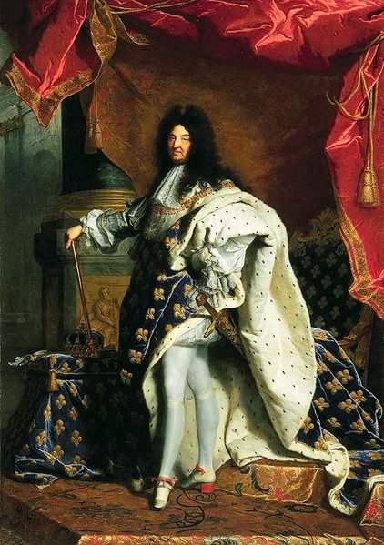
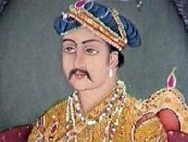
Monarch

Slide 15
Monarch
Definition:
Related words:
Example/Picture: write or draw your own

Slide 16
Unification

Slide 17
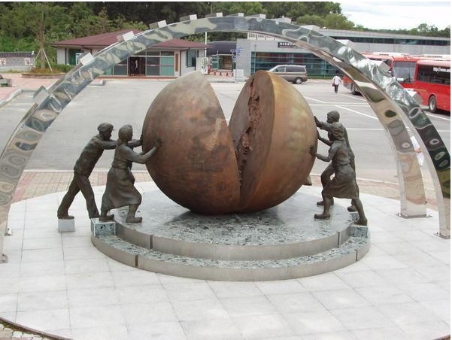
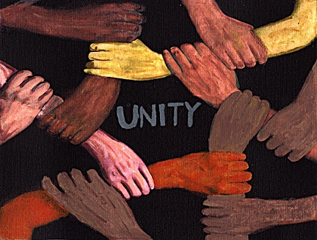
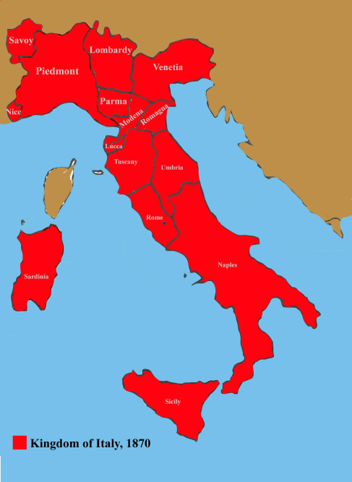
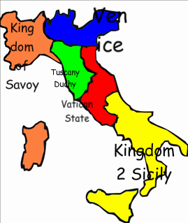
Unification

Slide 18
Unification
Definition:
Related words:
Example/Picture: write or draw your own

Slide 19
Nationalism

Slide 20
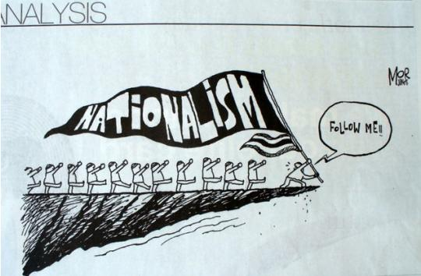
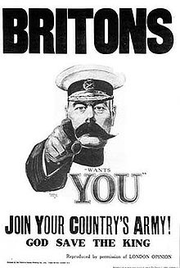
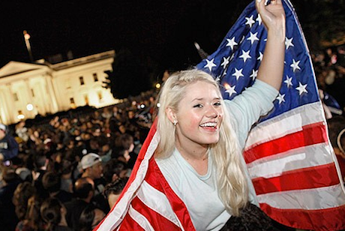
Nationalism

Slide 21
Nationalism
Definition:
Related words:
Example/Picture: write or draw your own

Slide 22
Imperialism

Slide 23
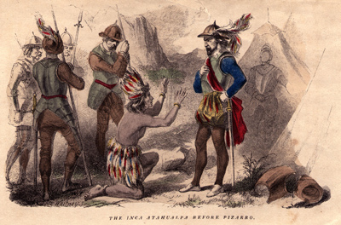
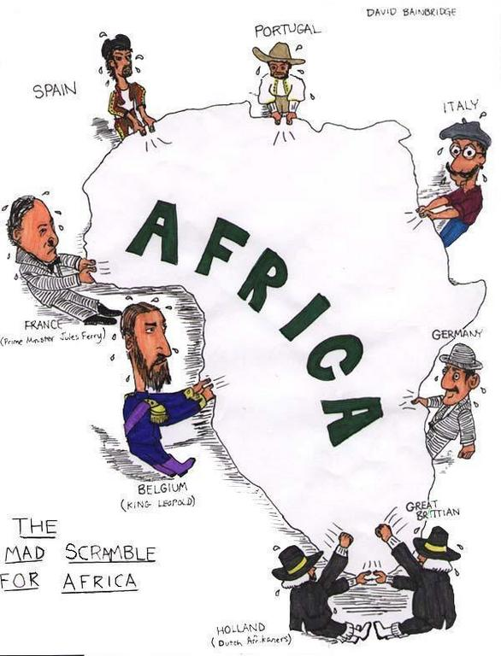
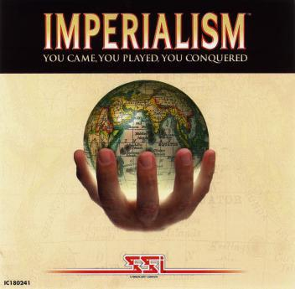
Imperialism

Slide 24
Imperialism
Definition:
Related words:
Example/Picture: write or draw your own

