Slide 1
Russian Revolution Week 1-6
Global 3
Ms. Lyons

Slide 2
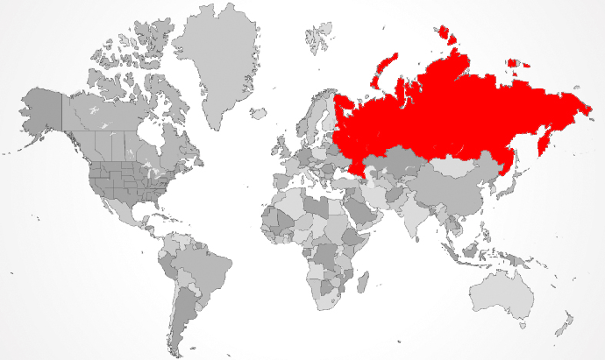

Slide 3
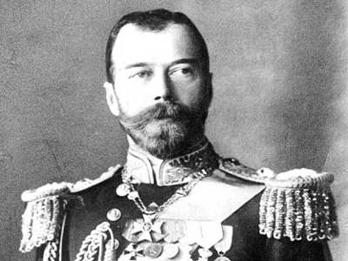
Life in Russia
Government: monarchy
Czars: rulers with total power
used secret police, harsh rule
Social classes: peasants were very poor

Slide 4
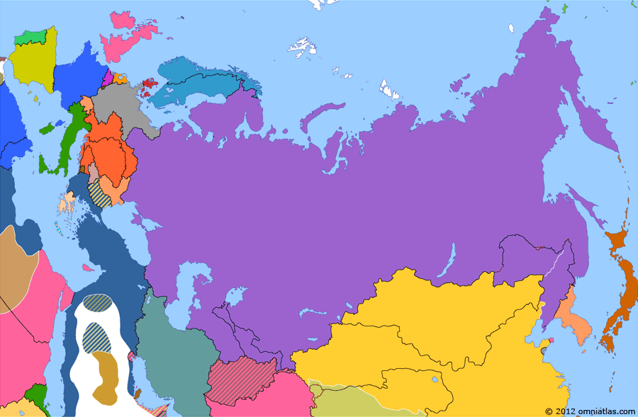
Russo-Japanese War
1904-5
Russia lost big time.
Gave up its sphere of influence in Korea to Japan
Czar looks weak and unorganized.
People lose faith in him.

Slide 5
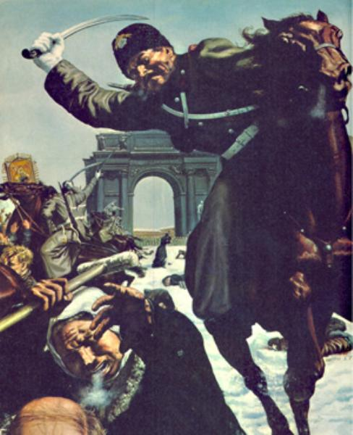
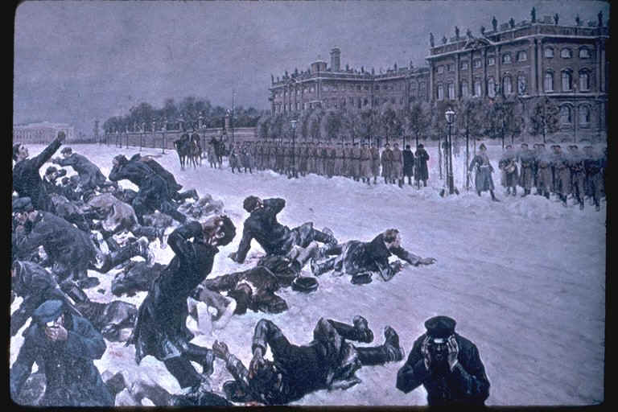
“Bloody Sunday”
1905: the people were thinking of a revolution
People walked to the palace of Czar Nicholas II.
They were peaceful, but soldiers killed many protesters.

Slide 6
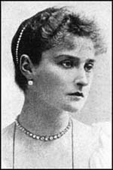
Russia Fights in World War I
Russians had few supplies or food
Czar Nicholas II went to the front lines
PROBLEMS:
Left his GERMAN wife, Alexandra, in charge
Czar was a bad military leader
Forgot about peasants at home

Slide 7
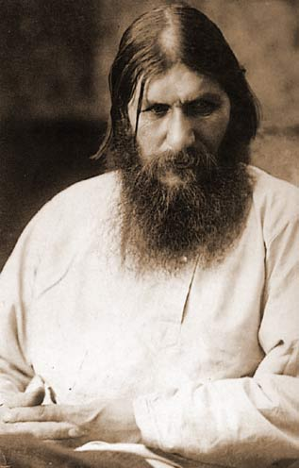
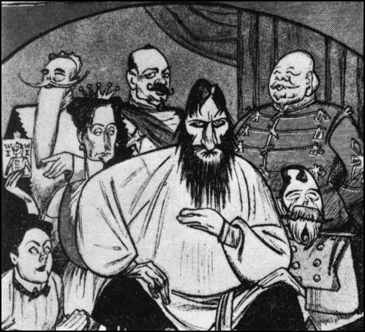
“The Evil Monk”
Rasputin, a “holy man” with special powers becomes powerful
Alexandra trusts him because he healed her son, Alexis

Slide 8
Anastasia’s version of Rasputin
http://www.youtube.com/watch?v=Ocm8QdNR_d8

Slide 9
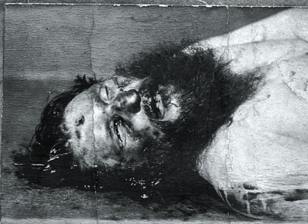
Rasputin Dies?
The nobles eventually had enough of him & killed him.
BUT it took 6 tries!
Poison
Shot 3 times
Beat with a dumbbell
Drowned in frozen river

Slide 10
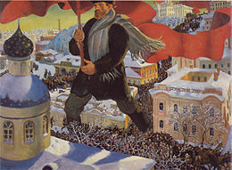
Who was leading the revolution?
The Bolsheviks
Believed in communism (Karl Marx)
Wanted to:
give peasants land
give workers control of factories.
keep the harsh rules & secret police force.

Slide 11
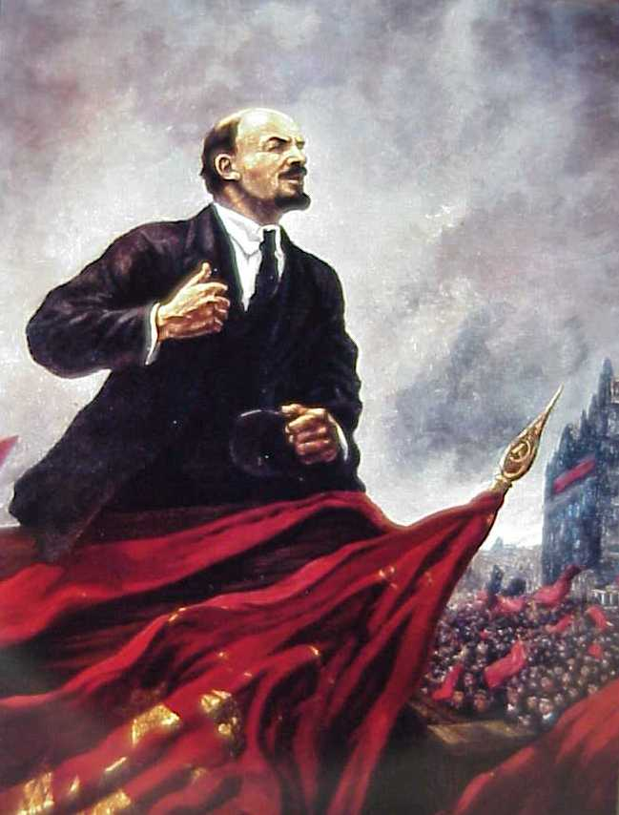
The first Bolshevik leader
Vladimir Lenin
Lenin’s slogan: “Peace, Land, and Bread”
Lenin pulled Russia out of WWI
Treaty of Brest-Litvosk

Slide 12
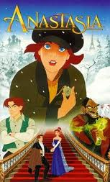
Russia’s Civil War
Lenin’s Red Army vs. loyalist “Whites”
Red army killed czar Nicholas II & the rest of the Romanov family.
Britain, France, & US tried to help Czar Nicholas II, but the Red Army defeated them

Slide 13
Anastasia’s Version of History
http://www.youtube.com/watch?v=NJz9gB1mT_4

Slide 14
Russia becomes the U.S.S.R.
Union of Soviet Socialist Republics
Lenin’s New Economic Policy: (1921)
A little capitalism mixed with communism
SOCIALISM!
Helped economy grow

Slide 15
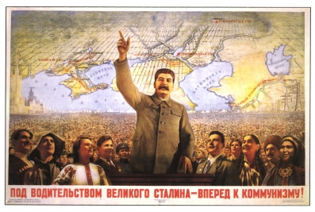
Lenin Dies!
Joseph Stalin came to power in 1924.
He used terror & brutality to rule.
He was a totalitarian ruler.

Slide 16
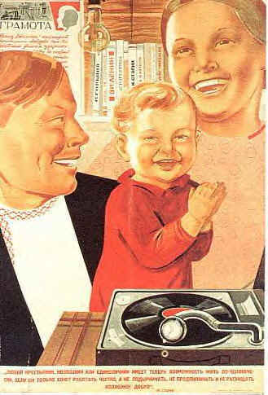
Stalin Makes Some Changes
The Great Purge
Stalin killed/imprisoned 1,000’s of people for plotting against him.
Command Economy
Government controlled all parts of the economy.
Propaganda
to make it all look great
Censorship
of stuff that makes him look bad

Slide 17
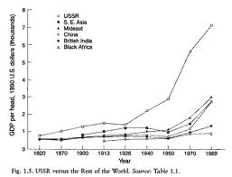
“Five-year plans”
More industrialization!
Better factories
Grow more crops with machines
Effects:
Less consumer goods
Low quality goods
Poverty for peasants

Slide 18
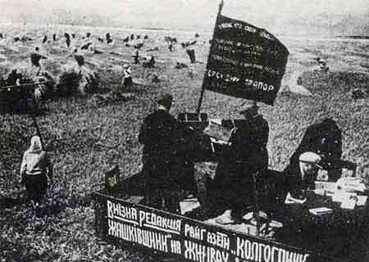
Collectivization
Government took all peasants’ land & forced them to live together on “collectives.”
Some peasants refused to grow crops.
If you didn’t meet the quota, you didn’t get to eat.
Mass starvation:
In Ukraine, over 5 million people died!

Slide 19
“If” by Rudyard Kipling
If you can dream and not make dreams your master; If you can think---and not make thoughts your aim, If you can meet with Triumph and Disaster And treat those two impostors just the same If you can talk with crowds and keep your virtue… If neither foes nor loving friends can hurt you, …you'll be a Man, my son!

Slide 20
T-Chart
Compare Lenin & Stalin
p. 252 of green Regents book has a helpful chart

Slide 21
Ra-Ra-Rasputin Song
http://www.youtube.com/watch?v=VmkySNDX4dU

