Slide 1
Political Revolutions
Global 3
Ms. Lyons

Slide 2
Aim: What circumstances cause people to start a revolution? Do Now: IMAGINE THIS… What if the school made everyone get the same haircut? Or for every minute you are late to a class, you pay the school $50? At what point are the rules unreasonable? What would you do about it?

Slide 3
Big Political Revolutions
American
French
Latin American

Slide 4
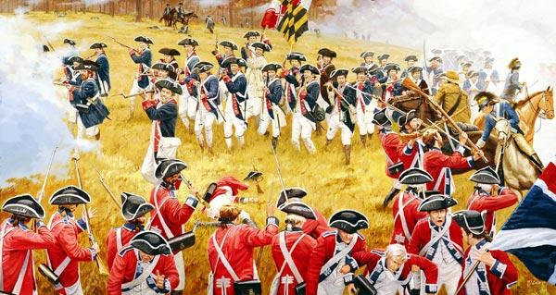
American Revolution: Colonists want Freedom!
1776: Declaration of Independence
13 colonies declare independence from England

Slide 5
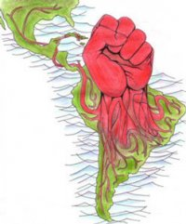
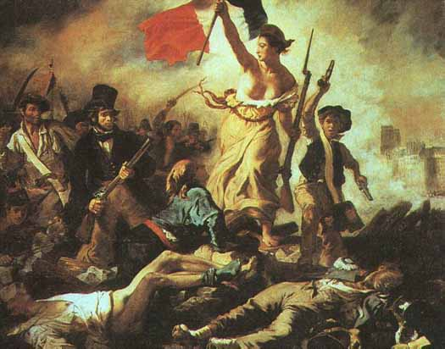
Effects of American Revolution
Inspired French & Latin American independence movements

Slide 6
French Revolution

Slide 7
Causes of the French Revolution (1789-1799)
Absolute monarchy
Social inequality
3 estates
Enlightenment
Ideas of democracy
English & American examples

Slide 8
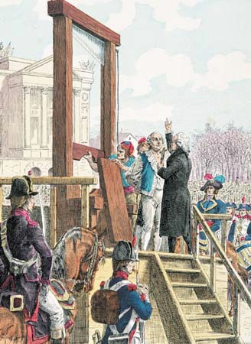
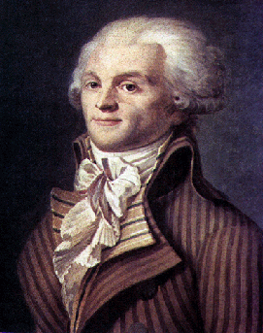
Craziness…
1793: The king was executed
Reign of Terror – led by Maximilien Robespierre
1,000s killed/imprisoned
Lasted 1 year

Slide 9
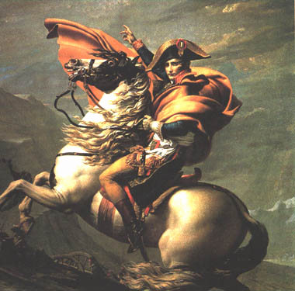
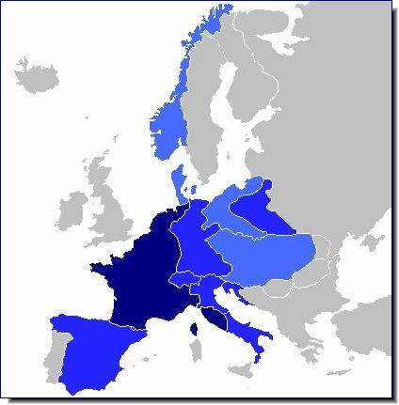
Napoleon takes over
Named himself“Emperor of France”
Absolute power
Napoleonic Code
Enlightenment ideas – equality
Big Empire (1804-1814)
Conquered all of Europe (except Russia & England)

Slide 10
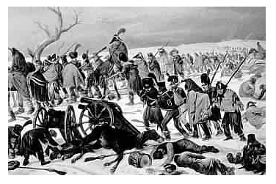
Napoleon’s Fall
Nationalism
European countries want freedom
Russia beat Napoleon
IT WAS TOO COLD!
He was exiled.

Slide 11
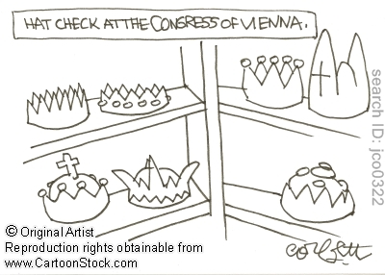
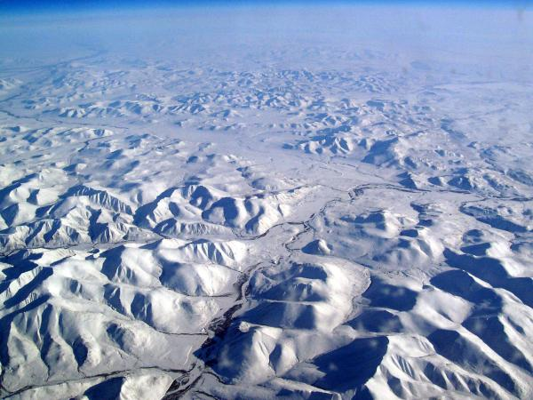
How did Europe react?
Congress of Vienna
Take away France’s power
Restore monarchs to power
Russia
“Russification” (made everyone the same)
Criminals: sent to Siberia

Slide 12
Meanwhile in the Americas…

Slide 13
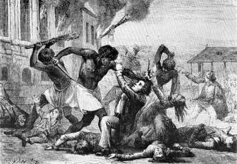
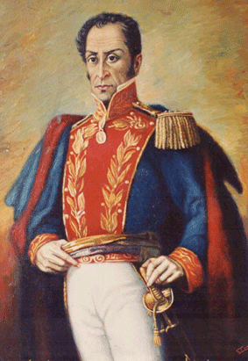
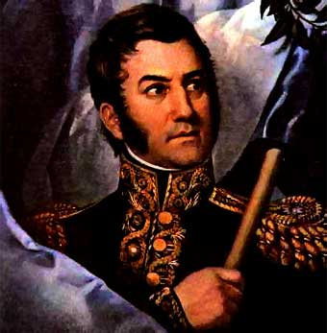
Latin American Revolutions (1790’s)
HAITI [1791]
French colony
Toussaint L’Ouverture (ex-slave) led revolt
SOUTH AMERICA [1800’S]
Spanish colonies
Simon Bolivar (a creole)
Joined with Jose de San Martin (Argentina, Chile)

Slide 14
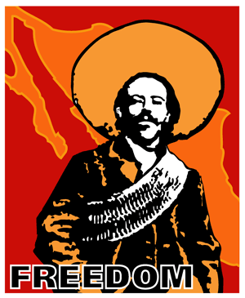
Mexican Revolution
1910-1930
Causes
Dictator: Porfirio Diaz
Only rich make $ from industry
Most people had no money, land, or education
Leaders
Emiliano Zapata
Francisco “Pancho” Villa
Venustiano Carranza
New president in 1917

Slide 15
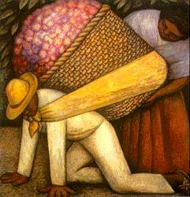
Effects of Mexican Revolution
Constitution:
gov’t took church land & gave it to people
more rights for workers & women
Social Reforms:
public schools & libraries
Economic nationalism:
lowered foreign dependence
Cultural nationalism:
writers, murals showed struggles of people

Slide 16
Questions after reading…
What was the author trying to tell you?
How was this poem related to revolution?
What are some issues or circumstances you are unhappy with?
Is writing/speaking your mind an effective way to start a revolution?

