Slide 1
WORLD MAP SKILLS
Social Studies
Ms. Lyons

Slide 2
GLOBAL 3

Slide 3
Find Great Britain on the map.

Slide 4
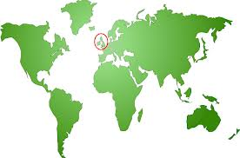
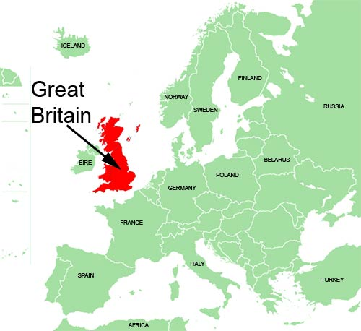

Slide 5
Find France on the map.

Slide 6
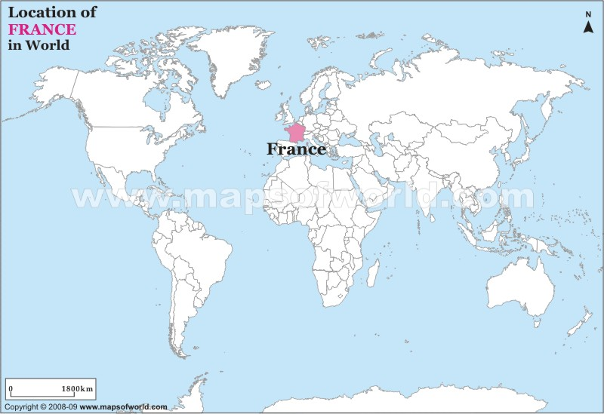

Slide 7
Find Italy on the map.

Slide 8
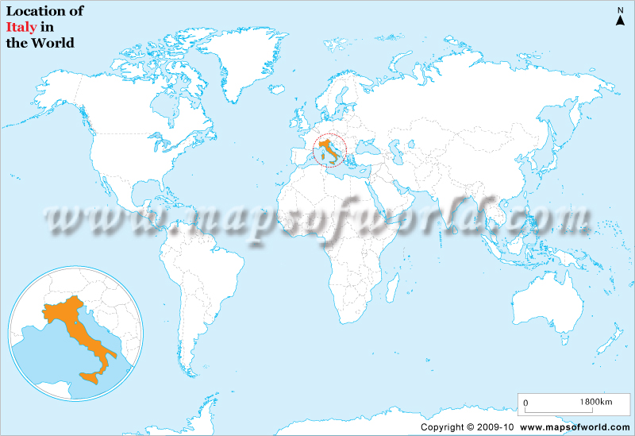

Slide 9
Find Germany on the map.

Slide 10
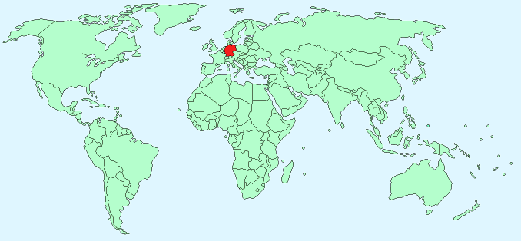

Slide 11
Find Russia on the map.

Slide 12
