Slide 1
Industrial Revolution
Global 3
Ms. Lyons

Slide 2
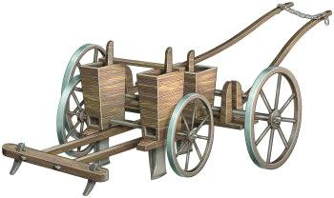
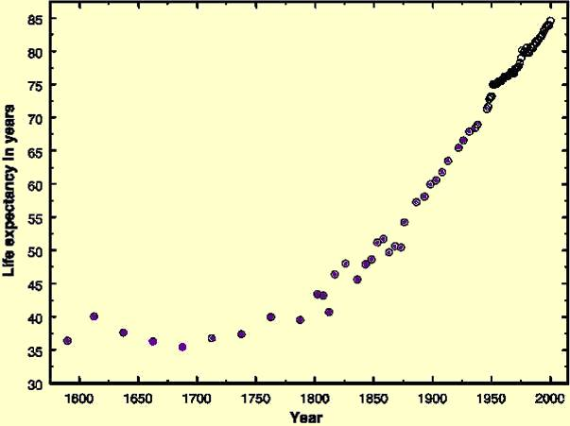
Agrarian Revolution
Better farming techniques!
Technology
Effect: more food for developing countries!
People live longer & have healthier babies

Slide 3
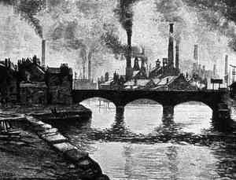
Industrial Revolution
Started in 1750 in Great Britain
Machines make more, faster

Slide 4
Causes of the Industrial Revolution

Slide 5
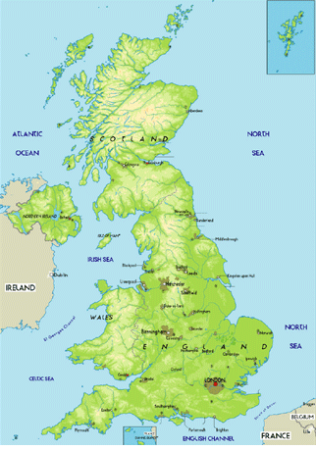
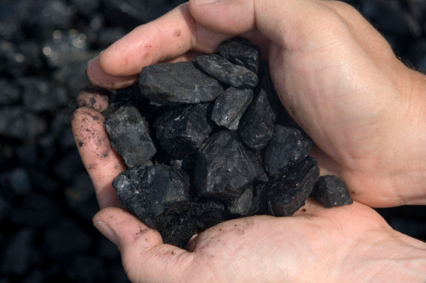
1. Geography
Natural resources – coal (power for machines)
Island- harbors for trade
Water- power for factories

Slide 6
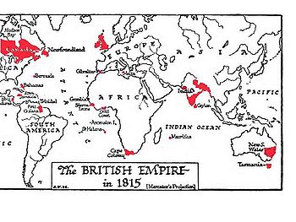
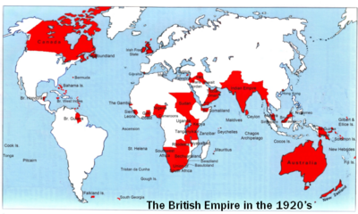
2. Capital from Colonies
Colonies (imperialism)
Make money to invest in factories

Slide 7
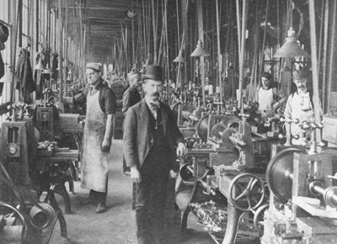
3. Technology
Machines
Make MORE things FASTER

Slide 8
4. Population Growth
Remember: Agricultural Revolution
More workers!

Slide 9
Effects of the Industrial Revolution

Slide 10
Laissez-faire
Government does not control
Growth of big business
More power to business owners

Slide 11
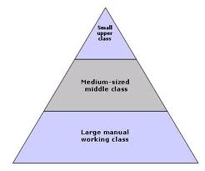
Growth of Middle Class
Factory workers have more money than farmers, but less than business owners

Slide 12
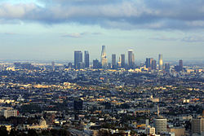
Urbanization
Want to live close to work
All factories = in same place
Crowded

Slide 13
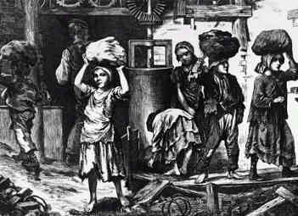
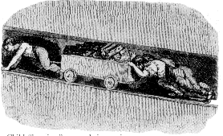
Working Conditions
12-16 hour days
Boring work
same thing all day
Dangerous machines

Slide 14
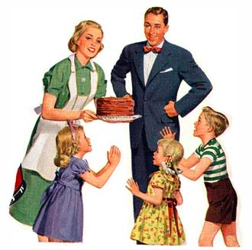
Change in Social Roles
Men worked at factories & women stayed home
Poor kids worked to help families

