Slide 1
Imperialism
Ms. Lyons

Slide 2
Japan & The Meiji Restoration
Japan was isolated for 200 years!
1854: Matthew Perry visits Japan
Treaty of Kanagawa: Japan opens ports to trade with U.S.
Lower classes overthrew shogun & put emperor back in power
WHY?
Some thought shogun was weak with foreigners
Some wanted to modernize Japan

Slide 3
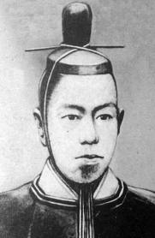
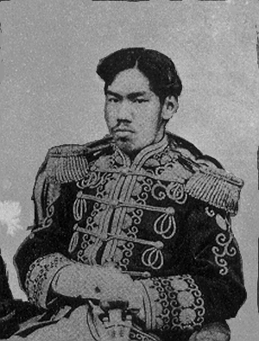
Effects of the the Meiji Restoration
Modernization
Industrialization
Imperialism
needed raw materials

Slide 4
Imperialism
Definition: strong country takes over a weak country
Strong countries:
Europe
Industrialized
Technology, weapons
Weak countries:
Africa, Asia
Not industrialized
Full of natural resources
Weak from civil war

Slide 5
Causes of Imperialism
Nationalism, Social Darwinism
Power!
Raw materials & markets to sell goods
Ethnocentrism
White Man’s Burden (educate the “less developed”)
Because they can…
Technology, weapons, ships

Slide 6
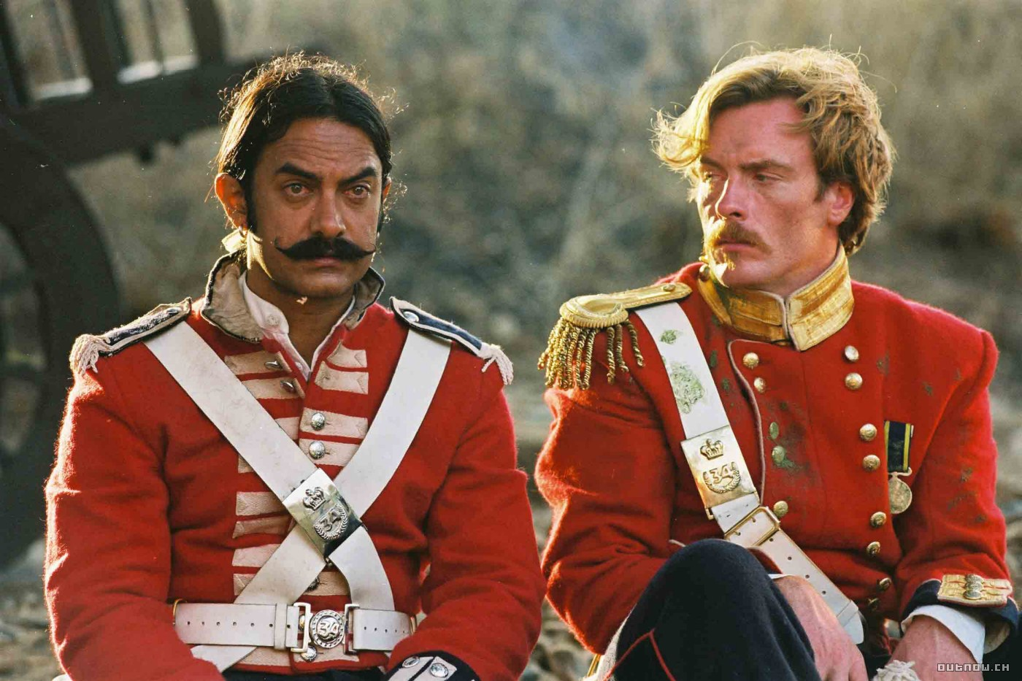
British controls India
British East India Company
Army of Indian soldiers (Sepoys)
Made them go against their religion (eat pig fat)
1857: Sepoy Rebellion
Soldiers revolted, but the British crushed them
British rule became even stronger

Slide 7
Sepoy Rebellion Video
http://www.youtube.com/watch?v=2yXKbd5IDzU
1:24 – 4:30

Slide 8
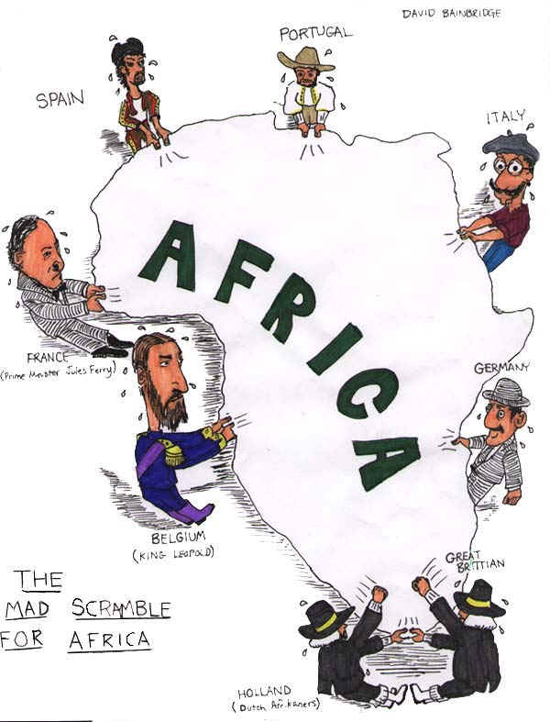
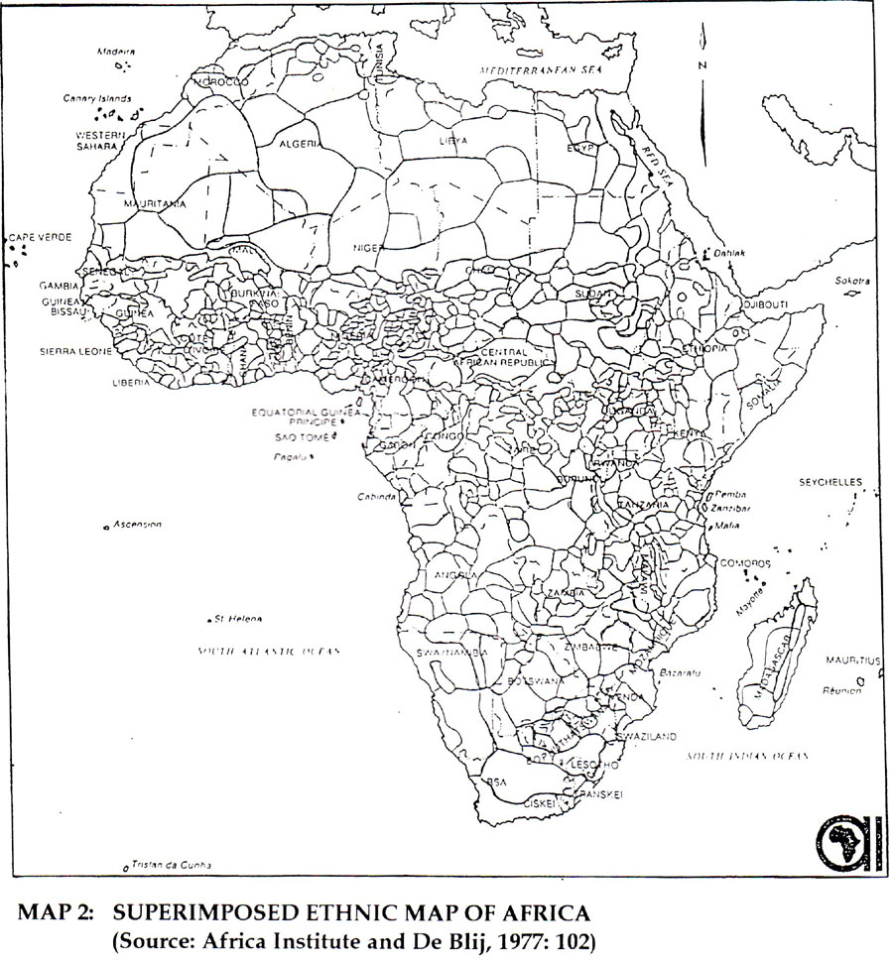
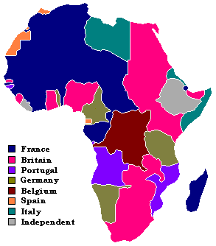
Scramble for Africa
European countries wanted parts of Africa
Berlin Conference (1884)
Divided up the continent with no concern for the African people (tribal boundaries)
By 1920, almost all of Africa was controlled by Europe

Slide 9
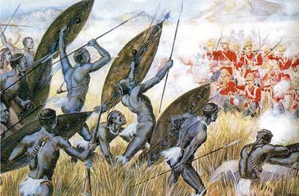
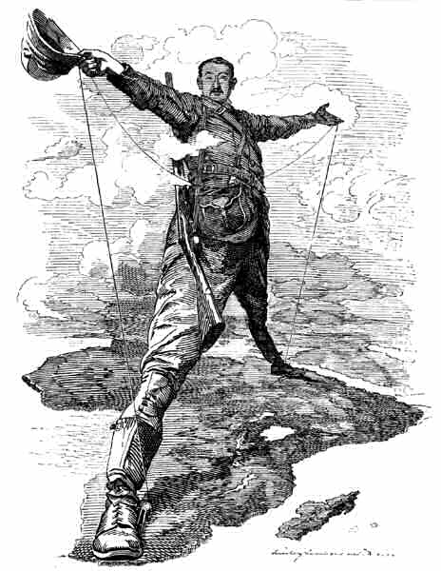
Southern Africa
Boers (Dutch) & British took over southern Africa
Zulus (collection of African tribes) resisted the Boers, but eventually lost to the British
Boer War (1899-1902)
British, under leader Cecil Rhodes, beat the Boers & united the colonies to create South Africa
Slave trade – illegal, but still happened

Slide 10
British in China
Opium War (1839)
Britain introduced China to opium
Chinese became addicted, so the gov’t tried to stop the trade
War broke out & the British won
Treaty of Nanjing made China…
pay for British war costs
open ports for trade with Britain
give Britain Hong Kong

Slide 11
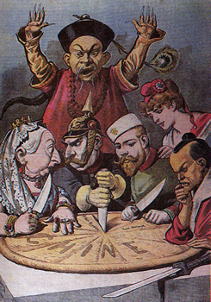
Spheres of Influence
Many European countries claimed pieces of China
Definition:
Area in which a foreign country does not have control, but is very powerful
Example: only that country can trade there

Slide 12
More Rebellion in China
Boxer Rebellion (1900)
China did not want to be controlled by other countries
Fought against British & Japan
ALMOST won, but the U.S. sent in troops to defeat China
China lost even more power
Sun Yixian
Led a revolution to overthrow Qing dynasty
He created a republic (vote for leaders/representatives)

Slide 13
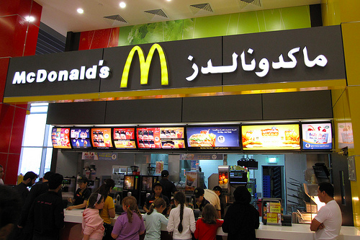
Effects of Imperialism on the Colonies
SHORT-TERM
LONG-TERM
Western culture spread
Transportation, education, & medicine improved
Resistance to imperialism became nationalism
Economies relied on a single cash crop to export
Local economies depended on industrialized countries
Resistance against Europe
Traditional countries/tribes were destroyed
Famines
Farmers exported crops instead of feeding own people

Slide 14
Effects of Imperialism on Europe
Discovered new crops, food, cultures
Competition for colonies led to war
Industrial nations controlled a new, global economy

