Slide 1
Human Rights Violations: PART 2
Global 3
Ms. Lyons

Slide 2
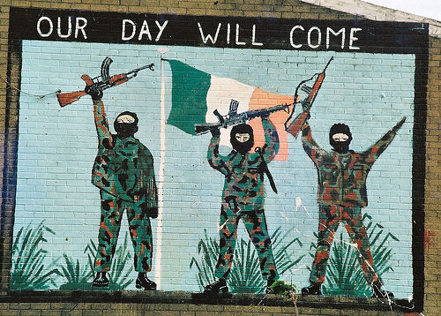
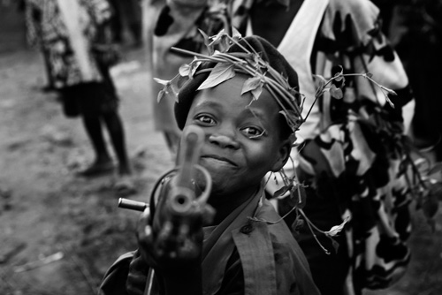
Human Rights Violations Around the World
Cambodia
Khmer Rouge
Yugoslavia (Balkans)
Serbs killing Albanians
South Africa
Apartheid
Ireland
IRA/Britain
Rwanda
Hutu/Tutsi

Slide 3
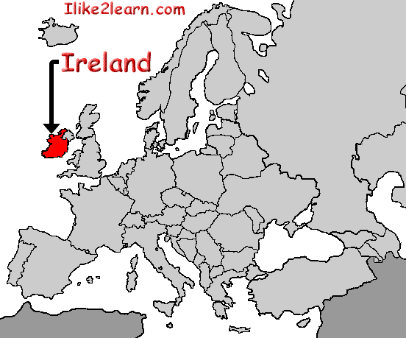
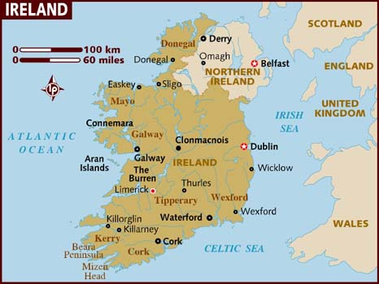
Ireland: “The Troubles”

Slide 4
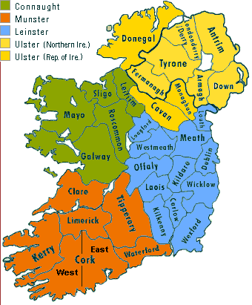
Background: History of Ireland
Mid-1600’s: controlled by Britain
1922: South of Ireland gets freedom from Britain
Roman Catholic
6 counties in the North controlled by Britain
Protestant

Slide 5
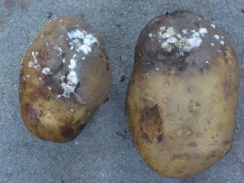
Human Rights Violated: 1) Irish Potato Famine
Grew wheat & oats for export to Britain
Grew potatoes for themselves
1845: disease hit potatoes
Britain would not allow Ireland to keep other crops (wheat & oats) to eat
1 million died of starvation or disease
Millions migrated to the US

Slide 6
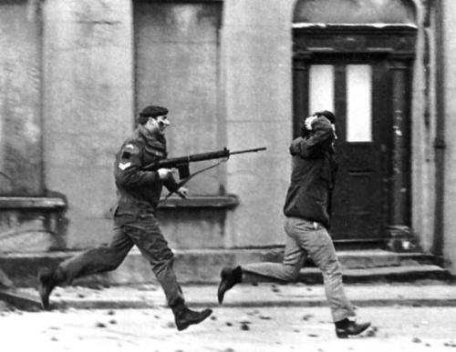
Human Rights Violated: 2) Bloody Sunday
Irish nationalists create IRA (Irish Republican Army)
1972: IRA marched for civil rights in Derry
26 unarmed males were shot by British
14 died, 7 teens
5 shot in the back
2 hit by army vehicles

Slide 7
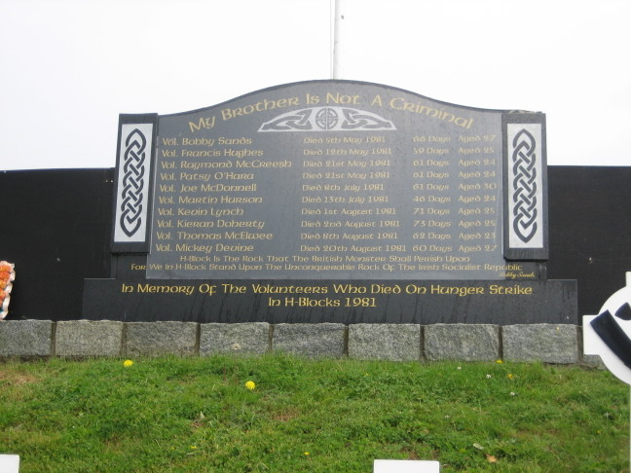
Human Rights Violated: 3) Hunger strikes
Britain put protesters in jail – political prisoners
Treated the same as murderers & told to wear prison uniform
1978: Blanket protest
Wore only blankets
Refused to leave cells
1981: Hunger strike
10 prisoners starved themselves to death
One was elected to the government (Parliament) while in prison
Prime Minister, Margaret Thatcher refused to meet demands
Hunger strike ended when families intervened

Slide 8
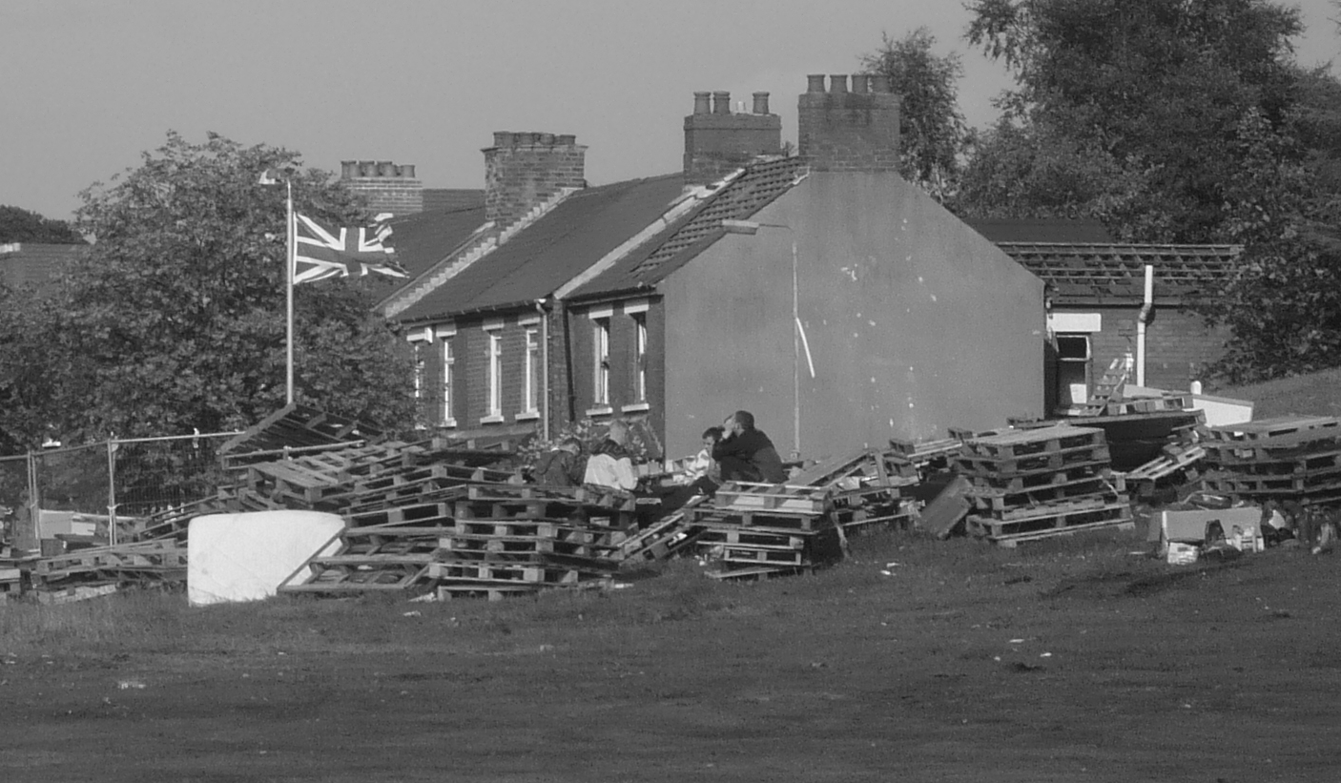
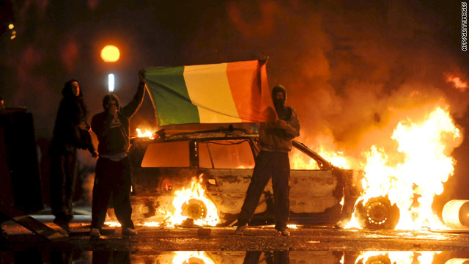
Human Rights Violated: 4) Orangemen Marches
Parades celebrating the defeat of Irish Catholics
Many Catholics don’t leave their homes on this day
Burn Irish flags
Still occurs today: July 12th

Slide 9
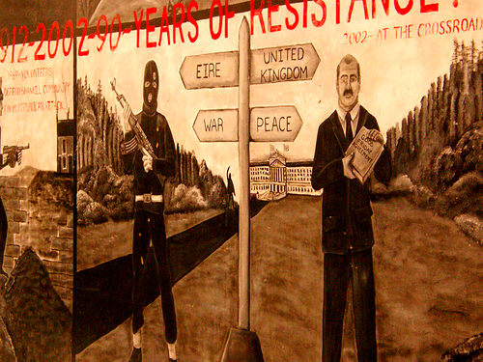
Actions Taken
1998: Good Friday Agreement
Both sides would de-militarize
Still issues…
Wall in Belfast dividing Loyalist &Nationalists
13 miles long
Been up since 1969

Slide 10
Rwanda: Hutu & Tutsi

Slide 11
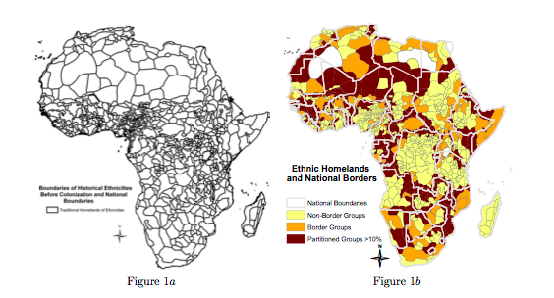
Background
Imperialism in Africa by Europeans
Effect: Tribalism
Europeans redrew Africa's boundaries into new countries & ignored existing tribal boundaries
Rwanda: 2 ethnic groups: Hutu & Tutsi
Tutsi (minority) controlled power for 100’s of years
Hutu people came to power in rebellion of 1959-62
1990: Tutsi tried to take back power, Hutus started genocide

Slide 12
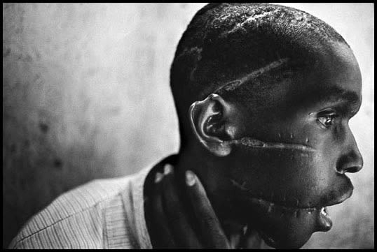
Human Rights Violations
Hutus imported machetes to kill Tutsis
8,000 killed each day
All Hutu & Tutsi people must carry ID cards
Tutsi people became Hutu slaves, Tutsi women raped, Tutsi people called “cockroaches”
States ethnic group
Skin color (light – Tutsi, dark – Hutu)
1 million Hutus fled the country
now refugees in DRC

Slide 13
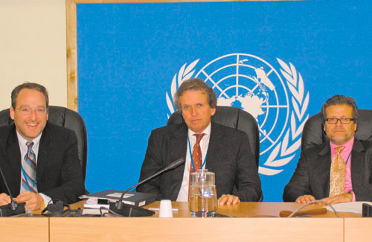
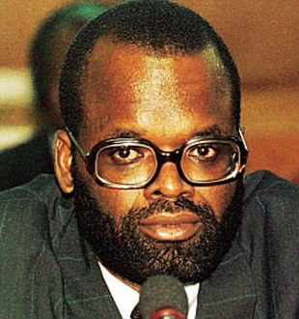
Actions Taken
Today: Tutsi president: absolute ruler → peace
US did nothing, Clinton apologized
Rwanda set up Gacaca (a justice system)
Security Council of the UN set up the International Criminal Tribunal
Prime Minister: life in prison

Slide 14
SOURCES
http://news.nationalgeographic.com/news/2004/04/0406_040406_rwandagenocide.html
http://www.un.org/en/preventgenocide/rwanda/education/rwandagenocide.shtml

