Slide 1
Human Rights Violations: PART 1
Global 3
Ms. Lyons

Slide 2
Human Rights Violations Around the World
Cambodia
Khmer Rouge
Yugoslavia (Balkans)
Serbs killing Albanians
South Africa
Apartheid

Slide 3
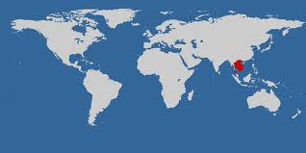
Cambodia: Khmer Rouge

Slide 4
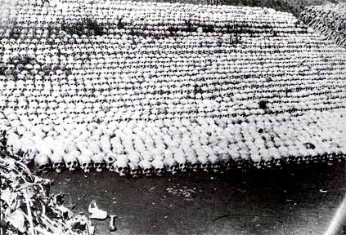
Background: Who was the Khmer Rouge?
Communist Party of Kampuchea (CPK)
Took control of Cambodia in 1975
Led by Pol Pot
Ruled until 1979
“Killing fields”: 2 million died

Slide 5
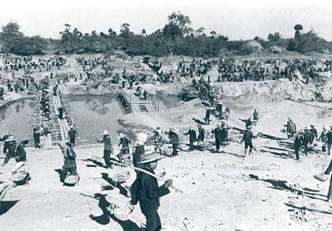
Communist Plan
Forced city people into the country to work on farms
1,000’s died during evacuation
GOAL: classless society (no rich, no poor)
NO MORE: money, private property, Western clothing, religion
All people must wear black
Notes:
Turned old churches & schools into prisons or reeducation camps

Slide 6
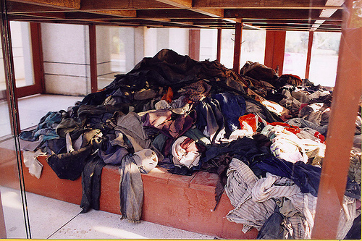
Human Rights Violations
ILLEGAL TO:
laugh, hold meetings, leave their homes, show affection to family
TORTURED & KILLED: scholars, minorities (Vietnamese, Chinese), traitor soldiers
S-21 (most important prison) – held 14,000 & only 12 survived
12 hour workdays to meet “Four-Year Plan”
Rice-growing goal

Slide 7
Life in Cambodia Today
1979: Vietnam invaded & kicked out Khmer Rouge
2 million died:
disease, lack of medicine, starvation, execution, exhaustion (overworked)
Many widows & orphans
100,000’s fled country & became refugees
Mine explosions – dead & disabled
Mental health issues – trauma
Poverty = still a problem today

Slide 8
Statistics

Slide 9
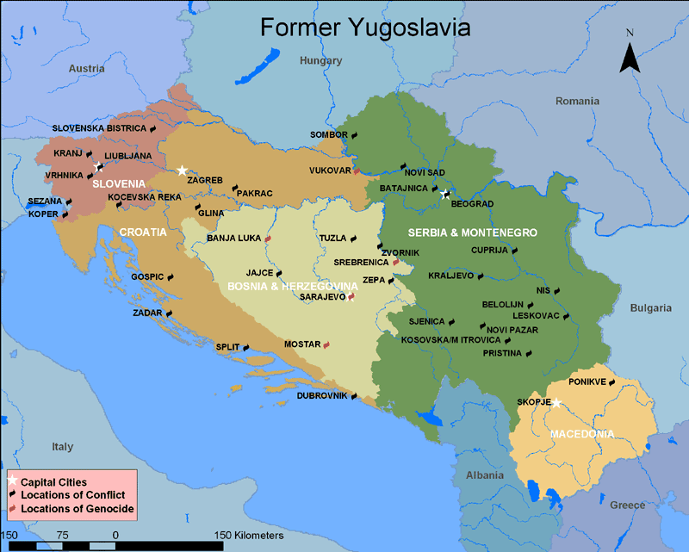
Yugoslavia (Balkans): “Ethnic Cleansing”

Slide 10
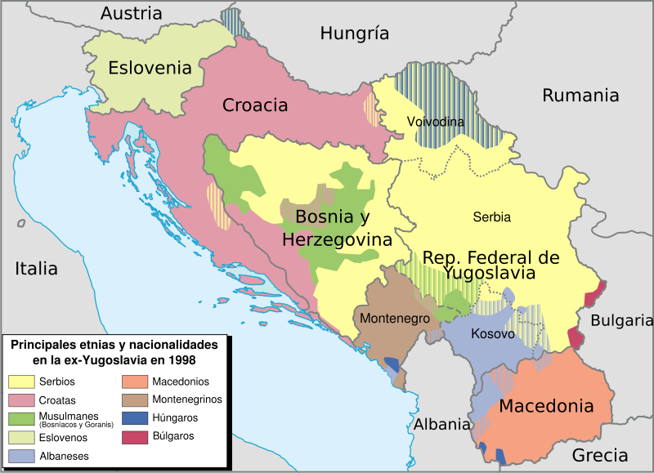
Background
Yugoslavia: created after WWI
Many ethnic and religious groups
Orthodox Christian Serbs, Roman Catholic Croats, Muslim Albanians… wanted own nations
Croatia, Slovenia, Bosnia, & Herzegovina all gained independence
Effect: war and ethnic violence

Slide 11
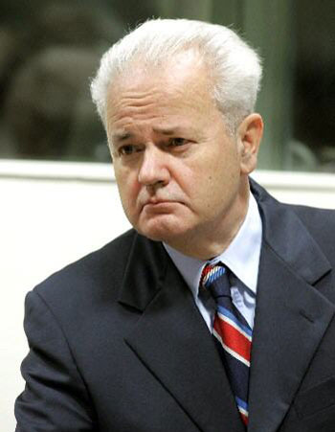
Leader
Slobodan Milosevic – president of Serbia in 1987
GOAL: “Great Serbia” – most powerful country in the Balkans
Strategy: Ethnic cleansing of non-Serbs
200,000 killed & 200,000 injured

Slide 12
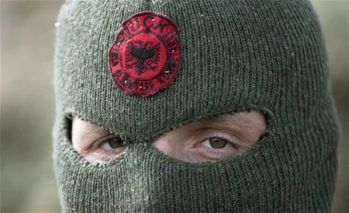
Conflict in Kosovo
Serbians targeted Albanians
1997: Albanians in Kosovo created a resistance group
BUT… Serbians crushed them.
If one Serbian was harmed, they burned an entire Albanian village down.

Slide 13
5 Phases of Ethnic Cleansing
Concentration.
Surround the area to be cleansed, warn Serbs who live there
Decapitation.
Execute political leaders and those capable of taking their places: lawyers, judges, public officials, writers, professors.
Separation.
Divide women, children, and old men from men of "fighting age” (ages 16-60)
Evacuation.
Transport women, children, and old men out of the country
Liquidation.
Execute "fighting age" men, dispose of bodies.

Slide 14
Gjylizare Babatinca, 32 says:
“It was very horrible,”, said as she described how her family was forced out of a house Wednesday by masked Serbs with automatic rifles…. “We were forced into the train cars they use for animals. We were packed tightly together…. It was completely dark, and we did not know where we were going.”

Slide 15
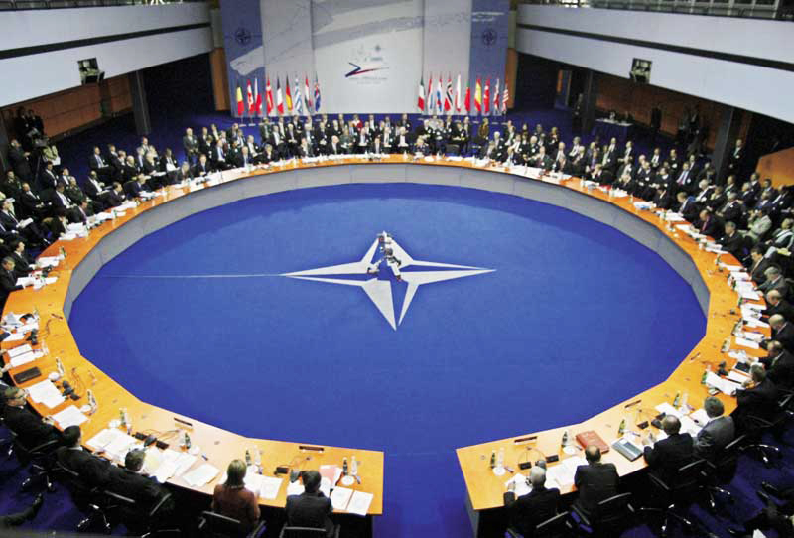
Actions Taken
The North Atlantic Treaty Organization (NATO) finally put a stop to the violence, and Milosovic was arrested.
He died of a heart attack in his cell while awaiting trial for his war crimes.

Slide 16
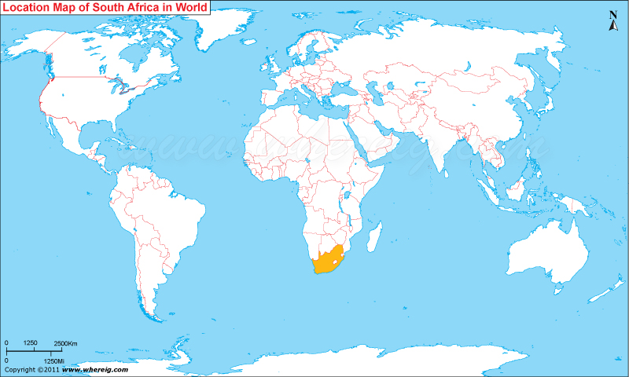
South Africa: Apartheid

Slide 17
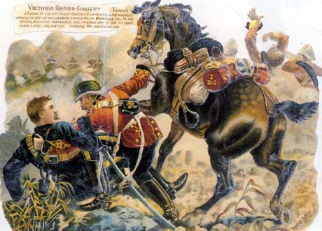
Background
1600’s: South Africa was colonized by Dutch & then British
Dutch living in South Africa were called Boers or Afrikaners
1900: Boer War (British vs. Dutch)
1910: Independence from Britain
1948: Afrikaner National Party invented apartheid
GOAL: whites keep control
Racial separation

Slide 18
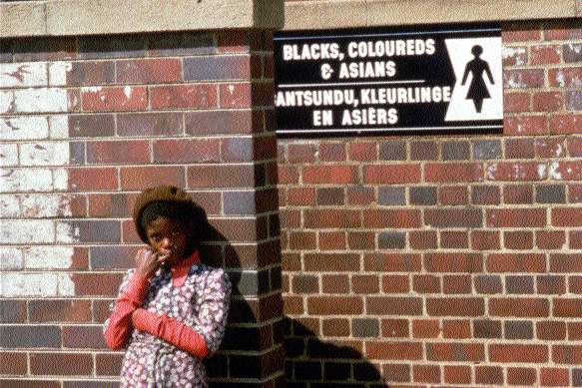
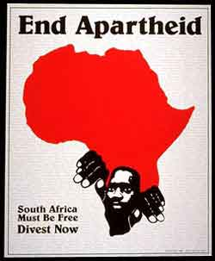
Human Rights Violations: Apartheid in South Africa
Segregation:
Blacks & coloreds must live in poor townships
Separate trains, schools, bathrooms, restaurants, beaches
No interracial marriage

Slide 20
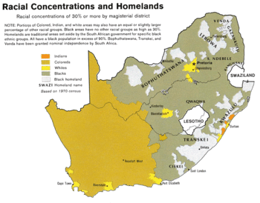

Slide 21
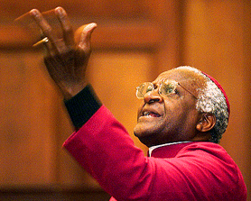
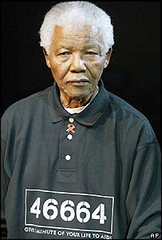
Actions Taken: People who fought against Apartheid
Nelson Mandela
Leader of African National Congress (political party)
Civil disobedience
Jailed: 1964-1990
Desmond Tutu
Told foreign investors to stop giving money to segregated SA
F.W. de Klerk
President of SA (1989) repealed segregation & released Mandela
1994: all races can vote
Mandela is voted president!
TODAY: whites still control most $

Slide 22
SOURCES
http://www.cambodiatribunal.org/history/khmer-rouge-history
http://balkansnet.org/ethnicl.html

