Slide 1
Nationalism
Global 3
Ms. Lyons

Slide 2
Nationalism: Unifies & Divides
Unifies Germany & Italy
Divides Austrian & Ottoman empires

Slide 3
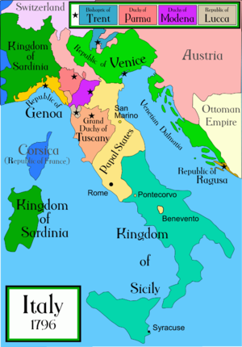
Italy after Fall of Rome
Since fall of Roman empire (400’s) – broken into small states

Slide 4
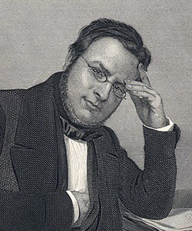
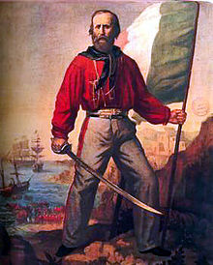
Leaders of Italian Unification
Camillo Cavour
“THE BRAIN”
Giuseppe Garibaldi
“THE SWORD”
Make friends with France & Prussia
Diplomacy
Won control of the south
& united with the north
Army = “the red shirts”

Slide 5
Germany under Prussia: 1815

Slide 6
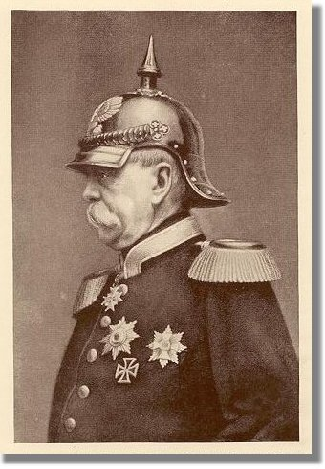
Otto von Bismarck
"Not by speeches and majority votes are the great questions of the day decided - that was the great error of 1848 and 1849 - but by blood and iron.”
“Blood and Iron”
War & industrialization
Took land from:
Denmark, Austria, France
1871: unified Germany
under Prussia

Slide 7
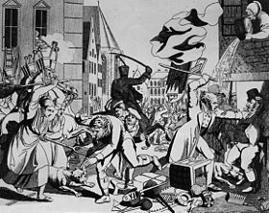
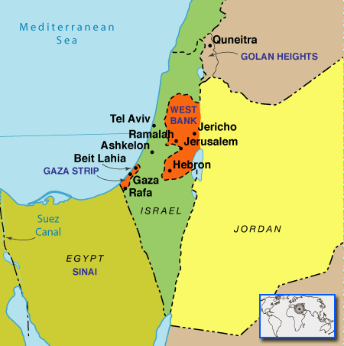
Palestine/Israel
Anti-Semitism
Zionism
Late 1800’s
Violence against Jewish people throughout Europe
A movement to build a Jewish state in Palestine
Israel = formed in 1948

Slide 8
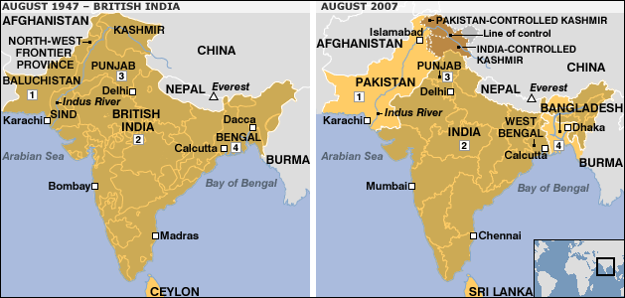
INDIA controlled by British until 1947
Indian National Congress
Muslim League
Mostly Hindus
Wanted democracy & westernization
Protect their interests (different from Hindus)
Talk of separate Muslim state
Pakistan

Slide 9
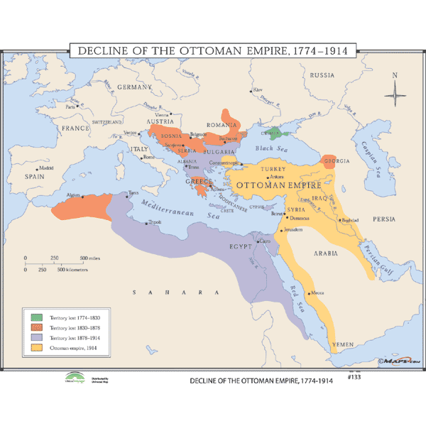
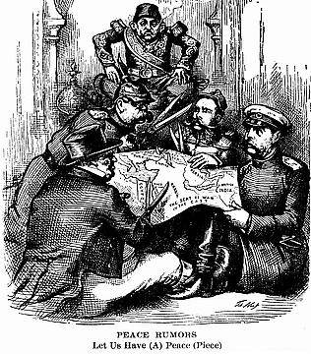
Ottoman Empire
By 1908: many countries won independence & broke off from Ottoman Empire
Greece, Serbia…
Nicknamed:“Sick man of Europe”
Easy target for Europe to take land

Slide 10
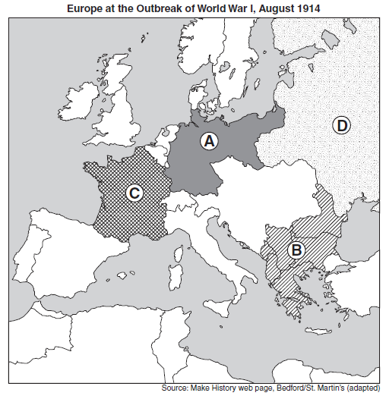
BALKANS…
1914:
known as the
“Powder keg”
of Europe
…World War I

