Slide 1
Economic & social revolutions
Global 3
Ms. Lyons

Slide 2
Different Political Systems
Monarchy
1 ruler (king/queen)
Example: William & Mary (England)
Absolutism
100% power
Example: Louis XIV (France), Suleiman (Ottoman Empire), Peter the Great (Russia)
Divine right
God chooses ruler
Example: China
Democracy
People rule
Example: ancient Greece (Athens)
Feudalism
System based on land ownership & military support
Example: Europe (Middle Ages) & Japan

Slide 3
After the Industrial Revolution, People Had even more ideas…

Slide 4
Philosophies (-isms)
Liberalism
Conservatism
Gov’t should protect people’s rights
“Democrats” today
Remember: corporations are legally “people,” so they liked this
Keep the same people in charge (monarchs)
“Republicans” today

Slide 5
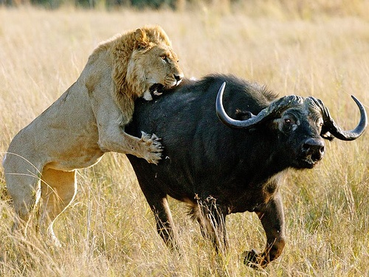
Philosophies (-isms)
GOAL: Make money
GOAL: Help all people
Social Darwinism
“Survival of the fittest”
Strong survive & weak die
Used for: businesses, racism, imperialism
Social reformism
Gov’t should help the poor (child labor)
John Stuart Mill
Utopian Socialism
All property & work is shared = no fighting
Karl Marx & Friedrich Engels

Slide 6
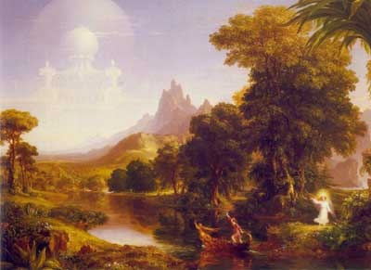
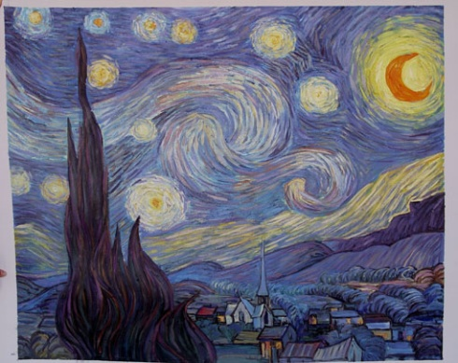
Education & the Arts
More education
Taught to obey authority
Romanticism
Feelings
Realism
Showed harsh lives & poverty
Impressionism
Trippy

Slide 7
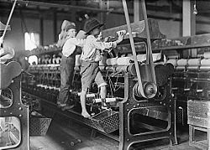
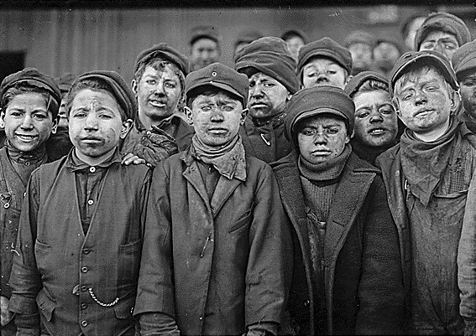
Social Reform Laws
Sadler Report
Regulated factories in Great Britain
Made child labor better
Kids under 9 years old cannot work
Kids under 18 years old = can only work low # of hours

Slide 8
Global Migration
WHY?
They could! (technology = better transportation)
Population growth (too crowded)
Social/political systems were better in other countries
EXAMPLES
Russian Jews fled Anti-Semitic violence
Italian farmers wanted better economy

Slide 9
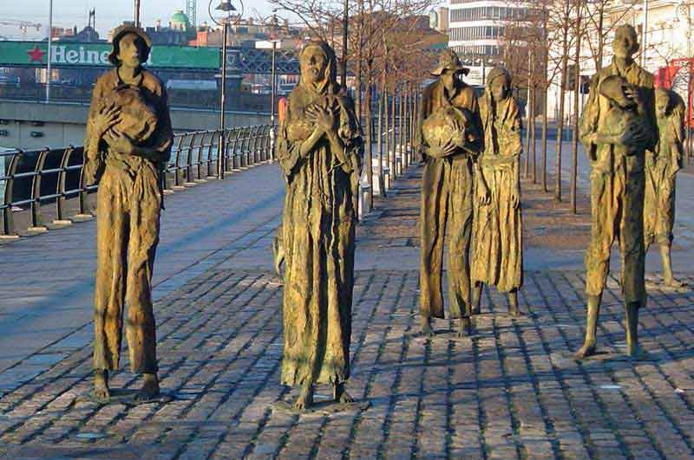
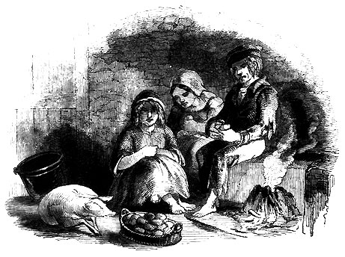
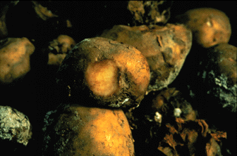
Most Common on the Regents:
Ireland (1845)
Potato crops failed
Famine (many people starved)
Came to the United States

Slide 10
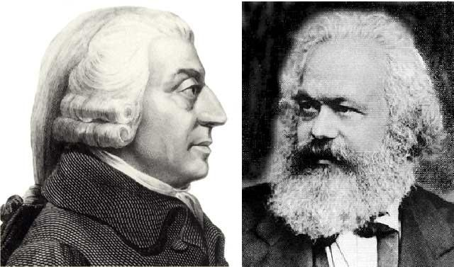
The 2 big Political Systems
Communism
Capitalism
Karl Marx & Friedrich Engels
Communist Manifesto
Gov’t controls prices
Bourgeoisie (rich) vs. proletariat (poor workers)
Proletariat will revolt
There will be a classless society
Adam Smith
Wealth of Nations
Businesses control prices
based on supply & demand
Laissez-faire
“Free trade”

