Slide 1
Between the World Wars
Global 3
Ms. Lyons

Slide 2
3 Big Things Going On…
Nationalism
Great Depression
Fascism

Slide 3
Nationalism

Slide 4
Where is Turkey on the map?

Slide 5
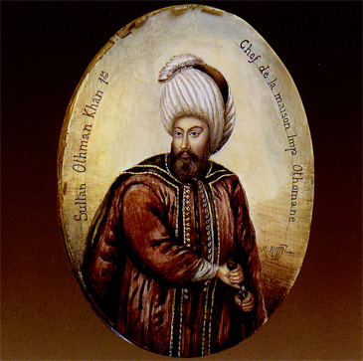
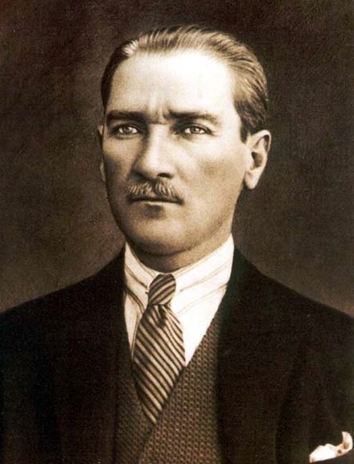
Turkey (part of the old Ottoman Empire)
Kemal Atatürk took over
“Father of the Turks”
Westernization
Clothes, laws, calendar, language
More rights for women
Industrialization
roads, railroads, factories built

Slide 6
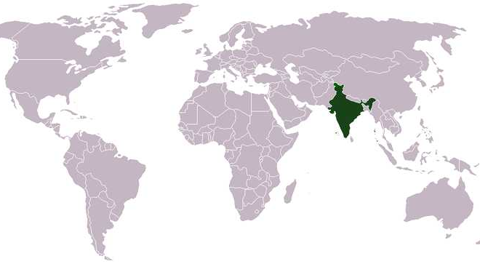
Where is India on the map?

Slide 7
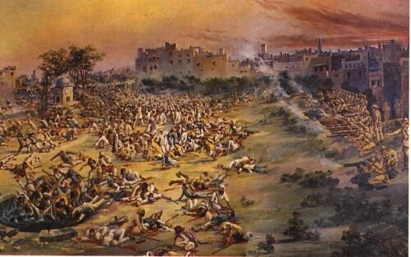
Nationalism in India
British controlled India (Sepoy Rebellion in 1857)
Amritsar Massacre (1919)
British shot a group of Indians with no warning
400 died, 1,200 wounded
This was the last straw - Indians needed independence

Slide 8
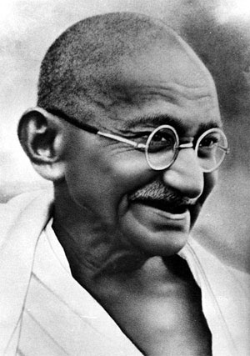
Independence Without Violence!
Mohandas Gandhi
Leader of Indian independence movement
Hated caste system
Wanted equal rights (women too)
Civil disobedience
No violence, disobey unjust laws
Boycotted British goods
Salt March

Slide 9
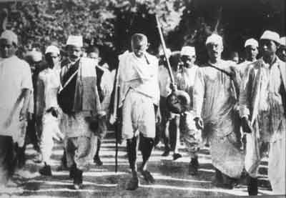
What does Salt have to do with Independence?
1923- Britain doubled the tax on salt
1930: Gandhi & friends walked 240 miles to the sea
When he got there, he had 1,000’s of followers
He picked up a piece of salt [against salt laws]
Sent to jail & many people protested
1931- Lord Irwin signed Gandhi- Irwin pact
Ended salt tax & gave Indians more freedom
1947- India became independent
1 year before Gandhi died

Slide 10
The Great Depression

Slide 11
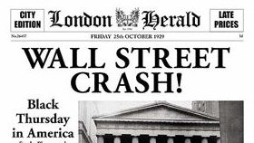
What Caused the Great Depression?
Industrialized countries bought less raw materials
Africa, Asia, & Latin America lost $$$
People couldn’t afford to buy products
Less workers hired
Stock market crash of 1929
People lost their life savings

Slide 12
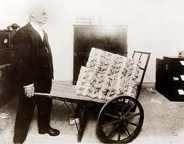
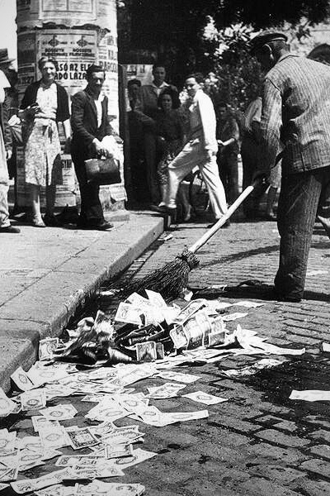
Effects of the Great Depression
Unemployment
Starving
Global trade stopped
Authoritarian rule
Some lost faith in democracy & capitalism

Slide 13
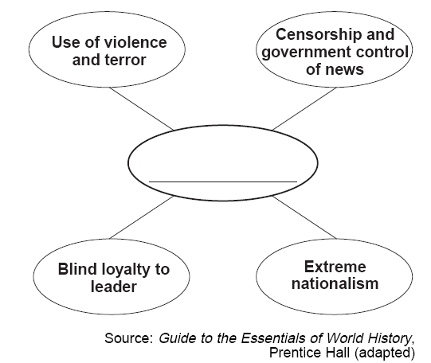
Fascism
How does this compare to democracy?

Slide 14
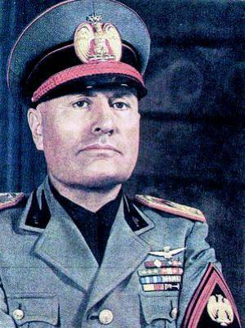
Fascism in Italy
Benito Mussolini
Promised to:
end unemployment
gain more land for Italy
get rid of Communist threats
What he did:
used force & terror to control Italy
ended free elections/free speech
killed or jailed his enemies

Slide 15
Germans are MAD about the Treaty of Versailles
Germany is broke.
It has no army.
It has been embarrassed.
Their government is weak – Weimar Republic.
One man comes along to help Germany become great again!

Slide 16
Adolf Hitler

Slide 17
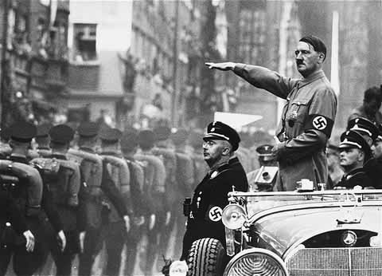
Hitler as the Nazi Leader
Ripped up Treaty of Versailles
Rebuilt the Germany military
Germans were the best race
Got out of poverty
Let’s blame the Jews
Anti-Semitism
Took away rights of Jews in Germany
Third Reich
Totalitarian state, no civil rights, killed enemies

Slide 18
Why did fascist leaders gain power?
The economies were so poor!
People wanted new people in power to help them get out of poverty.

Slide 19
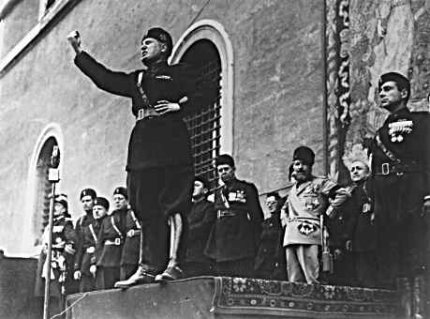
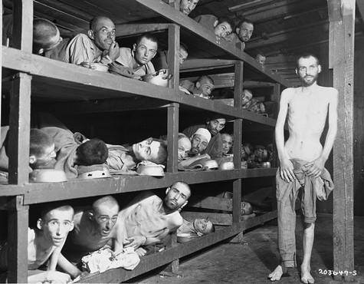
Were they good leaders?
Both Mussolini & Hitler improved economies
BUT at the cost of personal freedoms & human rights

