Slide 1
Global Trade, Black Death, & the Commercial Revolution
Global 2
Ms. Lyons

Slide 2
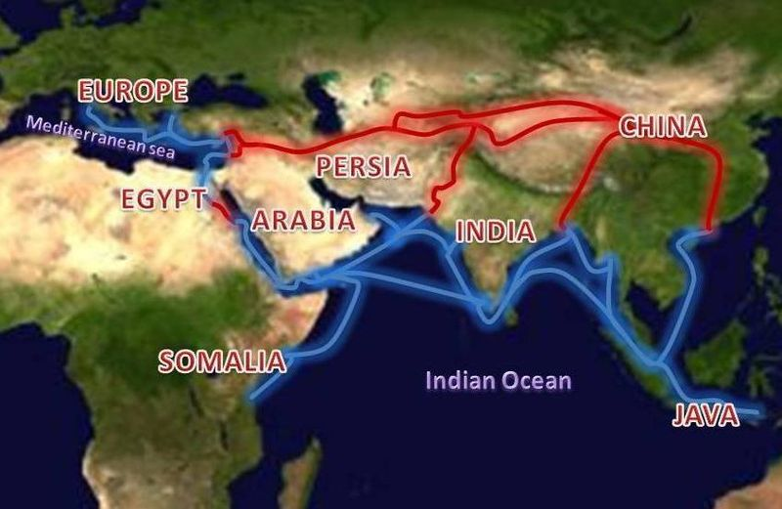
After the Crusades… LOTS OF TRADE
Trading Spots
Indian Ocean
Mediterranean Sea
Silk Road
Famous Trader
Zheng He
sailor from China

Slide 3
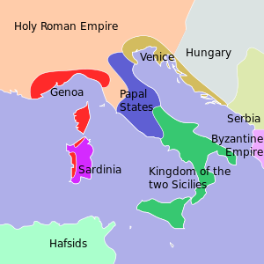
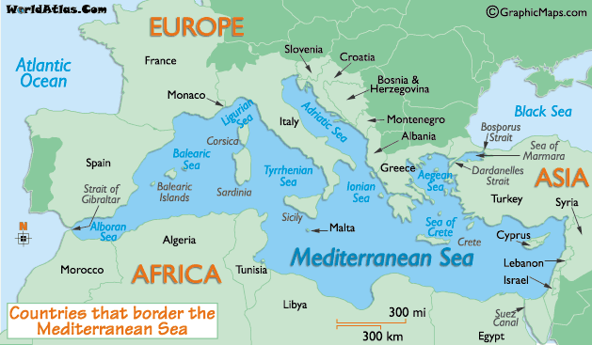
Italy is in the Center of the Action
#1 city = Venice
Trade fairs

Slide 4
Because everyone is trading…
They spread culture
AND… disease.

Slide 5
Black Death
AKA Bubonic Plague
1333 – 1351 CE
Disease spread by fleas that lived on rats
Bites formed big bruises & oozed pus
Death was painful

Slide 6
Started in China, in 1333 CE
Spread to North Africa & all of Europe

Slide 7
Effects of the Plague
Population Loss: killed 1/3 of Europe
Economy: less goods produced (less workers), higher prices, less trade
Political/Social Systems: feudalism ended, monarchs gained power
Religion: people questioned the Catholic Church, blamed & killed Jewish people

Slide 8
Commercial Revolution
Wednesday

Slide 9
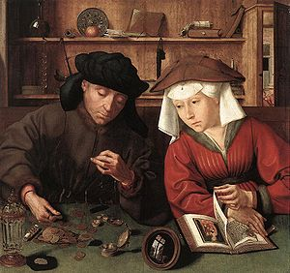
Commercial Revolution
1500’s-early 1700’s
150 years after the plague: population of Europe recovers
Money is now MORE important than land
Different people in power
Middle class created
Merchants
Traders
Artisans

Slide 10
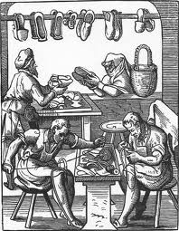
Guilds
Trade association
Example: all bakers work together
Effects:
High quality goods
Members got social services
Regulated hours & prices
Trained apprentices
Notes:
Apprentice: like an intern, learning the trade
Guild: alliance, work together for common goal (e.g. Guild Wars the video game)

Slide 11
Birth of Capitalism
Based on trade
Invest in business to make more money
Definition of capital: accumulated goods that bring income ($)

Slide 12
More Effects of the Commercial Revolution
Partnerships & joint stock companies
investments around the world
Banking
Loans, carry paper money rather than gold coins
Insurance
Feudalism ends
Serfs now sold goods for money
Notes:
Gold coins = heavier

