Slide 1
Renaissance
Global 2
Ms. Lyons

Slide 2
Renaissance: 1300’s-1500’s
Black Plague is ending
Feudalism is dead
Commercial Revolution revives trade
Italian city-states (Venice)

Slide 3
Renaissance means…
“Rebirth”
Europe came out of the Dark Ages
European Golden Age
Art
Literature
Science

Slide 4
Compare
Middle Ages
Renaissance
Religion
Church
Death
Heaven
Living world
Achievements of people
Education
These were all part of the ideology: Humanism

Slide 5
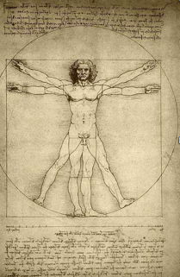
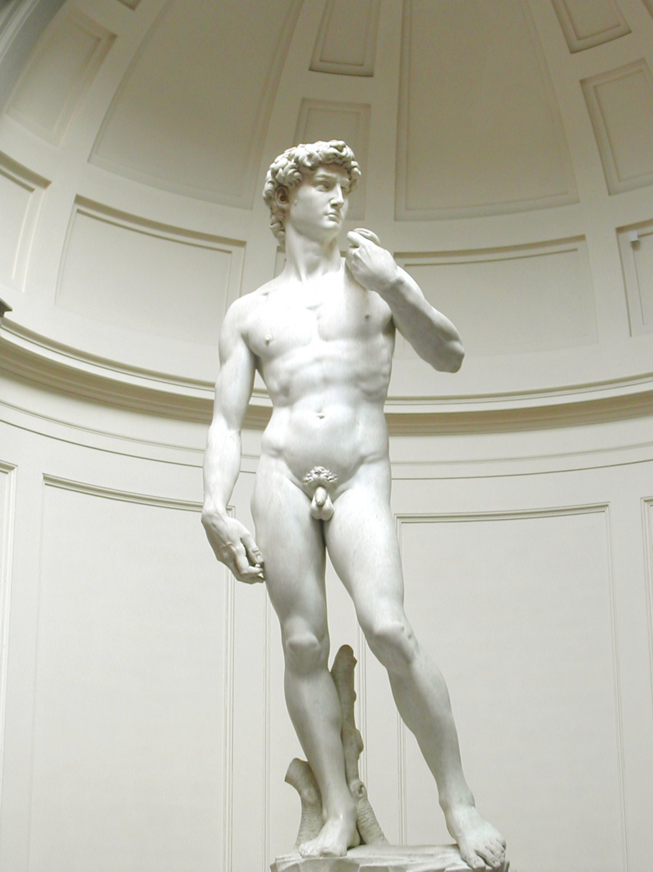
Art & Architecture
Greek & Roman influences
Columns, domes, arches (architecture)
Realistic
Anatomy – sculptures look like real bodies
Perspective – paintings look alive
Still religious themes

Slide 6
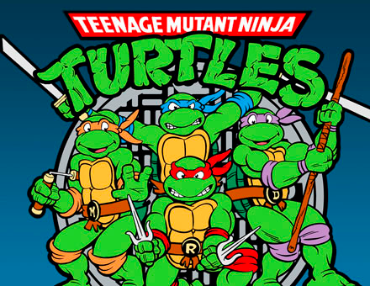
Famous Artists
Michelangelo
Sistine Chapel, David – a sculpture
Leonardo da Vinci
Mona Lisa – a painting, also sketched planes, submarines
Raphael
painter, student of Michelangelo & da Vinci
Donatello
sculptor
Sofonisba Anguissola
female, painter, not allowed to study body – not appropriate for women to see nude people

Slide 7
Michelangelo's Sistine Chapel

Slide 8
Leonardo Da Vinci’s Mona Lisa

Slide 9
Sofonisba Anguissola’s Self-Portrait

Slide 10
Literature
Books now written in everyday language
NOT Latin or Greek (only learned/spoken in school)
Dante
The Divide Comedy – a story through heaven & hell
Cervantes
Don Quixote – picks on knights & chivalry
Shakespeare
Romeo & Juliet, Hamlet - plays, wrote about human emotions
Machiavelli
The Prince – rulers should use any means necessary for success

Slide 11
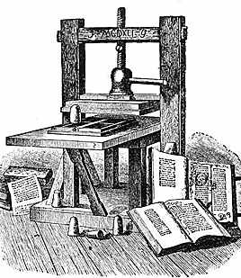
Printing Press Invented!
Technology 1st invented in China
Germany, 1456: Movable type invented by Johannes Gutenberg
Printed Bibles at first
EFFECTS:
Easier access to books
Literacy increased
Ideas spread faster

