Slide 1
Protestant Reformation
Global 2
Ms. Lyons

Slide 2
Martin Luther

Slide 3
Causes of the Reformation
The Renaissance
Humanism led people to question Church power
Strong Monarchs
Kings wanted to go against the Church
Problems in the Church
Leaders wanted power & wealth for themselves

Slide 4
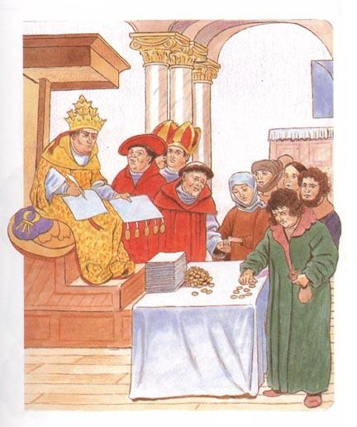
The Catholic Church was Selling Indulgences
If you paid the priests money, you would be promised salvation
Indulgences were like tickets to heaven
Notes:
Is it true? Could you really get into Heaven this way?
Is it fair?

Slide 5
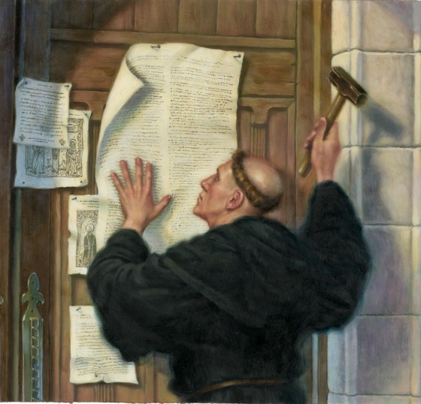
One man started complaining…
Martin Luther
German Monk
Wrote 95 Theses
posted them on the door of a church

Slide 6
Luther’s Beliefs
Only faith in God will get you into Heaven

Slide 7
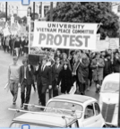
Protestant Reformation
This started a whole movement
Printing press spread his ideas
Christians that didn’t like the Catholic Church followed Martin Luther
Protestant Religion
Notes:
Protest → Protestant

Slide 8
Christianity
Catholic
Protestant
Lutheran
Calvinism

Slide 9
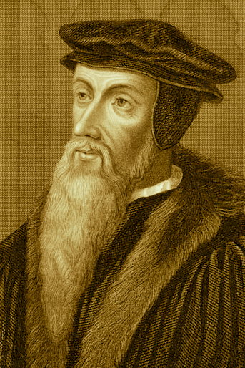
Luther wasn’t the only one protesting
John Calvin
Predestination
God already chose who will go to Heaven
Followers lived strict lives, didn’t spend much money

Slide 10
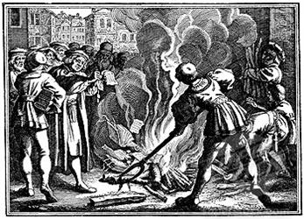
Catholic Church’s Reaction
Excommunicated Martin Luther & burned his books
Kicked out of the church
Made some changes to the Catholic Church
so their followers would not convert to Protestantism
Notes:
Asked him to take back his claims, he said no → excommunication

Slide 11
Effects of the Reformation
Loss of religious & political unity
Religious wars
Civil wars – Germany
Protestant England vs. Catholic France & Spain
Anti-Semitism
Hatred towards Jews
Witch hunts
People accused of worshipping the Devil
Many women killed

Slide 12
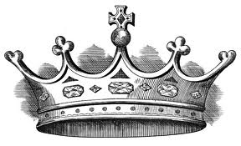
Who is going to fill the leadership role?
Now that the Pope is not so strong…
MONARCHS

