Slide 1
Comparing Feudal Systems & Crusades
Global 2
Ms. Lyons

Slide 2
Feudalism lasted from
900-1300 CE
During the Middle Ages

Slide 3
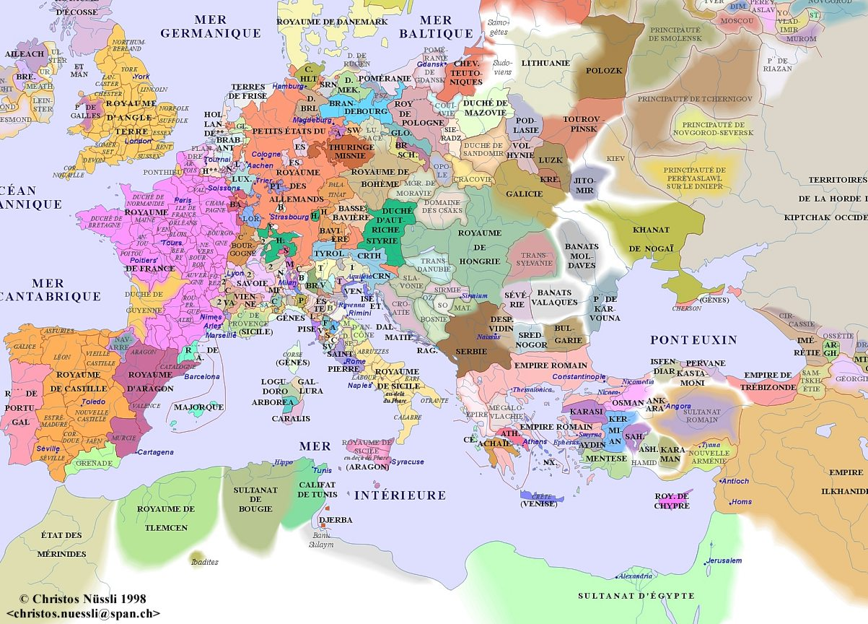
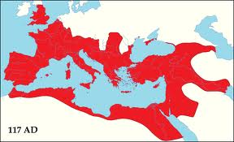
Why did feudalism begin?
After the fall of the Roman Empire…
No centralized government
Many “kings” couldn’t defend themselves

Slide 4
PROTECTION
LAND

Slide 5
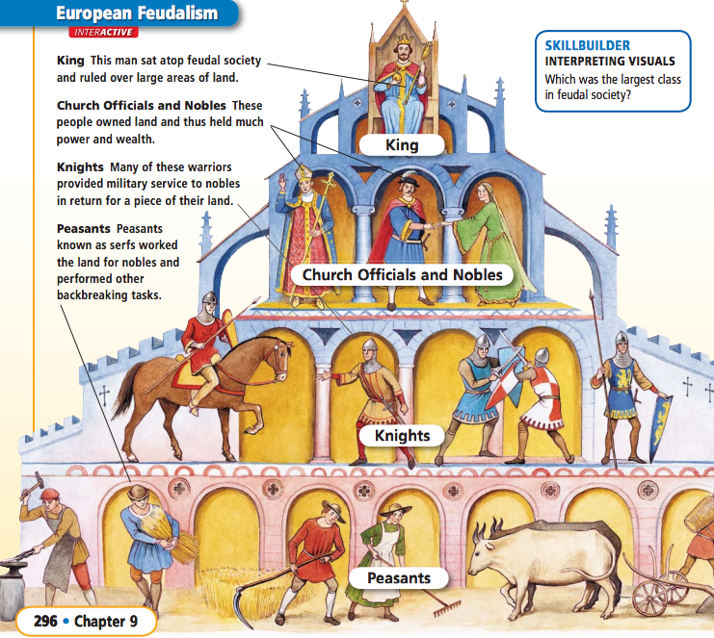

Slide 6
Land = MONEY
There was no paper money
So LAND was the most important thing to own
Manors (noble’s land) were self-sufficient, which means no trade was needed
Manorialism: economic system
Trading land for services

Slide 7
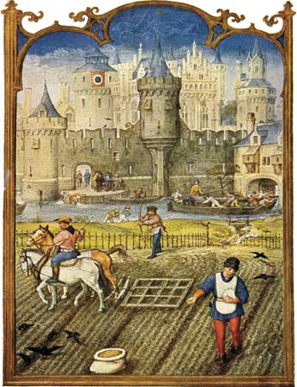
Serfs
Peasants (90% of the population)
Worked the land
Grew food for everyone
Died at young age
Couldn’t leave the manor

Slide 8
This sounds like ….
Nobles passed land to their oldest sons
No social mobility (can’t move up or down the pyramid)
Where you are born is where you stay

Slide 9
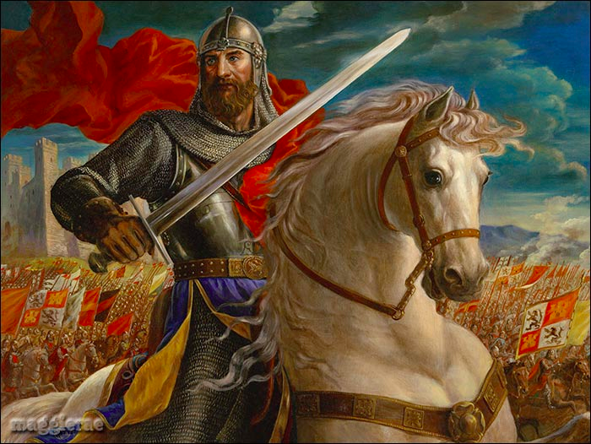
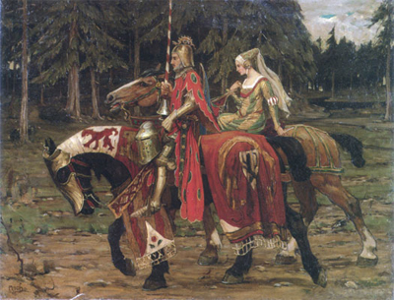
Chivalry
code of honor for knights in Europe

Slide 10
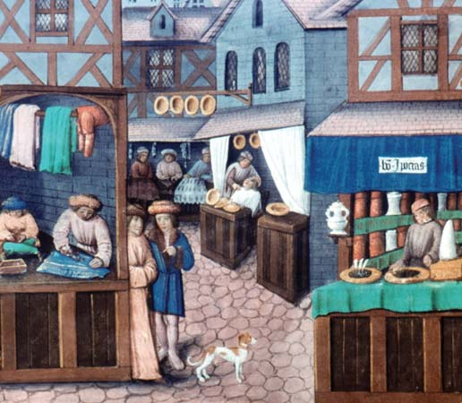
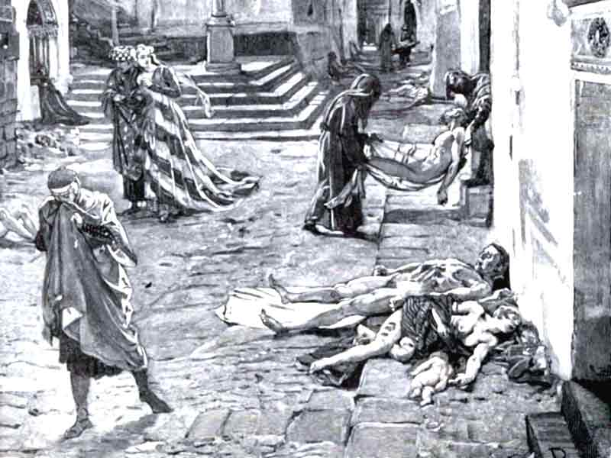
Why Did Feudalism End?
Black Plague kills many people
Serfs move into towns & cities
A middle class forms
Money replaces land as source of wealth

Slide 11
FRIDAY
Compare 2 Feudal Systems

Slide 12
Japanese Feudalism
Government is more centralized in Japan than Europe
Notes:
DY-mee-OH → OR “dime – yo”

Slide 13
Samurai’s Code of Behavior
Bushido
http://www.youtube.com/watch?v=HnbfAC6I4r0
Not so much protecting women BECAUSE women had more rights … some became samurais themselves!

Slide 14
COMPARE/CONTRAST

Slide 15
CRUSADES
TUESDAY, 2/26

Slide 16
Religion = HUGE.
Only thing that unified Europeans in the Middle Ages = Catholic Church.
Serfs, knights, lords came together to fight for the Catholic Church when they decided to retake the Holy Land (sacred land for Islam, Judaism, and Christianity).
Notes:
Serfs & knights were not truly loyal to their noble/lord. If they could get a better deal somewhere else, they would take it

Slide 17
What motivated the different groups to join the Crusades?
Pope (Urban II) wanted more power
Nobles wanted money & land
Serfs wanted to escape feudalism (freedom!)
All Christians were told their sins would be forgiven if they fought for God
Everyone wanted a chance for travel & excitement

Slide 18
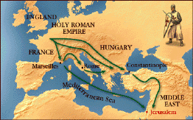
Many Crusades: 1100-1300
Catholic Church fought with Muslims for control of the Holy Land for 200+ years.
#1 city: Jerusalem
Other areas too (Constantinople)
Christians did not win, but many things changed after the Crusades.

Slide 19
What changed after the Crusades?
Increased religious hatred
Christians vs. Muslims
Trade increased, economy grew
Cultural diffusion → Europeans learned a lot
Europe becomes stronger
Pope lost power & nobles gained power
This leads to nation-states & absolute monarchs
Feudalism ended & money system replaced it
Notes:
Most feudal lords were killed, so the ones who lived gained more power.

